Slide 1
Improving routine data for child health in HMIS
Action plan for Uganda
Uganda Team

Slide 2
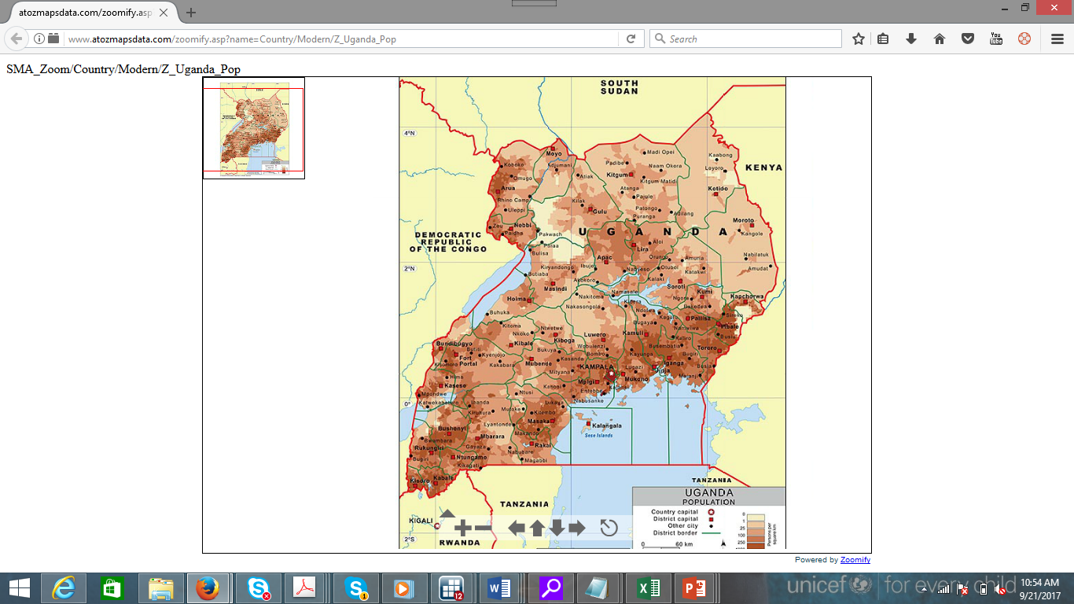
Map of Uganda
Total population 34.6m (2014)
Children data
0-4yrs-17.7%
5-9yrs-16%
10-14yrs-14.2%
15-19yrs-11.4%
<18yrs – 55%
Literacy rate -72.2%
Fertility rate (15-19yrs) – 25%

Slide 3
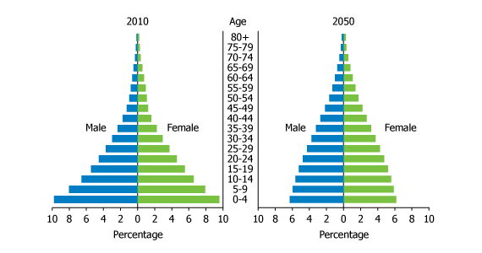
Uganda: At the Beginning of the Demographic Transition

Slide 4
Health Care System In Uganda

Slide 5
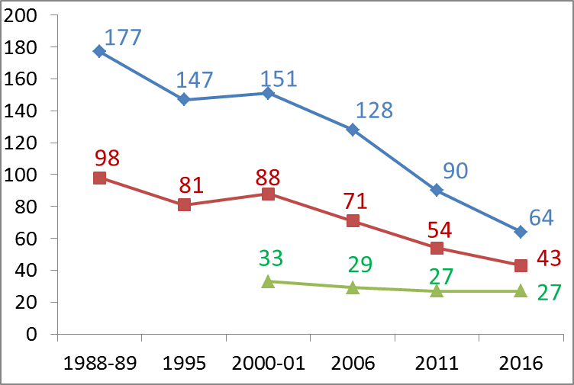
Trends in Child Mortality
Under 5 mortality ratio. Target 25
Infant mortality ratio
Neonatal mortality ratio
Target by 2030: 10

Slide 6
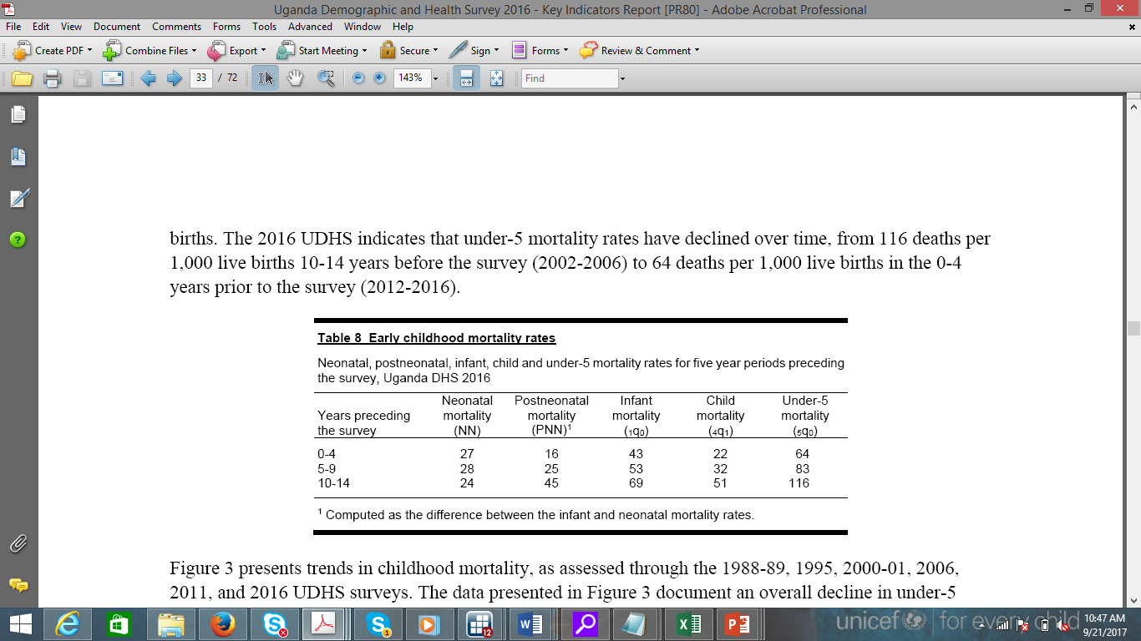
Trends on Child Mortality

Slide 7
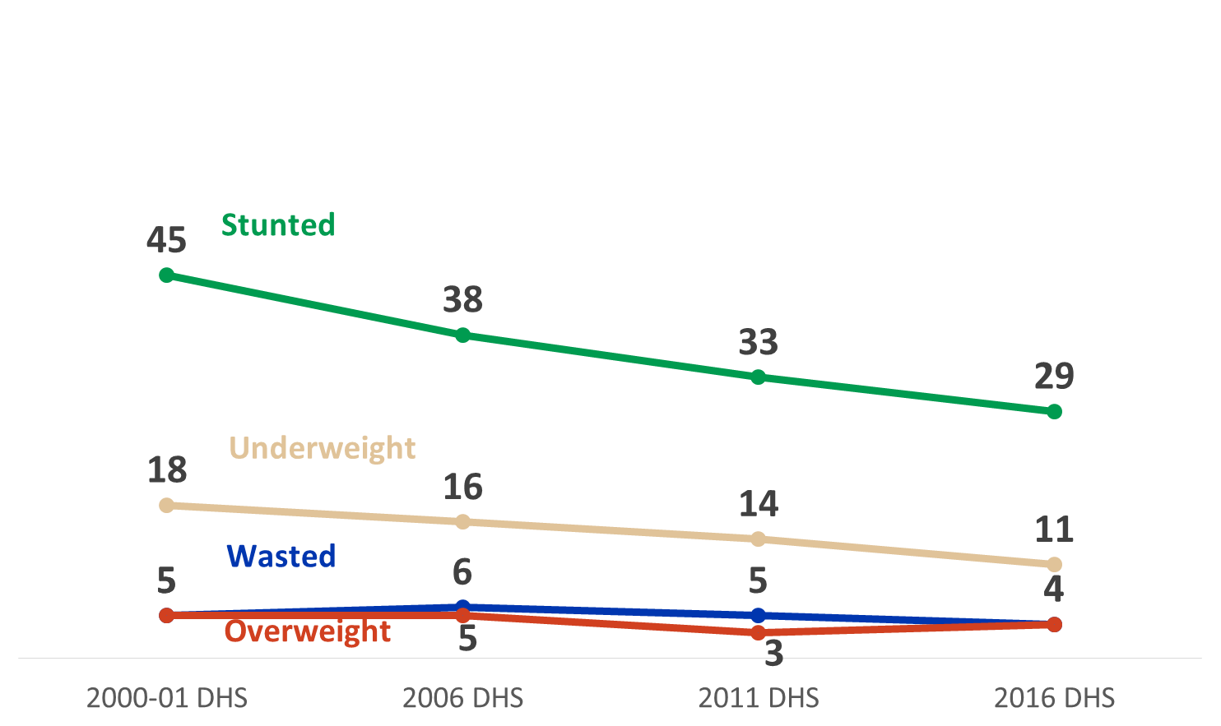
Nutrition Trends
Targets SDG 2030
Stunting <20%
Wasting<5%

Slide 8
Child Health Data Use: What have we learned?

Slide 9
Country experiences | What have we learnt?
Digital health information systems are critical for improving quality and timeliness in reporting especially at community level | Mobile technology to support CHWs and HWs to screen clients, diagnose and report real time are available as open source and have interoperability with DHIS II e.g. medic mobile, open SRP, IeDA All systems linked to the national health observatory system critical for MoH to track and monitor progress
Indicator mapping in relation to National and Global indicators is critical. E.g Child survival strategy, Sharpened plan, ENAP, EWEC, SUN | Harmonization of indicators is critical for tracking progress in child health
Engagement of the private sector in reporting and using child health data is important to improving child health outcomes | Nigeria adopted use of quality of care standards within the accreditation guidelines to access health insurance schemes.

Slide 10
Country experiences | What have we learnt?
Data use of quality improvement at all levels of the health sector from national to community level important to sustain improvement in quality, timeliness and outcomes | Use of RMNCAH scorecard for administrative or political leadership very good for their response Infusing simple data use tools within existing structures useful to support planning and drive improvement towards results.
Capacity building at all levels of planning including national, district, HSDs and community levels | National strategy that addresses how partners engage in contributing to a comprehensive M&E platform (one country HMIS system) is critical to aligning partners. In addition, establishing a country data collaborative with TA from global collaborative (WHO secretariat) has been beneficial to bring all stakeholders together to arrive at one platform.

Slide 11
Data Use: What Next?
Share with MoH and key stakeholders what we learned from the conference-MCSP
Share community related lessons at the iCCM task force meeting- Living Goods
Facilitate indicator mapping against required national and global reporting- MCSP
Explore need for country data collaborative

