Slide 1
Routine Child Health & Nutrition Data in Ethiopia

Slide 2
Current effort to improve routine data for child Health and nutrition in the national HIS
Roll out DHIS2
Rollout designed e-chis
EHDAP
Promoting the culture of data use
Implementing the national M & E costing strategic plan

Slide 3
Challenges in Improving routine data
Ways to capture and analyze data from different sources
Data discrepancy b/n the routine HMIS and facility survey
Denominator estimation problem
Lack of sufficient data element for child health & nutrition
Child Health Indicators aren’t analyzed & used for decision making
CHIS based IFHC include few child health related information
Inadequate referral linkage and feedback system among facilities
Poor data quality ; accuracy ,completeness and timeliness
Lack of capacity on data visualization ( preparation, interpretation of data visualization )

Slide 4
Prioritized problems on data elements and indicators
Ways to capture and analyze data from different sources
Data discrepancy b/n the routine HMIS and facility survey
Denominators estimation problem

Slide 5
Planned solutions for prioritized problems on data elements and indicators
Roll out to DHIS2 & EHDAP
Uphold the Implementation of (LQAS) at all level
Making the PMT functional at all level
Using EDHS and other survey data
Strengthening research & survey on child hood illness including malnutrition

Slide 6
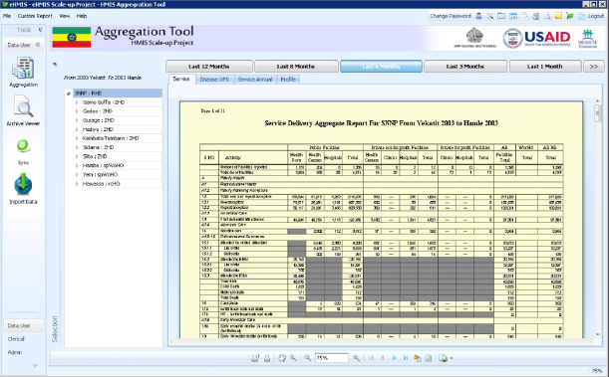
DHIS2

Slide 7
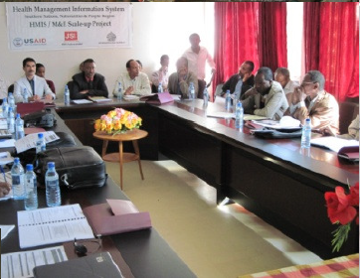
Strengthening Performance Monitoring Team at all level and regular supportive supervision and mentoring

Slide 8
Prioritized problems on National and Sub-national HIS
Child Health Indicators were not analyzed and used for decision
CHIS based integrated family health card include few child health related information
Inadequate referral linkage and feedback system among facilities providing child health services

Slide 9
Planned solutions for prioritized problems on National and Sub-national HIS
Ensure the implementation of the information revolution agenda of the HSTP
Strengthen the capacity of PMT at all level & Promote the Implementation (LQAS)
Strengthen supportive supervision and mentorship at all level
Implementing e governance

Slide 10
Planned solutions for prioritized problems on National and Sub-national HIS cont….
Scale up the community based CHIS to the electronic version
Develop standardized referral forms
Promote registration of referral and feedback mechanism on health card.
Take the issue as discussion agenda on PHCU level PRCMM

Slide 12
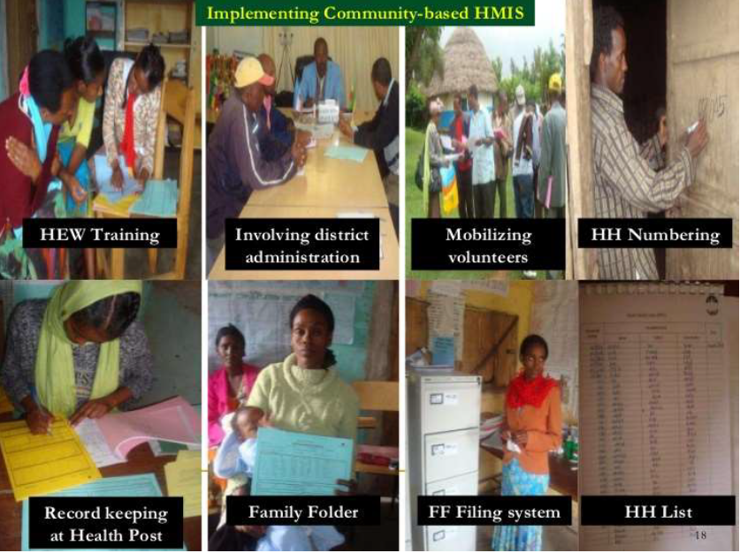
Revise and Scale up CHIS to eCHIS

Slide 13
Prioritized problems on Community Data and Digital Solution
Poor data quality ; accuracy ,completeness & timeliness of community data
Lack of capacity on data visualization
(preparation,interpretation of data visualization )

Slide 14
Planned solutions on prioritized problems on Community Data and Digital Solution
Strengthening Kebele command post, monthly review meeting & supervision of health post by health centers.
Ensure the implementation of the information revolution of the HSTP agenda
Strengthening capacity building and mentorships by local universities data management

Slide 15
Promote Data Visualization at community level

