Slide 1
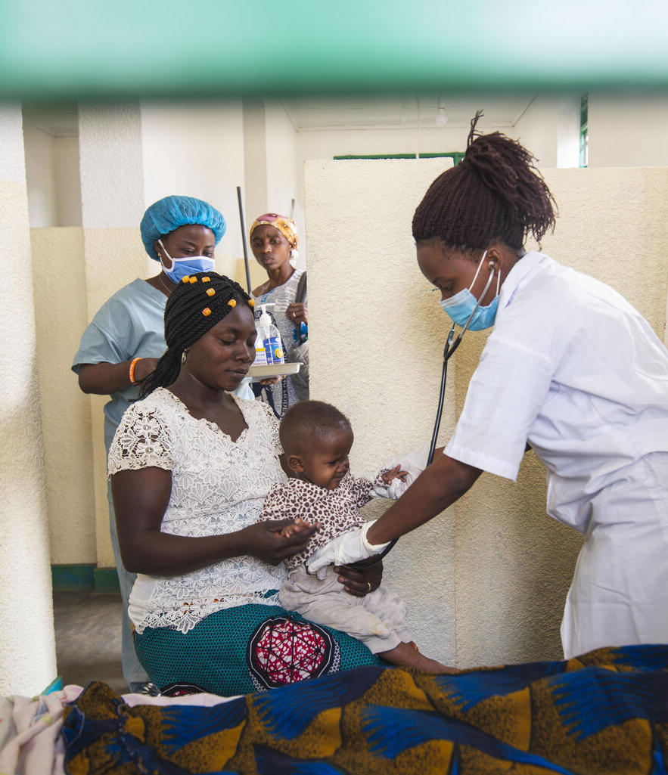
Country learnings and opportunities to advance pediatric quality of care
Wednesday, 5 July 2023
© UNICEF/UN0446450/Bashizi

Slide 2
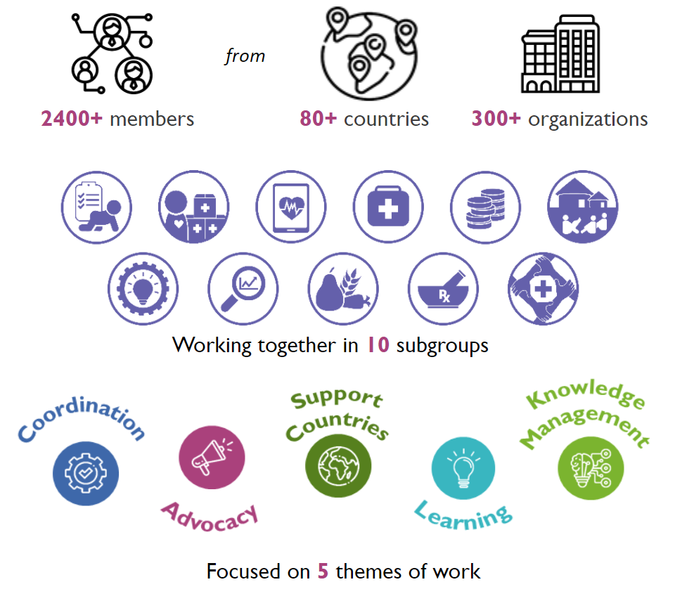
Child Health Task Force
Network for improving the quality of care for maternal, newborn and child health
Bangladesh, Côte d’Ivoire, Ethiopia, Ghana, India, Kenya, Malawi, Nigeria,
Sierra Leone, Tanzania, Uganda
Child Health Task Force
Goal: Create a platform in the child health community to advocate for and provide support to improve QoC for children
QoC subgroup

Slide 3
Objectives of this first webinar
Share country efforts and experiences on designing and implementing national and subnational programmes for improving quality of care for children
Share emerging opportunities and priorities moving forward to improve the quality of care for children, based on recent discussions with network countries and partners

Slide 4
Agenda
Welcome and framing: Dr Nuhu Yaqub, WHO Geneva Advances in improving pediatric quality of care in Kenya and Uganda Dr Janette Karimi, Head of Newborn and Child Health Division, Ministry of Health, Kenya Dr Jesca Nsungwa-Sabiiti, Commissioner for Maternal and Child Health, Ministry of Health, Uganda
Outcomes of recent discussions on pediatric QoC: Dr Anne Detjen, UNICEF New York Roundtable discussion facilitated by Dr Nuhu Yaqub, WHO Geneva
Questions & Answers
Closing, upcoming webinars: Dr Anne Detjen, UNICEF New York

Slide 5
Why increased focus on quality?
54 countries need accelerated action to meet the SDG target for under-five mortality.
Coverage and quality of essential child health services are crucial for progress in child survival
Projected under-five mortality rate per 1,000 live births in 2030 by country
The country color reflects the expected under-five mortality rate per 1,000 live births in 2030 assuming no additional action (continuing the recent trend in the rate of reduction from 2010 to 2021). The darker the red the higher the rate.
Source: UN IGME Report 2022

Slide 6
Global meeting of the Network for Improving quality of care for Maternal, Newborn and Child Health 14-16 March 2023, Accra, Ghana
The Network
has served as a pathfinder in bringing together health systems strengthening for QoC and programme implementation.
Continues to support the unfinished agenda of scaling up and scaling out QoC within and across countries
Countries are scaling out/integrating the full continuum of MNCH
can help to strengthen the implementation of QoC as part of ongoing initiatives : EPMM/ENAP/CSA
Maintain country-driven learning as a unique platform for peer-to-peer learning
Notes:
Because Quality is not a given. It takes vision, planning, investment, compassion, meticulous execution, and rigorous monitoring, from the national level to the smallest, remotest clinic. Dr Tedros Adhanom Ghebreyesus WHO Director-General
2017. 10 countries. MNH now CH. Link to EPMM/ENAP. Learning.

Slide 7
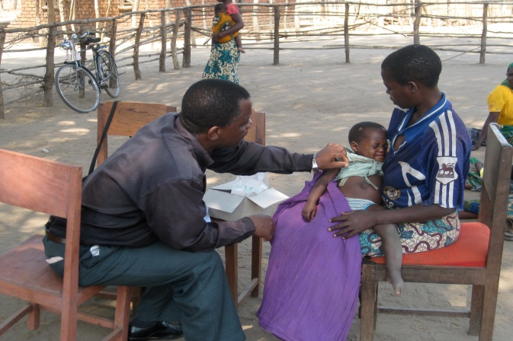
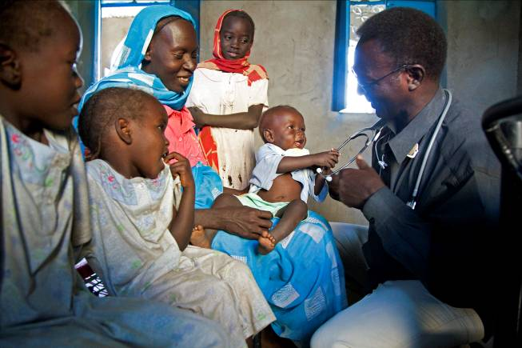
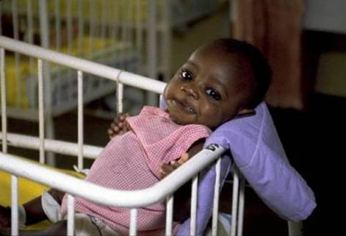
Where: Quality improvement of child health services needs to happen at all levels
PHC is where most children access prevention, promotion and sick child care
Home/Community
1st level facility
Hospital
Maternal Health
Specialized care
Number of Children Seen

Slide 8
Pediatric and small and sick newborns quality of care standards
Paediatric quality of care framework (2018)
SSNB quality of care framework (2020)
Notes:
Mention nutrition standards across all MNCH standards

Slide 9
What is the scope of paediatric QoC standards?
Informed by the health system building blocks
Cover care of children 0-14 years of age
Applicable to all health facilities offering child health services across levels of care
Prioritized areas to drive quality improvement
Child-, adolescent- and family centered
Address children’s provision and experience of care
No developed for community-based services but some adaptations possible

Slide 10
Application and use of the Paediatric QoC standards

Slide 11
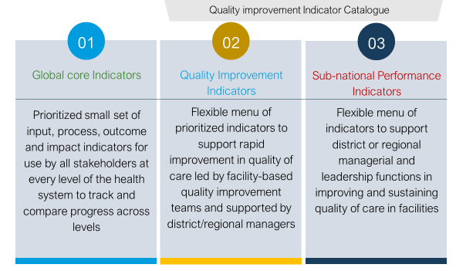
Pediatric QoC Indicators
Muzigaba M et al. BMC Health Serv Res. 2022
Quality of Care for maternal, newborn and child health: a Monitoring Framework for Network countries. Geneva: World Health organization, 2019

Slide 12
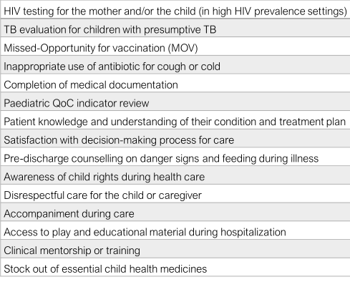
25 Pediatric QoC Core indicators
Proposed measurement:
HMIS (12)
Facility registries or medical records (3)
Surveys or interviews (9)
Inventory (1)

Slide 13
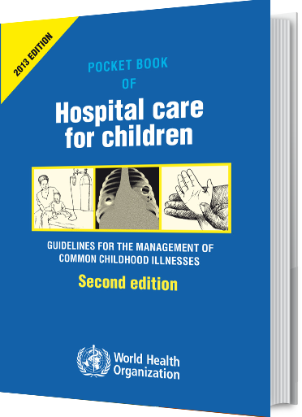
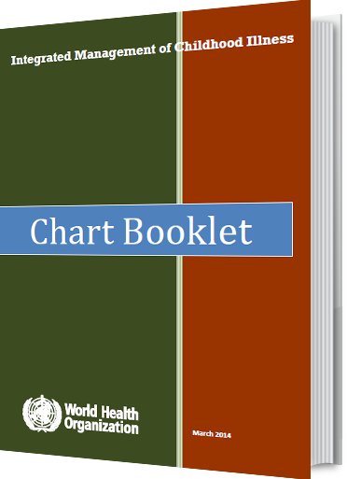
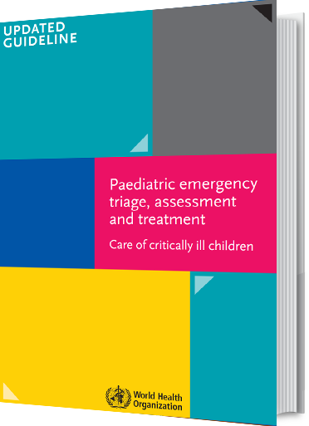
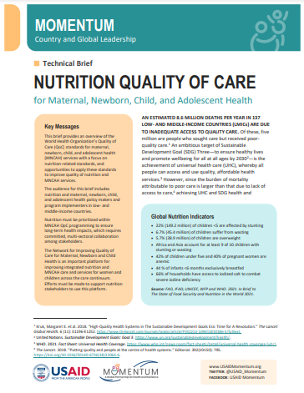
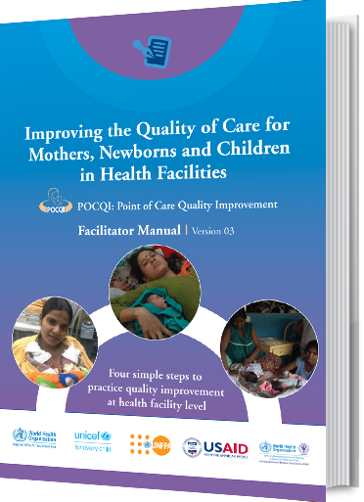
There are diverse resources to guide improvement of child health and nutrition services at national and subnational levels

Slide 14
Advances in improving pediatric quality of care in Kenya and Uganda
Picture
Dr Janette Karimi
Head of Newborn and Child Health Division
Ministry of Health, Kenya
Dr Jesca Nsungwa-Sabiiti
Commissioner for Maternal and Child Health
Ministry of Health, Uganda
Country learnings and opportunities to advance pediatric quality of care ​
Notes:
Kenya: elsaodira@gmail.com and janettekarimi@gmail.com,

Slide 15
Progress on Kenya Pediatric QoC Standards
Dr. Janette Karimi
Head, Division of New-born and Child Health

Slide 16
Newborn and Child Health in Kenya
*Data from 2003 and later are nationally representative while data before 2003 exclude North Eastern region and several northern districts in the Eastern and Rift Valley regions.

Slide 17
Newborn and Child Health Programming
This is done through 6 sections/units
Newborn care
Facility based management (ETAT+, IMCI, BPP)
Community based services (Mother Child Booklet, Community Maternal Newborn Care(CMNC), ICCM
Nurturing Care for Early Childhood Development (ECD)
Monitoring and Evaluation
5-9-year-old program (New)

Slide 18
Progress: Pediatric QOC Measurement

Slide 19
Progress: Pediatric QOC Measurement
Draft PQOC Standards developed (includes SSNB)
Indicator catalogue for the SSNB and Paediatric QOC standards developed with 65 core indicators, and a total of 45 CORE indicators
A health Facility Assessment tool developed to measure the facilities’ performance on the indicators to measure standards
The HFA tool was piloted in 10 counties. The key feedback:
Tool was easy to apply and captures the core quality issues but may need to be shortened
Customize lists of equipment, supplies and drugs to the levels of care
Standardize scoring format in all sections
Kisumu County utilised the tool to assess PQOC in selected health facilities in their county and developed an action plan/ recommendations for improvement based on the findings from the assessment

Slide 20
Progress: Pediatric QOC Measurement
WHO has mapped the 25 core paediatric and young adolescent QOC standards in Kenya as part of support to countries to support the uptake of these global core indicators into their national health information systems.
Currently, Kenya can map 9 out of the 25 indicators.
Next step is the harmonization between the 25 global QOC standards and the adapted Kenyan PQOC standards
Hold a consultative meeting to discuss the collection of the harmonised PQOC indicators through routine systems(eKQMH-DHIS)/surveys

Slide 21
Progress: Pediatric QOC Measurement
Current neonatal care indicators in eKQMH/KHIS
Organisation unit | Data | 2022
Alale (AIC) Health Centre | IDIM_11.9.1 The health facility shall ensure that skilled personnel, infrastructure and equipment are available to offer life-saving emergency and quality newborn care | 1.7
Alale (AIC) Health Centre | IDIM_11.9.2 The health facility shall manage all newborns as prescribed in the Essential Newborn Care guidelines | 1.2
Alale (AIC) Health Centre | IDIM_11.9.3 The facility shall be adequately prepared for resucitation of newborn babies within one minute of birth | 3
Alale (AIC) Health Centre | IDIM_11.9.4 The facility shall have a mechanism for detecting and referral of babies with danger signs or critically ill babies | 1
Alale (AIC) Health Centre | IDIM_11.9.5 The facility shall manage neonatal sepsis according to national guidelines | 3
Alale (AIC) Health Centre | IDIM_11.9.6 The facility shall use the current treatment guidelines for the care of HIV-exposed infants | 3
Alale (AIC) Health Centre | IDIM_11.9.7 The health facility shall ensure infection prevention measures are put in place in the neonatal unit. | 2.3
Alale (AIC) Health Centre | IDIM_11.9.8 The facility shall discharge the newborn appropriately in not less than 24 hours after birth. | 2.3
Alale (AIC) Health Centre | IDIM_11.9.9 The facility shall provide comprehensive health education and service information to the clients | 0

Slide 22
Challenges
Resources to disseminate and implement the Pediatric QOC standards widely in all counties (training county ToTs on PQOC standards and QI approach)
Institutionalising PQOC standards such that the standards are maintained beyond the facility QI project
Support for routine monitoring of PQOC indicators through eKQMH/KHIS
QOC requires Health systems strengthening including sufficient,skilled HRH, referrals, commodities and equipment which have some gaps
Kenya is the first country to include the 9th standard on community because of ICCM but there are no suggested global indicators in that area

Slide 23
Opportunities
Using hub and spoke model to implement the PQOC standards where after county TOTs are trained, they train and mentor level 4 and 5 facilities who in turn mentor the level 2 and 3 facilities in implementing the standards
All partners to support both maternal and PQOC in their counties of focus
Expanding eKQMH to collect more indicators to monitor of MNH QOC indicators
Prioritising QOC in EPMM/ENAP country plans
Working together with maternal health and QI teams to implement maternal and paediatric QOC
Advocacy at the National and County Levels to strengthen the health systems to support quality service delivery

Slide 24
Next Steps
Further analysis of the mapping data and report writing-WHO by 10th July
Incorporation of indicator mapping recommendations into Kenya PQOC CORE Indicators- July 2023
Validation and launch of Kenya PQOC Standards, QI Indicator catalogue, Kenya PQOC CORE indicators and the HFA QoC Assessment Tool July November 2023
Incorporation of the PQOC core indicators into eKQMH/KHIS
Dissemination of the PQOC standards and Training of TOTs-2024
County-level training on implementation of the PQOC standards-2024
Routine mentorship to counties in the implementation of the Maternal and Pediatric QOC standards-2024

Slide 25
THANK YOU
ASANTE

Slide 26
Experience Sharing – Implementing Pediatric QoC
Uganda
Dr Jesca Nsungwa sabiiti
Commissioner Reproductive ad Child Health, 5th July 2023

Slide 27
Trends in childhood mortality from 1989 to 2016 (Uganda Demographic and Health Survey)
Death in the neonatal period accounts for 63% of the deaths in children less less than 1 year of age .
Malaria and pneumonia are the leading causes of U5 deaths.
Fall in diarrhea, severe malnutrition, and pediatric HIV

Slide 28
Timelines for Introducing QoC standards implementation in Uganda
2010 – 2015. Patchy Implementation of ETAT trainings across the country
2018-2019 Adaptation of MNH standards. Initial discussion on adapting the Paed QoC
standards.
Development of Paed QoC HF assessment tool, adapting Paed Death review
guidelines. Discussion on incorporation of Paed QoC monitoring into HMIS/DHI2
Ongoing Process to review ETAT training Materials and to finalize PDR
guideline and start roll out. Planned mapping of the data for Paed QoC
indicators.
Notes:
To include Jaundice, TB, and update on classification of very severe disease - removed bulging Fontenelle, nasal flaring
Scaling coverage of high-impact interventions for common childhood illnesses is a priority for the Ministry of Health (MoH). In 1996, Uganda adapted the 11-day Integrated Management of Childhood Illness training, which was later expanded to include newborns, WHO updates, and renamed Integrated Management of Newborn and Childhood Illnesses (IMNCI).

Slide 29
Planning | Quality Control | Quality Improvement
? Entry Points – multiple possibilities | Set Standards (Adapted) | Set aim
Decide Objectives for Improving Quality | Intermittently measure/ assess against standards | Diagnose problem
Plan steps to achieve the objectives | Take action when performance does not meet the standards | Test remedies
Plan Measures to Achieve Quality |  | Apply successful remedies
 |  | Sustain the gains

Slide 30
Strengthening the guaranteed package of primary health pediatric services
Strengthening care for pediatric complications at the second & tertiary level of care
Strengthening CRVS health interventions
(a) IMNCI - Basic Care for Common Childhood Illnesses (b) ETAT Plus - Emergency Referral Care (c) Others specialized care e.g. cardiology, nutrition
Optimize Prevent, Protect and Treat Diarrhea and Pneumonia (PPT)
(Zinc and ORS co-pack, Oxygenation etc. )
ICCM- Community Case Management Plus HIV, TB, Malnutrition Screening
Population wide Services (Integrated Outreaches, Child Days)
Post Discharge Follow Up and Care

Slide 31
Progress Implementation
Main Entry Points
Pediatric Death Audit
ETAT and IMNCI
Smart Discharge
Nutrition
Pneumonia with a focus on Oxygen
Adaptation of Pediatric Audit Tools including ICD11
Targeting the Learning Network Sites
Quality of Care Indicators to include in HMIS and Results Based Financing

Slide 32
Progress in implementation
MOH made use of GFF and funding from Partners to implement the maternal and newborn QI intervention in 18 Pilot health facilities in 6 districts.
This provided experience on which to build on Paed QoC implementation.
Patchy implementation of Paed QOC improvement interventions across the country.
A system for Documentation of Outcome of Paed QoC (CommonCore Paed Qoc indicators) from implementing Paed QI through the above entry points is being set

Slide 33
QI change packages implemented in IMCI
Weekly CMEs with drills on diagnosis and prescriptions
Orientation of all clinicians on IMNCI guidelines
Displayed algorithm at all clinical areas
Proper quantification of stock of drugs
Duty plan that specified staff attending OPD and time of arrival
1
providing appropriate care to children with cough or difficulty breathing
Instituted biweekly review meetings on child health
Extracted and pinned IMNCI guidelines on management of fever at consultation rooms/triage areas
Reviewed the client flow, and identified step for taking temperature and the other vitals
Implemented internal data quality checks
2
correctly assessing, categorizing, and treating children with fever

Slide 34
Trends in Institutional Perinatal deaths (IPMR) across the country (2017-2022)
The IPMR has reduced by 36.4% (from 29.1 to 18.5 per 1,000 total births).
The greatest reduction has been registered among the Macerated and Fresh stillbirths
No change in early neonatal deaths.
National FY 2021/2022 MPDSR Report

Slide 35
The Planning Spiral
7 - Situation analysis
1 - Situation analysis
6 - Expansion
2 – Prioritisation
5 -Monitoring
3 - Option appraisal
4 – Pediatric QoC Implementation
Source: A. Green, “An Introduction to Health Planning in Developing Countries”

Slide 36
Lessons Learnt
Consensus building takes time. Need to prioritize it as the initial process in the implementation journey – affected pace of introd. Paed QoC in Uganda.
Having a strong coordination structure at the national: Child Health and quality assurance depts; with a TWG that brings the two together are key in moving the paed QoC agenda.
There is need to define the entry platform for introducing Paed QoC- if not clearly thought through might affect comprehensiveness of intervention and sustainability .
There is synergy in building on the existing MNH quality implementation. However need to nurture the Paed QoC piece in the beginning is critical, otherwise will lags behind MNH QOC piece.
Need to institutionalize data collection for the Paed in existing HMIS for sustainability. A systematic approach to examine the HMIS to determine what data elements already existing is critical and what might need other sources is important

Slide 37
Improving pediatric Quality of Care
QoC Network meeting, Accra, Ghana
“Deep-dive” Pediatric QOC
Notes:
How do we ensure that pediatric QoC is part of the overarching quality of care work at all levels – national, sub-national level
How do we ensure that QoC is at the center of all programmes that deliver child health services (planning, budgeting, measurement, implementation)?

Slide 38
Identified Barriers for pediatric QoC
Lack of socialization/champions for QoC for children at policy and service delivery level, including teaching facilities and private sector
Insufficient coordination within MoH (QMT, child health, other programmes)
Human Resources: Lack of specialist education/cadre​ (pediatricians, pediatric nurses etc.) to drive Ped QoC from the technical side.
Monitoring/accountability: quality data collection at the point of care to improve QI
Need to be inclusive of community based prevention and care
Need more learning on improving QOC for children
Weak funding for QoC in child health programmes
Beyond Child Health: Common HSS barriers e.g. HR/turnover, stockouts

Slide 39
Opportunities
Leverage the existing ecosystem for quality
Learn from MNH experience but also experience/ongoing work on QI by other programmes (Malaria, HIV, Nutrition)
Expand national and subnational committees to include child health focal points
Target systems rather than project approaches (need to align partners and donors)
Include pediatric QoC in relevant in policy documents, guidelines and tools across all levels
Focus on all child health entry points:
IMCI: could serve as a good starting point for pediatric QoC (requires coming together of all relevant programmes)
Leverage the increasing institutionalization of community health
Facility level: expand from maternal-newborn service delivery points to ETAT, PICU, pediatric wards
Build QI capacity of child health managers/actors, including at subnational level.
Ensure everyone is familiar with terminology, processes, tools, need to understand how they can integrate this in their programmes
Identify coaches, mentors etc. - might not be the same as those engaged for MNH​
Measurement is critical: Some pediatric QoC indicators are already in HMIS – start measuring and monitoring and build on this
Paediatric death audit is a practical entry point for initiating quality improvement as part of routine facility processes
Notes:
The increasing focus on the lifecourse continuum facilitates the integration of pediatric QoC with newborn and adolescent QoC.
Nigeria example: Expand MN QoC strategy, incorporate in RMNCAH&N strategy and National Quality policy and strategy
Include pediatric QoC in certification for health facilities

Slide 40
Roundtable discussion
Picture
Picture
Dr Nuhu Yaqub
Medical Officer, Child Health
WHO Geneva
Dr Janette Karimi
Head of Newborn and Child Health
Ministry of Health, Kenya
Dr Jesca Nsungwa-Sabiiti
Commissioner for Maternal and Child Health
Ministry of Health, Uganda
Dr. Anne Detjen
Child Health Specialist
UNICEF New York
Country learnings and opportunities to advance pediatric quality of care ​
Notes:
Kenya: elsaodira@gmail.com and janettekarimi@gmail.com,

Slide 41
Roundtable discussion (moderator TBC)
How do you effectively coordinate as MNCH programme with your Quality Management units (or what it’s called in your country) – how do you divide your roles and responsibilities
How do you coordinate with other programmes that are key for delivery of essential child survival interventions (especially malaria, nutrition, HIV/TB) who might have their own mechanisms as well as learnings in place that you can align (e.g. under IMNCI strategy)
To audience? What are some of the issues around pediatric QOC you would like to learn from other countries and/or discuss with other countries in a learning exchange
What are some tools/guidance /support that would be helpful to advance your priorities for improving quality of care for children?

Slide 42
Q&A – Audience reflections

Slide 43
Upcoming webinars
Themes – dates will be announced via the Child Health Task force and QOC network channels
Measurement
Pediatric Death audits
Practical examples: Quality improvement efforts at subnational level

