Slide 1
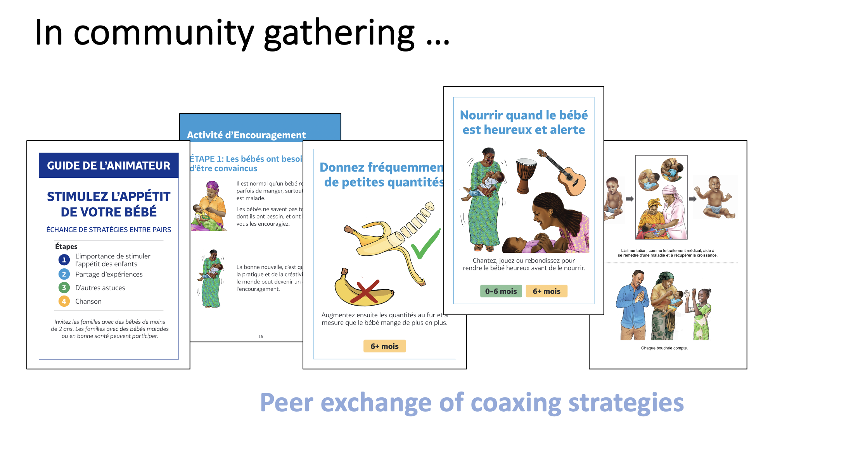
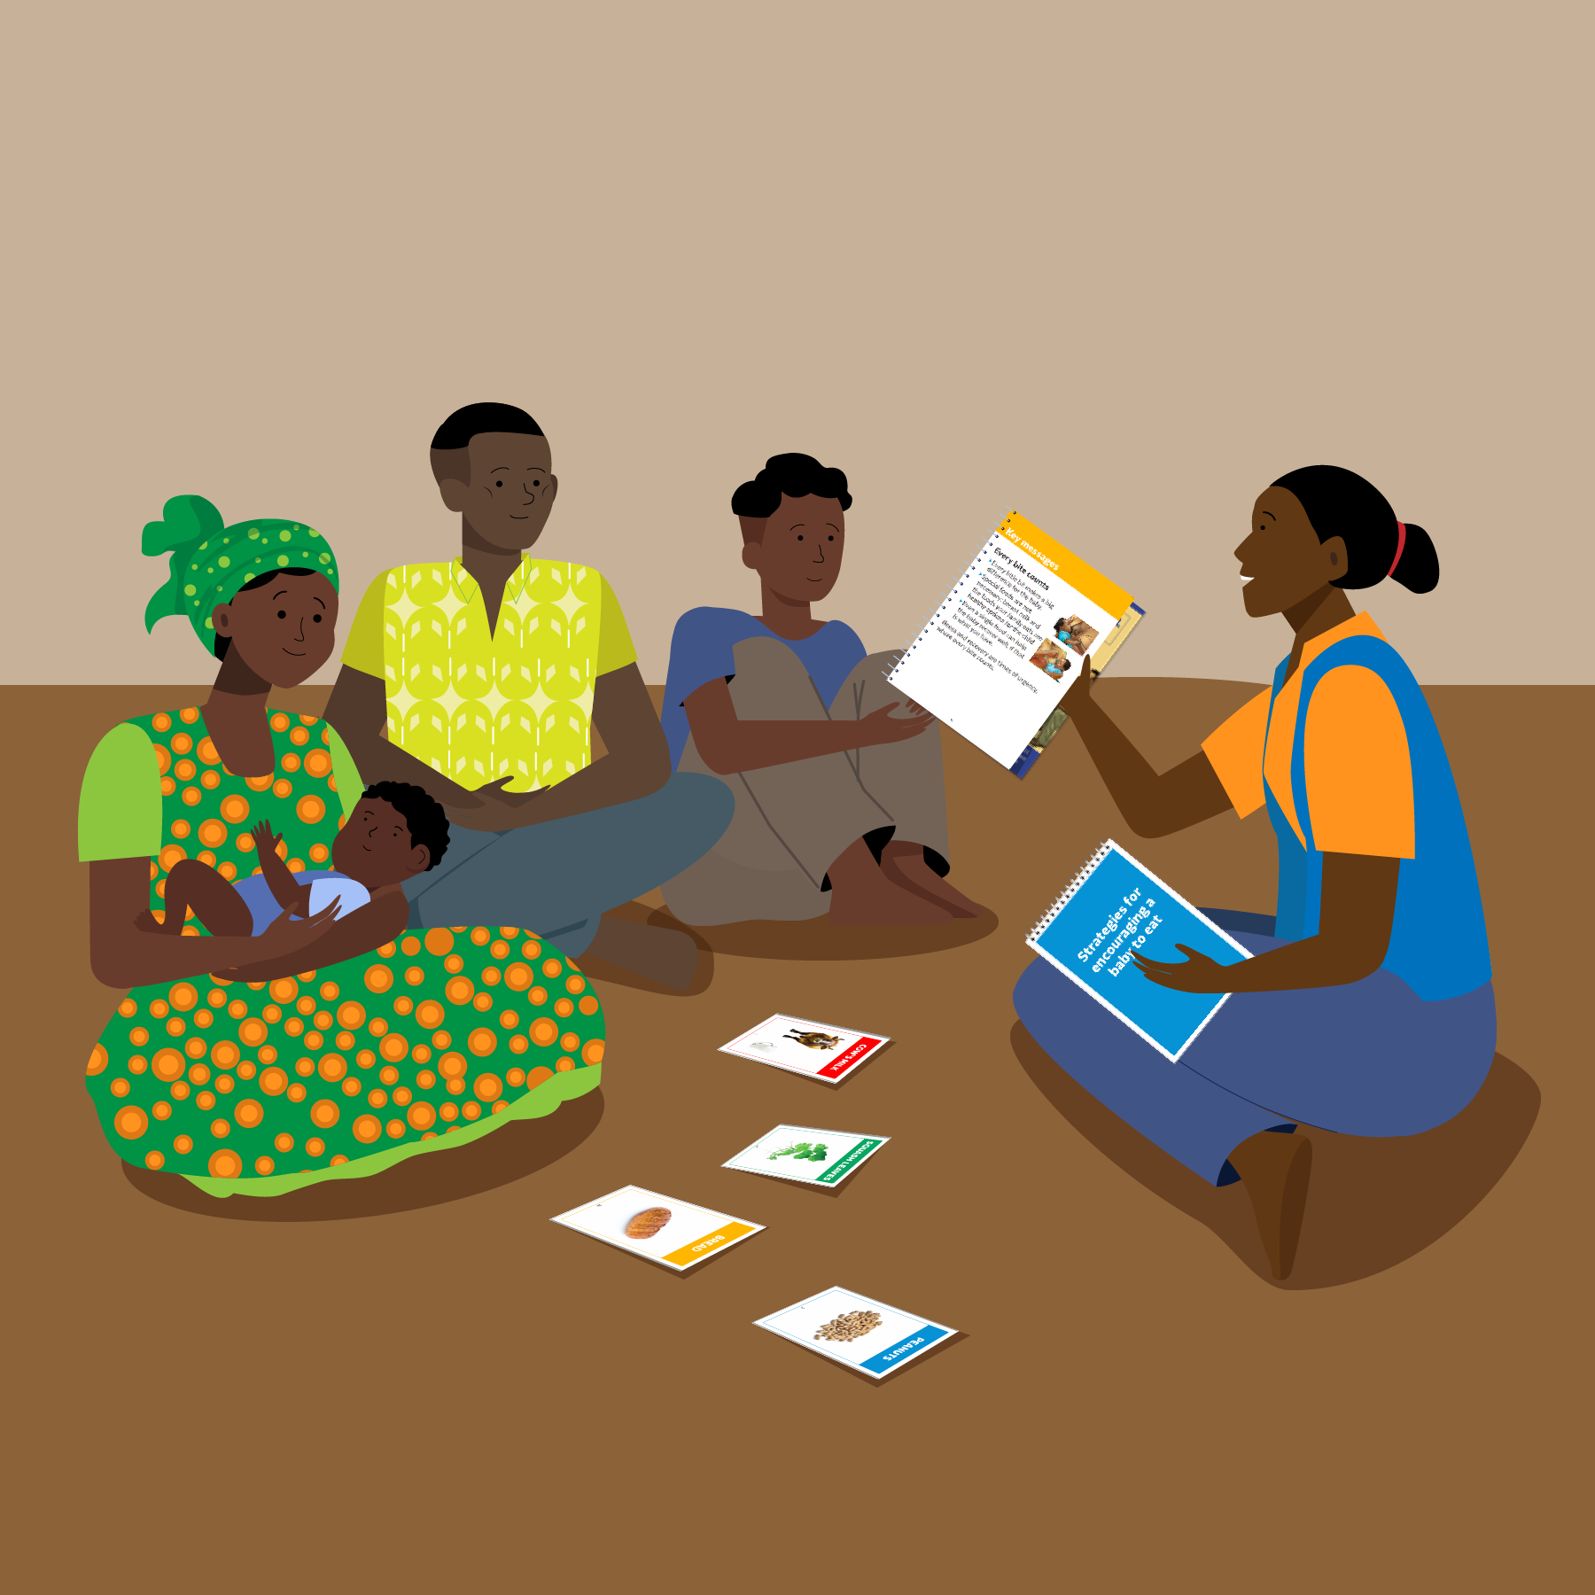
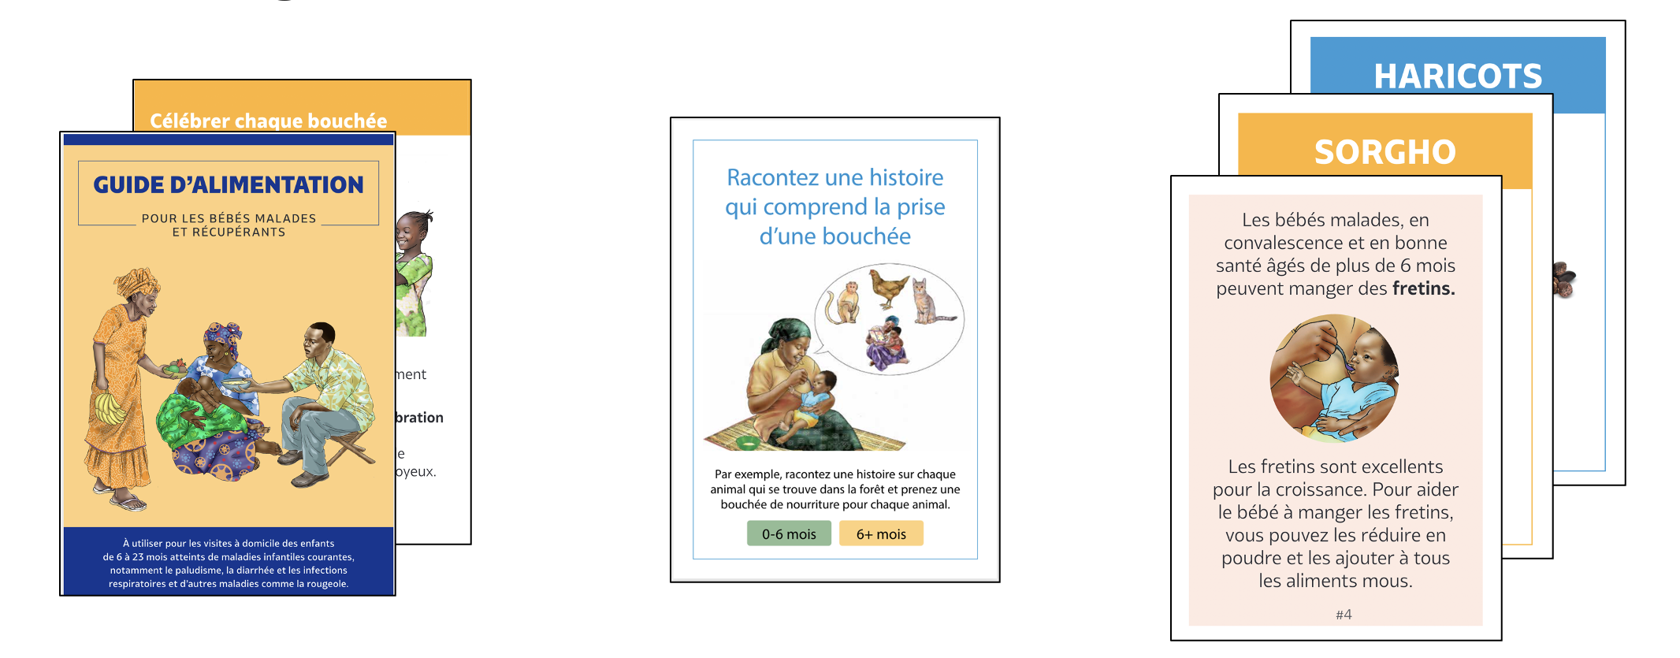
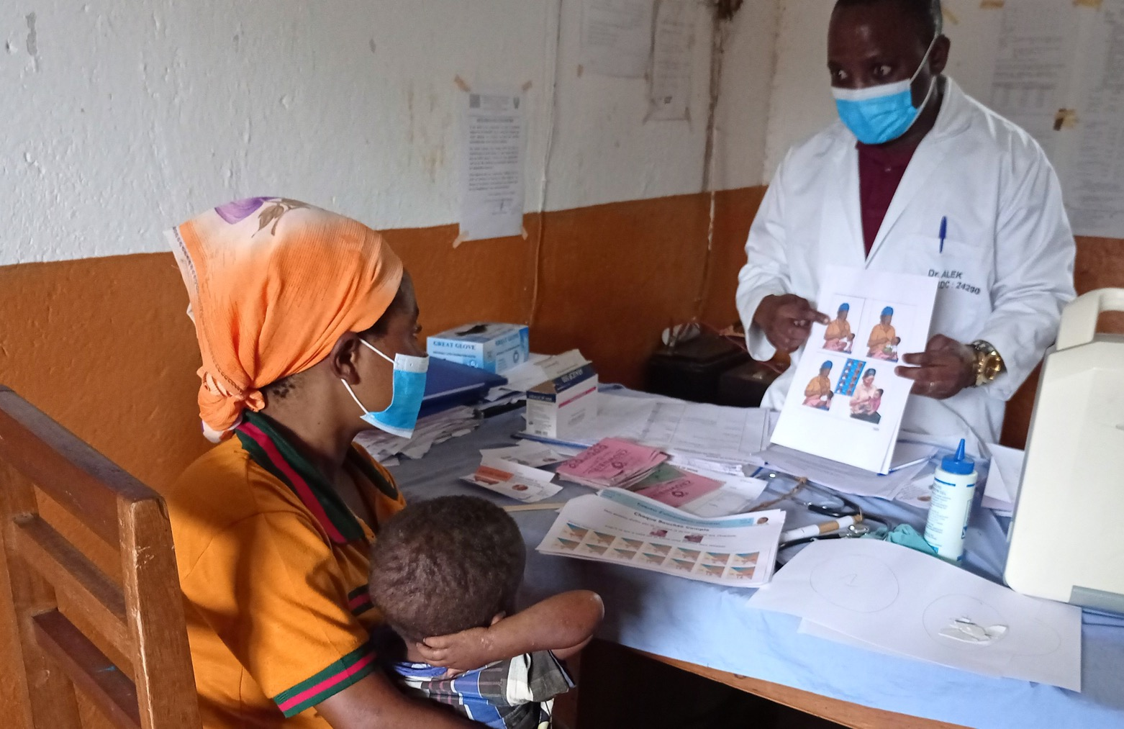
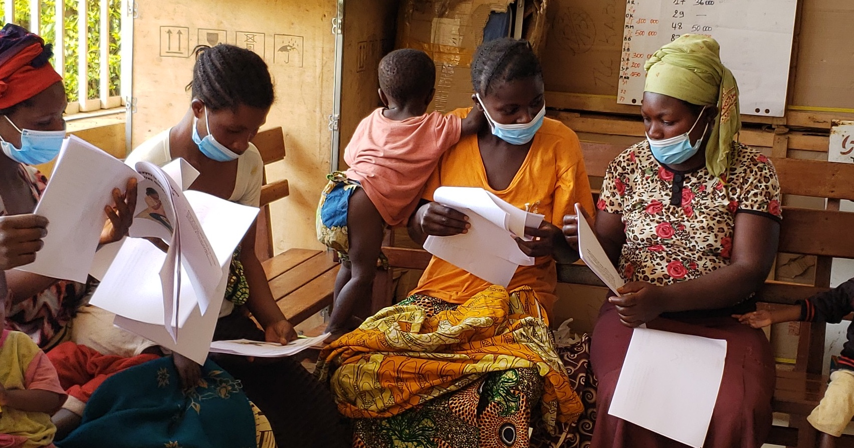
Improving the feeding of young children during and after illness : A behavioral design approach
Authors : Augustin Ngandu (1), Lynn Van Lith (1), Radha Rajan (1), Danielle Naugle (1), Didier Mbayi Kangudie (1), Lisa Sherburne (2), Emily Zimmerman (3), Madeline Kau (3), Riantsoa Kanto Najaina Tovohasimbavaka (3)
Breakthrough ACTION, Johns Hopkins Center for Communication Programs
JSI Research and Training Institute
Ideas42
Introduction
Behavioral design
The Democratic Republic of the Congo accounts for 11% of under-5 child mortality; an urgent concern to address this inequity is ensuring adequate nutrition for young children experiencing illness. Young children with illnesses need adequate nutrition to recover from and avoid malnutrition. As in many settings, they consume far less than the recommended amount of food during these critical periods. In DRC, we used behavioral design to develop and test solutions to increase children's nutrition during and after illness.
Based on the research findings, and through a behavioral design process, 62 solution ideas were generated, which were filtered down to 12 prototypes that were tested, and 5 innovative solutions resulted. Some solutions address community members, and others involve health providers, increasing their empathy and communication skills to improve the relevance of nutrition recommendations emphasizing locally available nutritious foods.
Final materials
Support caregivers to increase feeding their children during illness
Continue breastfeeding and feeding during illness
In sick child consultations, a “Feeding Prescription,” counseling aids, and reminder stickers support health providers to counsel consistently and effectively. A Reflection and Orientation activity prompts them to re-think their counseling approach, building motivation to use the new tools.
Bukavu
Bukavu
Give supplementary food for 2 weeks after illness
The phrase “chaque bouchée compte” (each bite counts) was found to be universally motivational and affirming of the behavior that any increase is a positive step towards improving child feeding and reducing malnutrition risk during and after illness.
Behavioral diagnosis
Feeding prescription
Reminder stickers
Qualitative research with caregivers, other family members, health workers, other community members explored perceived threat of children becoming malnourished during and after illness and perceived efficacy to prevent this outcome.
Materials and methods
Counseling aids
In community gatherings of caregivers facilitated by a community health worker, Peer Exchange of Coaxing Strategies build caregivers’ skills and confidence to encourage young children to eat when appetite is poor.
Interviews (n=58)
Observations in health facilities
Mothers (n=24)
Fathers
(n=7)
Grandmothers
(n=8)
Sick & postnatal consultations (n=8)
Peer Exchange of Coaxing Strategies
Bukavu
Facility-based providers (n=7)
Community health workers (n=4)
Local leaders
(n=8)
Vaccination visits (n=2)
COMMUNITY GATHERING
In home visits by a community health worker, families of sick children learn together to celebrate every bite and plan to overcome challenges to feeding the child during illness and recovery. Foods activity cards help them reflect on affordable, nutritious foods that they might not have considered for their young children.
Results
Qualitative research highlighted several behavioral factors leading caregivers to feel discouraged and powerless.
Poverty and scarcity create practical and cognitive burdens
Deference to appetite leads to missed opportunities to coax
Focus on quality over quantity
Perceptions of good and bad foods limit the choice set
Sick visits focus on medical treatment
Facilitation guide
Coaxing activity
Food activity
Identify achievable improvements
Build skills and confidence to overcome limited appetite
Emphasize quantity rather than specific foods
Expand families’ choice sets
Elevate importance of feeding
Discussion
Refocus attention
Boost providers’ confidence to help
This research and design process suggests opportunities for programs and services to support caregivers and health workers to improve child feeding during illness and recovery by addressing underlying behavioral and contextual drivers. These intervention designs can be easily adaptable to other country settings in improving the feeding of young children during and after illness. Nutrition and Social and Behavior Change specialists can integrate the new tools into the existing materials that caregivers or health providers use to improve practices around feeding and consultations.
The innovative solutions also involve health providers, by increasing their empathy and communication skills to improve the relevance of nutrition recommendations emphasizing locally available nutrition foods.
Conclusion
A behavioral design approach is a valuable way to better understand the behavioral factors impacting feeding during and after illness, and to design innovative solutions to enhance nutrition-related outcomes for infants and young children, even in resource-constrained settings. While the final materials were designed for the DRC context, they can be updated and locally contextualized for other countries where similar challenges exist.
Photo credit : Augustin Ngandu, 2021
Photo credit : Augustin Ngandu, 2021
This poster is made possible by the generous support of the American people through the United States Agency for International Development (USAID). The contents are the responsibility of Breakthrough ACTION and do not necessarily reflect the views of USAID or the United States Government.
Contact : Emily Zimmerman , ideas42
Email: ezimmerman@ideas42.org
Website: https://www.ideas42.org/

