Slide 1
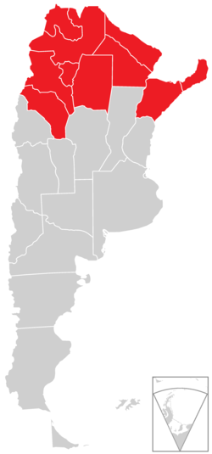
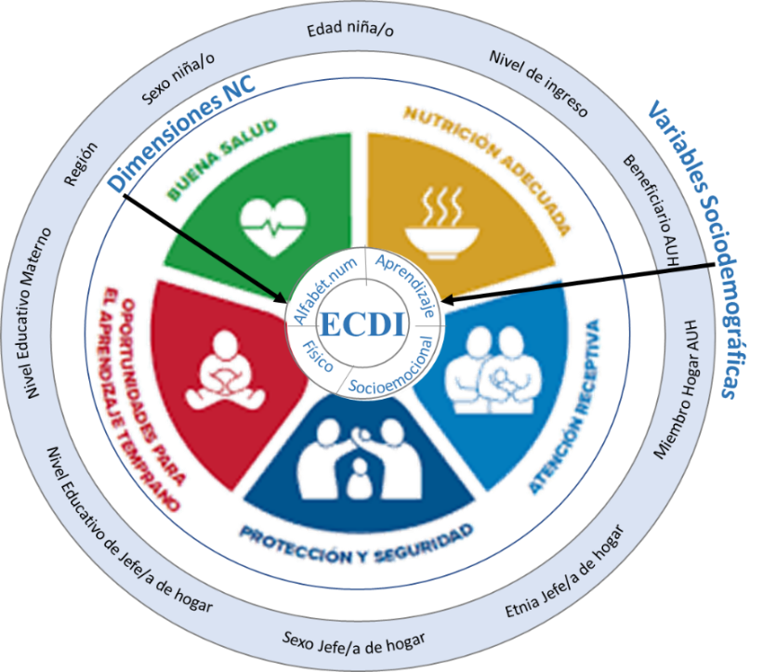
Child Health Task Force 2023. Accelerating progress towards the 2030 SDGs – Reducing inequities in child health.
Subgroup: Monitoring and Evaluation
Early Childhood Development and domains of the Nurturing Care framework in urban conglomerates of Argentina
María Eugenia Herrera Vegas, Agustina Marconi; María Elisa Zapata
BACKGROUND
The Nurturing Care Framework (NCF) outlines five comprehensive and interrelated evidence-based domains (health, nutrition, early learning, security and safety, and responsive caregiving) that are essential for adequate child growth and development.
Country information in Argentina:
1 in 2 young children live in disadvantaged households.
68.5% of children aged 3 and 4 receive minimal nurturing care (McCoy, D. et al, 2022)
86.2% of children aged 3 and 4 meet adequate early childhood development milestones.
OBJECTIVE
To describe and examine associations between on track early childhood development in 3- and 4-years old children living in urban areas and domains of the NCF, including regional and household income level features
NCF Access and Regions
Average overall access to NCF of 79,1%, descends to 72.7% in the Northeast and to 75.3% in the Northwest regions, compared to 81.7% in AMBA.
NCF Access and ECDI
Children with learning opportunities at home or attending ECEC, and positive interactions and responsive caregiving show higher ECDI scores. Children in the Northwest show the lowest ECDI scores (81,0%)
Logistic Regression.
Children are more likely to meet ECDI milestones when having a Birth Certificate as the most predictive NCF indicator; positive associations include participating in early learning activities, having absence of harsh discipline, and at least 3 children's books. Among covariables, children’s age (51 to 53 months) is the most predictive factor for ECDI; maternal education is positively associated.
METHODS
Observational, analytical and cross-sectional study, based on information from the Multiple Indicator Cluster Surveys (MICS) database performed in Argentina in 2019-2020.
Data modelling provides a descriptive analysis and a multivariate logistic regression (n=2638), based on the Early Childhood Development indicator (ECDI), the selection of 11 indicators for 5 domains of the NCF and a set of 10 sociodemographic variables;
NCF Domain | Variable | Adjusted OR | Adjusted OR | C.I. 95% | p- value
Safety and Protection | Absence of harsh discipline
 | No | Reference | Reference
 | Yes | 1.69 | 1.69 | 1.32- 2.16 | 0.000
Early Learning | Children’s book available (≥3)
 | No | Reference | Reference
 | Yes | 1.40 | 1.40 | 1.06- 1.83 | 0.000
Receptive Care | Early learning home activities
 | No | Referencia | Reference
 | Yes | 1,73 | 1.73 | 1.26- 2.36 | 0.001
Safety and Protection | Birth Certificate
 | No | Referencia | Reference
 | Yes | 2,36 | 2.36 | 1.06- 5.25 | 0.035
Covariables | Age Group (quarterly)
 | 36-38 | Reference | Reference
 | 39-41 | 1.93 | 1.93 | 1.23- 3.02 | 0.004
 | 42-44 | 1.38 | 1.38 | 0.91- 2.10 | 0.123
 | 45-47 | 2.02 | 2.02 | 1.29- 3.15 | 0.002
 | 48-50 | 1.76 | 1.76 | 1.15- 2.71 | 0.009
 | 51-53 | 4.26 | 4.26 | 2.44- 7.43 | 0.000
 | 54-56 | 2.27 | 2.27 | 1.45- 3.57 | 0.000
 | 57-59 | 3.75 | 3.75 | 2.28- 6,16 | 0.000
 | Maternal Education
 | <incomplete high school | Reference
 | Comp. Highschool / incomp. university | 1.65 | 1.65 | 1,25- 218 | 0,000
 | Complete university | 1.59 | 1.59 | 1,07- 2,37 | 0,022
NCF Access and Households Wealth (Quintiles)
Average overall access to NCF of 79,1%, descends to 72,4% in the poorest quintile (Q1), compared to 92,4% access in the richest quintile (Q5).
RESULTS.
Descriptive Analysis.
54.1% children (N=2638) live in low income households (Q1 and Q2); 44.5% of children’s mothers present lower than incomplete high-school education. Average access to NC indicators of 79,1%.
CONCLUSIONS
Access to NCF model is high in 7 indicators and medium in 4 indicators, but unequal among regions and household income levels. On track ECDI scores are also unequal.
Early learning opportunities and Safety and Protection domains show lower access, larger inequalities, and positive associations with ECDI. However, strongest ECDI predictors are associated to high access to Birth Certificate, and 4 years of Age.

