Slide 1
Call to Action Improve access and use of quality medicines to save lives of children and newborns
July 26, 2023

Slide 2
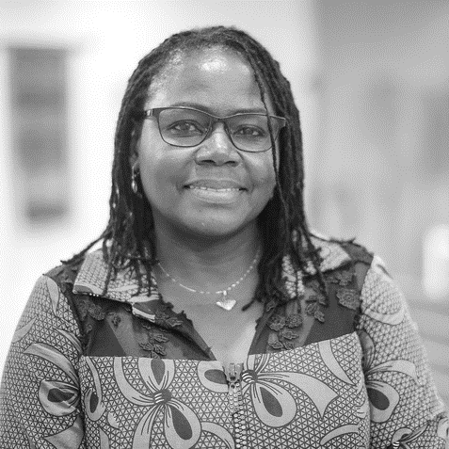
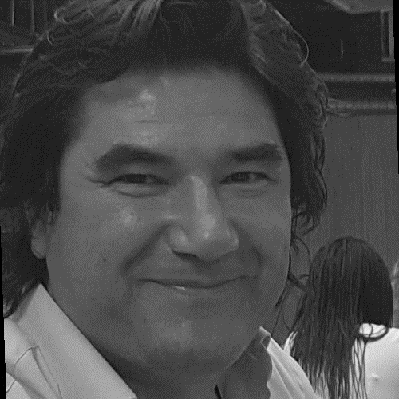
Introduction USAID and Partners
Presenters
Dyness Kasungami, Director, Global Child Health Task Force Secretariat, and Senior Child Health Advisor, JSI
Moderators
Jane Briggs, Senior Principal Technical Advisor, Lead on MNCH and FP, USAID Medicines Technologies and Pharmaceutical Services (MTaPS) Program implemented by MSH
Beth Yeager, Deputy Director USAID Promoting Quality of Medicines (PQM) + program, implemented by US Pharmacopeia
Joseph Monehin
Senior Child Health Advisor, USAID
Francisco Blanco
CHTF sub-group chair, Chief Quality Assurance at UNICEF Supply Division
Siobhan Vega, Maternal and Child Health Deputy Director, USAID Global Health Supply Chain Program- Procurement and Supply Management, implemented by Chemonics

Slide 3
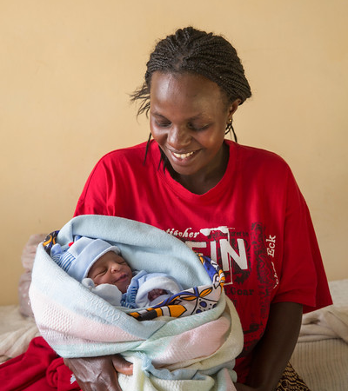
Agenda
Child Health Task Force (CHTF)
Child Survival Action
Call to Action paper: purpose and contents
Questions and discussion

Slide 4
Introduction: Child Health Task Force Newborn and Child Health Commodities subgroup
The subgroup on newborn and child health commodities raises awareness and promotes collective efforts to improve how commodities for newborn and child health are prioritized, financed, and managed.

Slide 5
54 countries need accelerated action to meet the SDG target for under-five mortality:
Projected under-five mortality rate per 1,000 live births in 2030 by country
The country color reflects the expected under-five mortality rate per 1,000 live births in 2030 assuming no additional action (continuing the recent trend in the rate of reduction from 2010 to 2021). The darker the red the higher the rate.
Source: UN IGME Report 2022
Notes:
Source: UN IGME, 2022
7 years to 2030
The challenge that drives us to act – 54 countries off-track to achieving U5MR target of 25 or fewer deaths per 1,000 live births
Map shows the projected U5MR in 2030 if progress continues at the current rate (according to UN IGME 2022 report)
Focus on central and west Africa, as well as Somalia in the East
These countries are also fragile/conflict zones
Deep red: CAR, Chad, Guinea, Niger, Nigeria, Somalia, SS

Slide 6
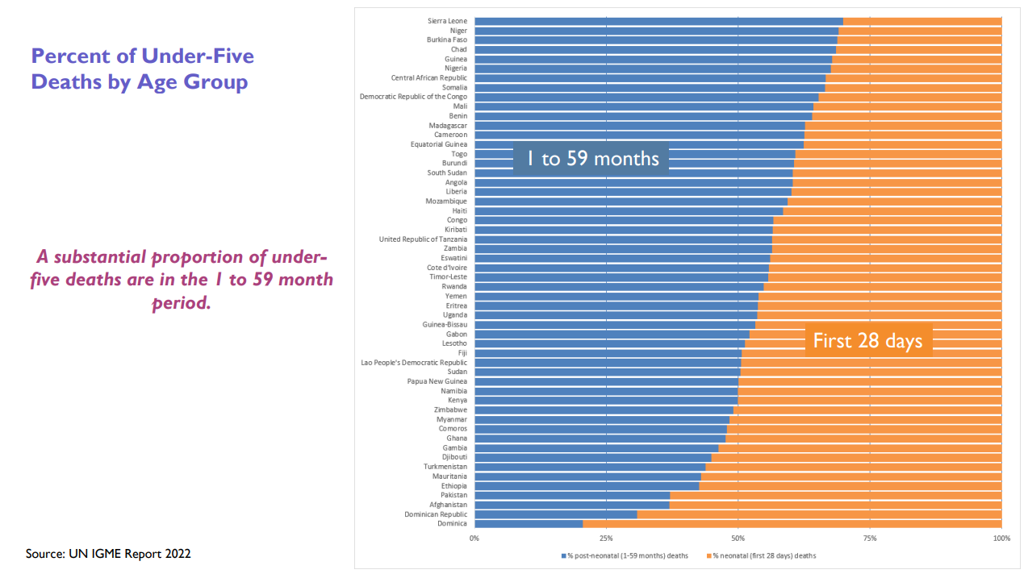
Global Challenge: Percentage of Under-Five Deaths by Age Group
In 38 of the 54 off-track countries, over 50% of the deaths occur in the
1-59 month period.
These are generally also the countries with the highest overall under-five mortality rates.
The majority of the deaths in the 1-59 month age group are caused by pneumonia, diarrhea and malaria
Undernutrition is a major risk factor for mortality
Massive gaps exist in coverage and quality of essential interventions
These conditions can be prevented and most often treated at the primary health care level
Some resource-constrained countries have made progress

Slide 7
Child Survival Action initiative
Focuses on the 54 countries, 42 in Africa, that urgently need accelerated efforts to achieve the SDG3 2030 target on child mortality
Reaches the children being left behind and at risk from leading killers - pneumonia, diarrhea, and malaria
Strengthens primary health care in facilities and communities to more effectively prevent, diagnose, and treat these causes of child death
Builds effective partnerships between governments, local partners, civil society, private sector, regional and global organizations
Mobilizes required resources from domestic and international sources and sectors
For more information: https://www.childhealthtaskforce.org/hubs/child-survival-action

Slide 8
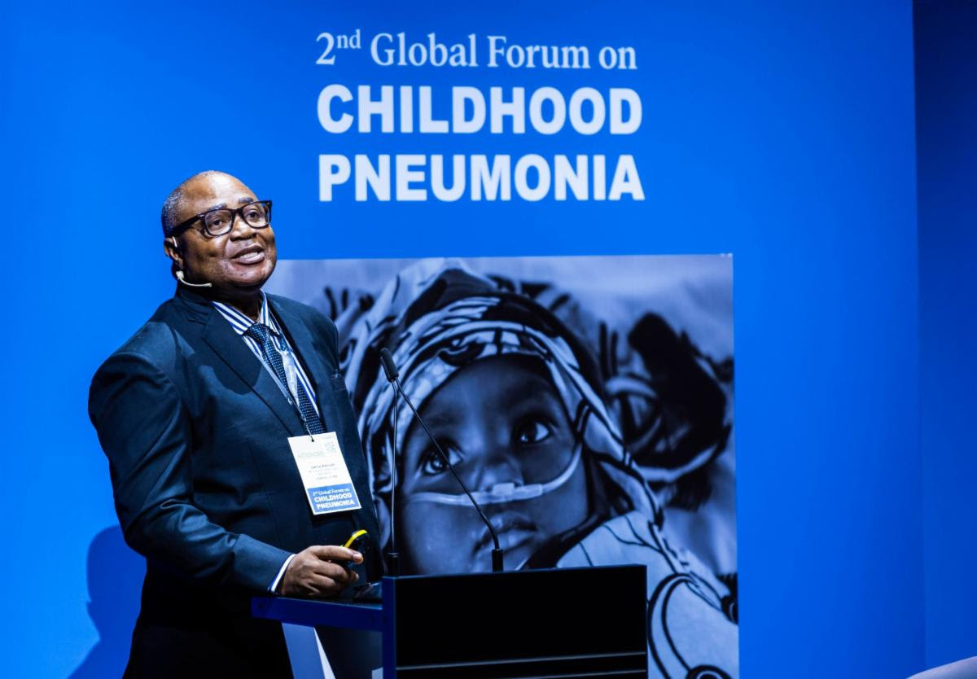
Child Survival Action Launch
World Health Assembly, May 23, 2022 in Geneva, Switzerland
Panel of Ministers of Health and other global health leaders on how we can act together to achieve the 2030 target for child survival. Recording of the livestream and presentation can be accessed here in English and ici en français
2nd Global Pneumonia Forum, April 26, 2023, in Madrid, Spain
In collaboration with the Ministry of Health and Sanitation, Sierra Leone (MOH), the Task Force and its partners, Global Financing Facility, Save the Children International, USAID, UNICEF, and World Health Organization, were delighted to launch the Child Survival Action (CSA) Initiative. Two-pager here in English and ici en français

Slide 9
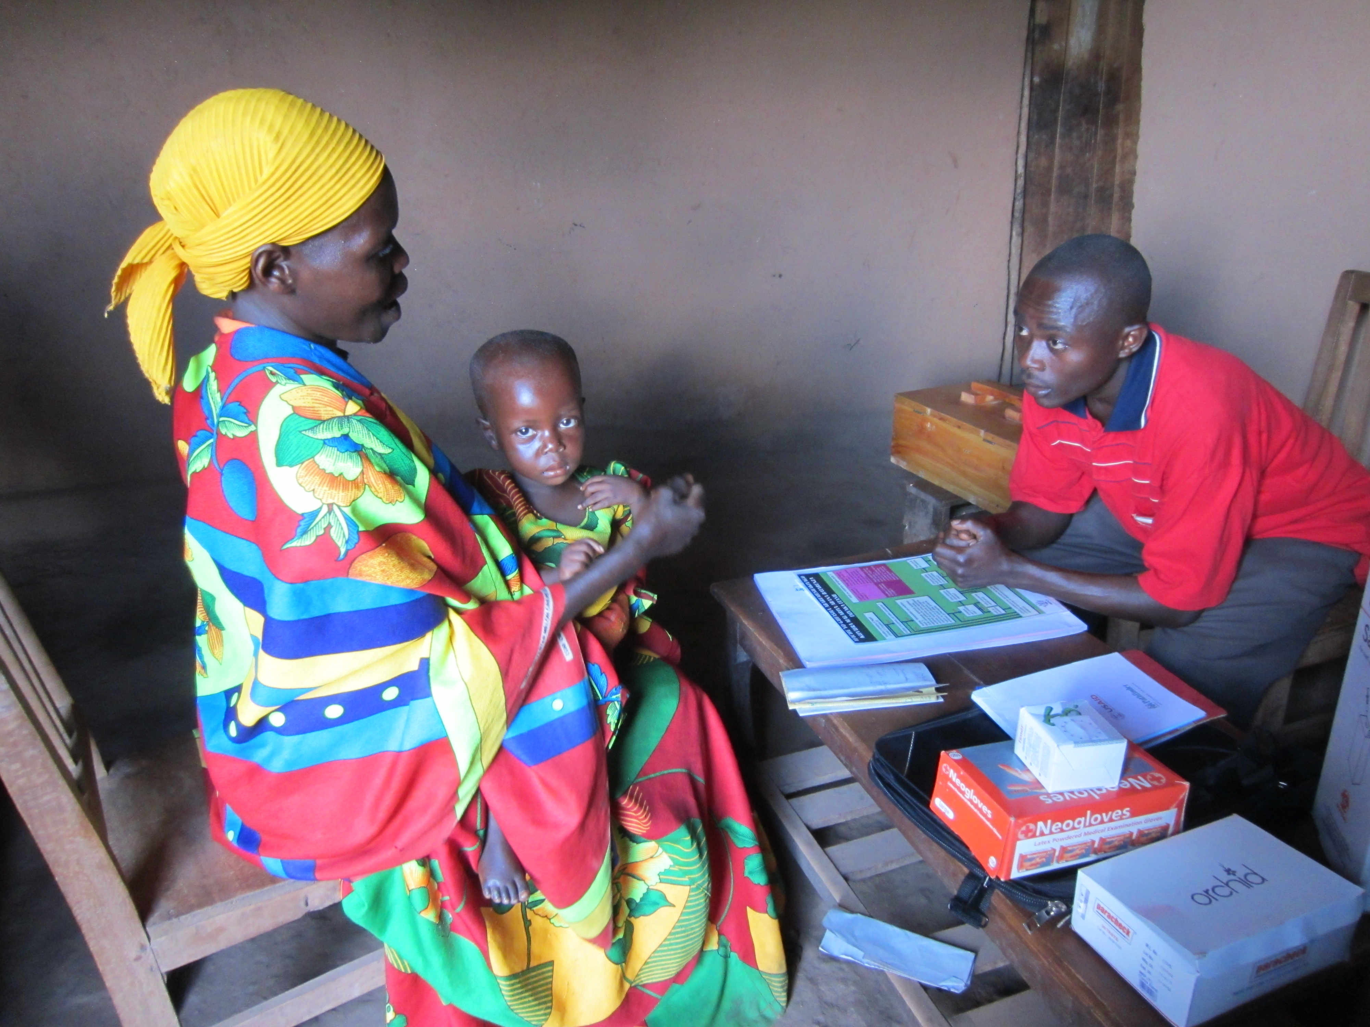
Context: The global challenge
There are over 700,000 under 5 deaths each year from pneumonia and other treatable respiratory infections, with 90% in 40 LMICs
Global changes in treatment of newborn and child health conditions have still not been widely adopted
54 countries need accelerated action to meet the SDG target for under-five mortality
Access to and appropriate use of amoxicillin and gentamicin for newborn and child health through primary health care remains a challenge
Photo credit J Briggs MSH

Slide 10
Call to Action: Addressing key barriers and bottlenecks
What is needed to further the advances already made and increase access to and appropriate use of pediatric amoxicillin and gentamicin?
Prioritized bottlenecks:
Financing
Quantification
Quality
Appropriate Use
Inadequate financing of pediatric amoxicillin and gentamicin formulations
Inaccurate quantification at all levels
Quality of child health products not guaranteed
Inappropriate use of medicines for treatment of pneumonia and PSBI by providers and caregivers

Slide 11
Call to Action: Improving uptake of amoxicillin and gentamicin
Evidence and solution building process to review experience and evidence related to selected bottlenecks
Consultative process:
Review of recent literature
Call for evidence, experience, and data
Surveys to priority countries
Consultative meetings
Convene country stakeholders, donors, and implementing partners
Share evidence on prioritized bottlenecks in uptake of medicines for newborn and child health
Discuss root causes
Develop consensus on actionable, prioritized solutions
Call-to-action paper
with defined roles for both countries and global partners
Series of 3 consultative meetings with the Newborn and Child Health Commodities subgroup of the CHTF :
Consultative Meeting #1: Quantification & Financing
Consultative Meeting #2: Quality
Consultative Meeting #3: Appropriate Use
Included technical experts from:
Government agencies
Global health institutions
NGOs
Private sector
Academic institutions
Experts reviewed current evidence, identified root causes, and agreed on actionable solutions
May 2022
Recordings and presentations can be found here: https://www.childhealthtaskforce.org/events/2022/05/improving-uptake-amoxicillin-and-gentamicin-three-part-consultation

Slide 12
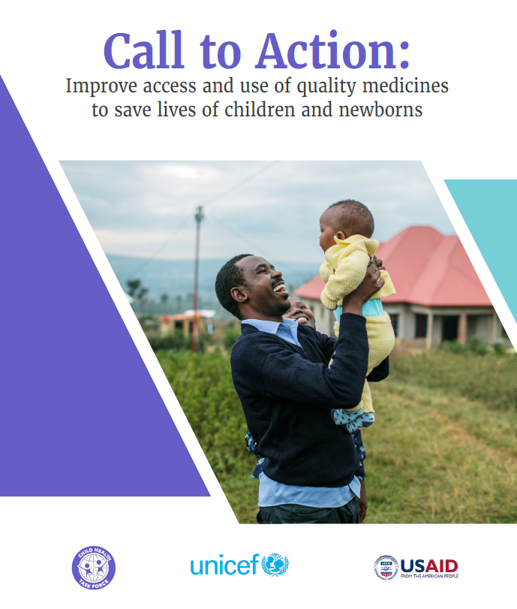
Call to Action Paper: Purpose
Re-ignite action to improve uptake of amoxicillin and gentamicin for children and newborns (also serve as proxy for other essential medicines in PHC)
Sets out the recommended solutions
not necessarily new and innovative but not currently being implemented
Start with low hanging fruit that are feasible in the short term
Describes the critical roles of country stakeholders, donors, implementing partners, and civil society organizations in driving purposeful action and saving children’s lives
Use to bring all country stakeholders together around a common goal and drive action
Stresses the importance of strong heath systems
Available in English, French, Portuguese and
Spanish: https://tinyurl.com/C2HTFamox

Slide 13
Key action points: Strengthening quantification
Coordinate forecasting and supply planning
Improve timeliness and accuracy of data collected at all levels of the health supply
Build skills for data organization, routine review and analysis of consumption data and use
established tools to conduct quantifications

Slide 14
Key action points: Increasing financing
Build capacity to manage available domestic resources
Improve transparency of financial commitments for procurement of medicines and build accountability
Include community-level requirements for amoxicillin in grant applications to the Global Fund

Slide 15
Key action points: Improving quality assurance
Advance regulatory convergence and harmonization
Strengthen coordination mechanisms to eliminate constraints to procurement of quality products
Ensure that procurers accurately specify quality requirements in tender documents and purchase only quality-assured products
Raise public awareness of substandard and falsified products
Use long-term procurement agreements and tax and tariff waivers to incentivize local manufacture
Ensure uninterrupted availability of quality assured gentamicin (plus 1 ml syringes) and amoxicillin
Strengthen national regulatory agencies to support GMP inspections, streamline registration, and post market surveillance

Slide 16
Key action points: Enabling appropriate use
Align national policies and guidelines with global recommendations and disseminate through range of media
Provide electronic decision-making tools to support providers
Ensure effective supervision, mentoring, and coaching
Set standards and indicators to monitor availability and use practices of providers and caregivers
Design and implement evidence-based, multifaceted interventions
Research linkages between rational use of medicines and payment mechanisms and insurance schemes

Slide 17
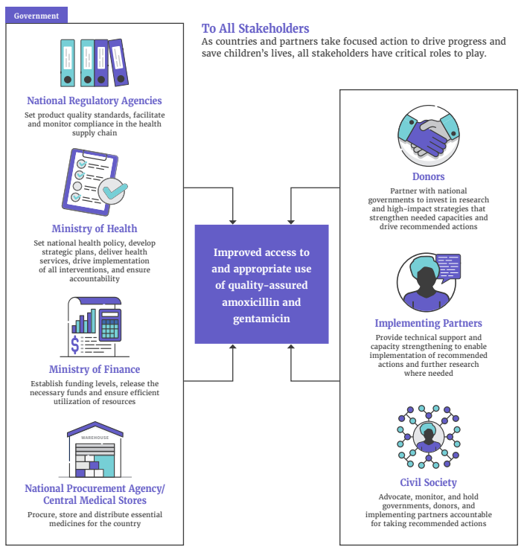
Doing your part: Role of stakeholders
To all stakeholders:
As countries and partners take focused action to drive progress and save children’s lives, all stakeholders have critical roles to play

Slide 18
Next steps
Proposed next steps:
Discussions with partners and government counterparts in country
Consideration of recommendations in future strategies and activities

Slide 19
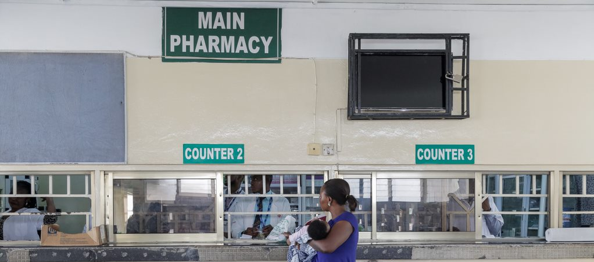
Thank you!
Thank you!
Questions?
Discussion

Slide 20
Connect with us
Engage with the Commodities subgroup co-chairs:
Joseph: jmonehin@usaid.gov
Fransisco: fblanco@unicef.org
Subgroup information, recordings and presentations from previous meetings and webinars are available on the subgroup page of the Child Health Task Force website: www.childhealthtaskforce.org/newborns
*The recording and presentations from this webinar will be available on this page in a couple days
Join the Child Health Task Force here: https://bit.ly/joinchtf & follow us on LinkedIn: www.linkedin.com/company/child-health-task-force
Photo credit: Liberia, Kate Holt/MCSP

Slide 21
The Child Health Task Force is managed by JSI Research & Training Institute, Inc. through the USAID Advancing Nutrition project and funded by USAID and the Bill & Melinda Gates Foundation.
This presentation was made possible by the generous support of the American people through the United States Agency for International Development (USAID), under the terms of the Contract 7200AA18C00070 awarded to JSI Research & Training Institute, Inc. The contents are the responsibility of JSI and do not necessarily reflect the views of USAID or the U.S. Government.
Photo credit: Liberia, Kate Holt/MCSP

