Slide 1
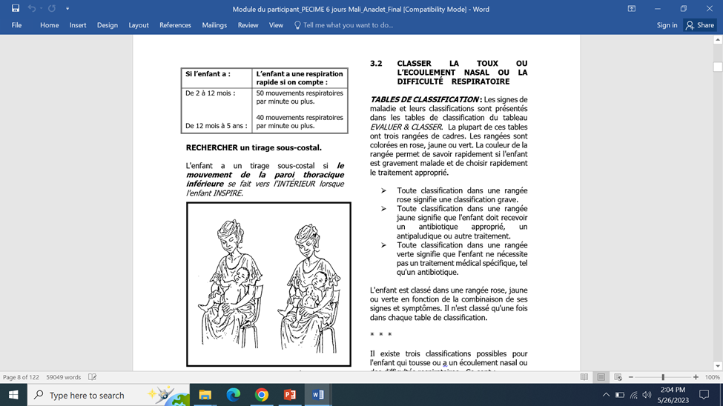
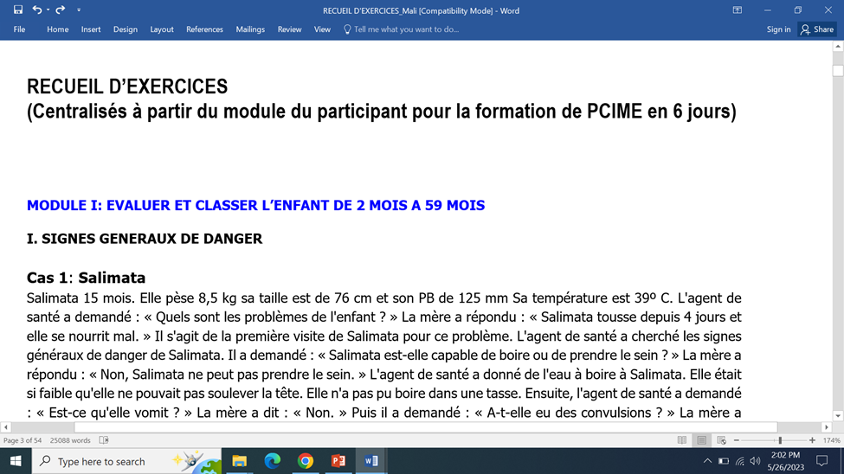
From Classic 12-Day to a Shortened Integrated Management of Newborn and Childhood Illness (IMNCI) 6-day Course: Describing the Process in Mali
Authors: Anaclet Ngabonzima¹, Moussa Sacko², Lazare Coulibary^{1,} ,Joseph Obure¹, Aminata Traore² ¹MOMENTUM Integrated Health Resilience, DC, ²MOMENTUM Integrated Health Resilience, Mali
BACKGROUND
METHODS AND RESULTS
REFERENCES
Integrated management of newborn and childhood illness (IMNCI) remains an important child survival strategy if implemented at scale¹⁻⁴. This has been a challenge in low-resource settings mostly due to the high costs and time associated with a classic 11- or 12-day IMNCI training course.
Implementing classic IMNCI training is a challenge, as it is neither cost-effective nor practical; especially in fragile settings where human resources are limited as lengthy absences to attend training courses disrupt service delivery.
Evidence shows that shortening IMNCI course can reduce direct training costs up to 46% without compromising its quality.⁵
MOMENTUM Integrated Health Resilience (MIHR) has been supporting its partner countries, including DRC, Mali, Niger, and South Sudan to improve IMNCI quality. Among those countries, only DRC has shortened IMNCI course.
Leveraging the experience of other countries, MIHR supported Mali to adopt the shortened IMNCI course.
In 2022, MIHR project staff conducted high-level advocacy by holding discussions within key Mali Ministry of Health (MOH) officials for the adoption of the shortened IMNCI course.
This advocacy led to a national stakeholders’ workshop in 2023 to convert the current 12-day IMNCI course to a shorter, 6-day model.
The process involved people from different Ministry of Health (MOH) departments, Mali Pediatric Association (AMAPED), National Institute of Health Sciences Training, IMNCI resource persons, MIHR, and relevant IMNCI implementing partners in Mali.
Participants adapted and adopted one participant module to replace the existing IMNCI seven (7) modules. The new participant module is 100 pages, compared to 500 with the former modules. This was achieved through reducing theory and combining some exercises.
The new training module also incorporates possible severe bacterial infections (PSBI) integrated into Mali’s IMNCI guideline following MIHR support in June 2022.
In additional to the participant module, an exercise book was developed containing the most important exercises judged crucial for IMNCI learners.
Participants discussed and validated the training agenda and the training methodology for the shortened version that focuses on key elements of the modules and skills acquisition.
Next steps include training more health care providers using the shortened version in Gao and Timbuktu and then evaluate the impact of shortened IMNCI course on
IMNCI quality and adherence in fragile settings.
.
New IMNCI participant training module
Gera T, Shah D, Garner P, Richardson M, Sachdev HS. Integrated management of childhood illness (IMCI) strategy for children under five. Cochrane Database Syst Rev. 2016 Jun 22;(6):CD010123. doi: 10.1002/14651858.CD010123.pub2. PMID: 27378094; PMCID: PMC4943011
WHO. First Global Review and Coordination Meeting on Integrated Management of Childhood Illness (IMCI). Santo Domingo: World Health Organization, 1997
https://dcp-3.org/sites/default/files/dcp2/DCP63
https://www.exemplars.health/-/media/files/egh/resources/underfive-mortality/senegal/whointegrated-management-of-childhood-illness-imci.pdf?la=en
https://www.dovepress.com/effect-of-shortened-integrated-management-of-childhood-illness-trainin-peer-reviewed-fulltext-article-RMHP
https://onlinelibrary.wiley.com/doi/full/10.1111/padr.12523. Accessed on May 12th 2023
https://www.unicef.org/turkiye/en/press-releases/children-mali-bear-heaviest-brunt-conflict-security-situation-worsens. Accessed on May 10th 2023
IMNCI EXERCISE BOOK
CONCLUSIONS
Engaging key stakeholders and national authorities is crucial to facilitate policy change with regards to IMNCI course shortening.
Classic and long IMNCI modules can be revised and shortened into one IMNCI participant module through keeping the most practical content and exercises to reduce costs and time associated with longer trainings.
MOMENTUM Integrated Health Resilience (MIHR)
MIHR is the U.S. Agency for International Development’s global flagship project to strengthen equitable and quality maternal, newborn, and child health care and service delivery in fragile settings, including Mali (2021 – 2025).
In Mali, MIHR targets two regions located in the North, Gao and Timbuktu. These are among the most fragile regions due to security issues in Northern of the country since 2013, which disrupted health services and increased the child mortality rate ^{6,7}
Implementing IMNCI in these fragile settings requires a shortened version of IMNCI course to be able to train more health care providers due to high turnover.
Shortening the standard IMCI course enables training more IMNCI providers and investing in post training follow-up and supportive supervision and mentoring, which are key to improve and sustain quality IMNCI.
JUNE 2023
CHTF Virtual Conference 2023
FOR MORE INFORMATION
Anaclet Ngabonzima| Child Health Lead/angabonzima@momentumihr.org
MOMENTUM Integrated Health Resilience is made possible by the generous support of the American people through the United States Agency for International Development (USAID) under the terms of USAID cooperative agreement #7200AA20CA00005. The contents of this document are the sole responsibility of MOMENTUM Integrated Health Resilience and IMA World Health and do not necessarily reflect the views of USAID or the United States Government.

