Slide 1
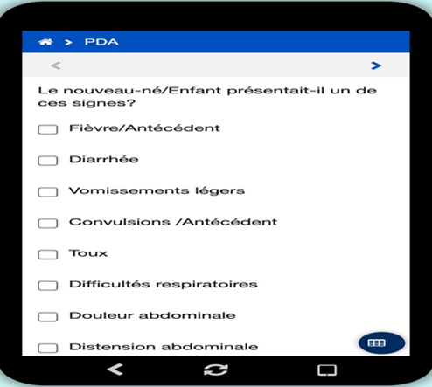
Introduction of Facility-Based Pediatric Death Audits as a Quality Improvement (QI) Tool in Fragile Settings: The Mali Experience
Authors: Anaclet Ngabonzima¹, Demba Traore², Lazare Coulibary¹, Joseph Obure¹, Jimi Michel¹, Aminata Traore² ¹ MOMENTUM Integrated Health Resilience, DC ² MOMENTUM Integrated Health Resilience, Mali
BACKGROUND
METHODS AND RESULTS
PDA REVIEW FORM DIGITIZATION
A large number of preventable under-five deaths still occur because of poor quality of care (QOC), particularly in low resource settings.²⁻⁴
To reduce the number of under-five deaths further, the quality of child health care and factors that contribute to the deaths should be examined for appropriate response at all levels.^{5,6}
Maternal Death Surveillance and Response (MPDSR) has been rolled out in many countries of Sub-Saharan Africa (SSA) including Mali, which rolled out MPDSR in 2017.
Despite the WHO guidelines on Pediatric Death Audit (PDA) published in 2018, few countries have rolled out PDA to help avoiding future similar deaths.
MOMENTUM Integrated Health Resilience (MIHR) recognizes PDA as a QOC tool and has been supporting PDA introduction in its partner countries, including DRC, Mali, Niger, and South Sudan.
This poster will highlight experiences from PDA roll out in Mali.
In 2022, MIHR conducted high-level advocacy within the Mali Ministry of Health (MoH) for the adoption of the 2018 WHO PDA guidelines.
This advocacy led to a national stakeholders’ workshop to review and adapt the WHO PDA guidelines and tools for the Malian context.
The process involved representatives different stakeholders including the Pediatric Association and Society of Obstetricians, among others.
Mali’s existing Maternal and Perinatal Death Surveillance and Response (MPDSR) guideline and data collection tools were initially launched in 2017, and were revised to integrate PDA and became the Maternal Perinatal and Pediatric l Death Surveillance and Response (MPPDSR).
National MPDSR directives were revised to be MPPDSR to cater for Pediatric Death Audit.
Existing MPDSR committee members in Gao and Timbuktu were extended to include staff involved in pediatric care and were then trained on PDAs.
The extended MPDSR committees started piloting notification and audit of pediatric deaths in 2022.
In addition, members of the MPDSR committee were trained on quality improvement to help them translate PDA recommendations into actions.
In 2023, using Commcare, PDA tools were digitized to make the PDA process easier, and digitalization took into consideration the maternal and perinatal death review tools as they were not yet digitized.
In April 2023, national dissemination of MPPDSR was conducted.
NEW MPPDSR GUIDELINE AND DIRECTIVE
REFERENCES
https://www.npr.org/sections/goatsandsoda/2018/09/05/644928153/what-kills-5-million-people-a-year-its-not-just. Accessed on May 15th 2023
https://www.who.int/news-room/fact-sheets/detail/children-reducing-mortality. Accessed on May 10th 2023
United Nations Inter-agency Group for Child Mortality Estimation (UN, IGME). ‘Levels & Trends in Child Mortality: Report 2018, Estimates developed by the United Nations Inter-agency Group for Child Mortality Estimation. 2018
https://aho.org/fact-sheets/children-and-mortality-fact-sheet. Accessed on May 4th 2023
https://apps.who.int/iris/bitstream/handle/10665/279755/9789241515184-eng.pdf. Accessed on April 19th 2023
Koffi AK, Maina A, Yaroh AG, Habi O, Bensaïd K, Kalter HD. Social determinants of child mortality in Niger: results from the 2012 National Verbal and Social Autopsy Study. J Glob Health. 2016;6(1):010603
https://onlinelibrary.wiley.com/doi/full/10.1111/padr.12523. Accessed on May 12th 2023
CONCLUSIONS
High-level advocacy is crucial to facilitate policy changes.
Combining top–down and bottom–up processes can facilitate the rapid PDA rollout.
The introduction of PDA can be made easier by extending the existing MPDSR committees during the roll out.
Digitizing PDA tools would potentially facilitate implementation and monitoring.
MOMENTUM Integrated Health Resilience (MIHR)
MIHR is the U.S. Agency for International Development’s global flagship project to strengthen equitable and quality maternal, newborn, and child health care and service delivery in fragile settings.
8 countries, including the Mali, are currently implementing the 5-year award (2021 – 2025).
In Mali, MIHR targets the two regions located in the north, Gao and Timbuktu.
These are among the most fragile regions due to security issues in the northern part of the country since 2013, which increased child mortality rate to about 12 for every 100 children.⁷
High-level advocacy with managers of national health programs is a key strategy for updating national maternal and child health policies or standards in line with new scientific evidence. PDA roll out can be made easier by being built on the existing MPDSR to be rolled out.
JUNE 2023
CHTF Virtual Conference 2023
FOR MORE INFORMATION
Anaclet Ngabonzima| Child Health Lead | angabonzima@momentumihr.org
MOMENTUM Integrated Health Resilience is made possible by the generous support of the American people through the United States Agency for International Development (USAID) under the terms of USAID cooperative agreement #7200AA20CA00005. The contents of this document are the sole responsibility of MOMENTUM Integrated Health Resilience and IMA World Health and do not necessarily reflect the views of USAID or the United States Government.

