Slide 1

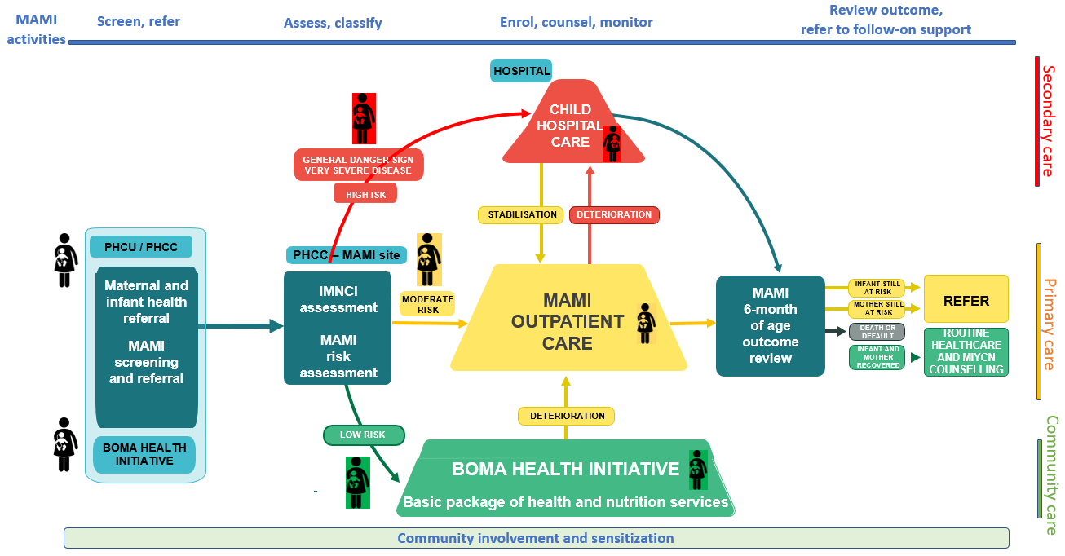
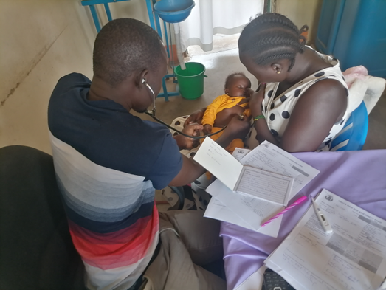
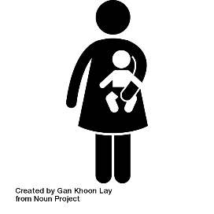
Reducing Health Inequities for Infants under 6 Months and Their Mothers in South Sudan through the MAMI Care Pathway.
MOMENTUM Integrated Health Resilience
M. Traore-Hebie¹, A. Boi Nasira², M. Poni Jackson², N. Sassa², D. Wendo², K. Dearden¹, H. Deconinck³
¹IMA World Health, Washington DC, United States, ²IMA World Health, Juba, South Sudan, ³Ghent University, Faculty of Medicine and Health Sciences, Department of Public Health and Primary Care, Ghent, Belgium
BACKGROUND
RESULTS
Globally, one in four newborns are born too small or too early,¹ and 8.5 million infants under 6 months (u6m) are wasted.² In South Sudan, infants and their mothers experience high levels of morbidity and mortality, exacerbated by inequities in access to health services.³
MOMENTUM Integrated Health Resilience (MIHR) has piloted the management of small and nutritionally at-risk infants and their mothers (MAMI) care pathway (CP) in five healthcare facilities and their catchment area. The MAMI CP includes community and facility screening; risk assessment; and treatment and support for the infant and the mother until the infant reaches 6 months.⁴
With MIHR support, the government was able to gather stakeholders to contextualize and implement the MAMI CP for at-risk infants and their mothers despite the uneven commitment to maternal, newborn, child health and nutrition.
To date, 4,586 pairs were screened of which 52% had a girl infant (Table 1). Out of all infant-mother pairs, 72% were screened at the health facility level versus 28% at the community level (Figure 2).
Overall, 357 moderate-risk pairs were enrolled, and 77 high-risk pairs were referred to hospital (Figure 3).
Figure 2. Profile of MAMI infant-mother pairs screened in South Sudan
METHODS
Table 1. MAMI infant-mother pairs reached by infant gender
MAMI infant-mother pairs, by infant gender | Total
Screened in the community and health facility | 4586
Boy infant | 2214 (48%)
Girl infant | 2372 (52%)
Assessed in OPD | 1505
Boy infant | 761 (51%)
Girl infant | 744 (49%)
Currently enrolled in MAMI CP | 357
Boy infant | 153 (43%)
Girl infant | 204 (57%)
In a 12-month prospective, longitudinal cohort study, we enrolled a cohort of 500 infant-mother pairs at moderate risk in primary care and explore enablers and barriers of the MAMI CP adoption process and quality of care with mixed methods. Primary quantitative data are collected continuously and qualitative data at key points. A participatory evaluation and learning system documents feasibility and acceptability of integrating the approach into existing health services to inform implementation guidance and policy adaptations.
First, under the leadership of the Ministry of Health, stakeholders were engaged in the CP design that built upon an analysis of national policies and capacities. An iterative collaborative process adapted and field-tested generic MAMI CP materials to the South Sudanese context. Next, 115 clinical and community health workers were trained on implementing the CP.
In MAMI CP, risk factors across maternal and child health and nutrition are assessed among infant-mother pairs, and those with moderate risks are enrolled for health management and support. Figure 1 shows the adapted MAMI Care Pathway Flow Chart, and Box 1 shows the classification criteria for the infant-mother pairs.
Figure 3. Profile of MAMI mother-infant pairs assessed in OPD in South Sudan
Clinical Officer conducting a MAMI risk assessment of the infant-mother pair in a primary care centre, South Sudan, March 2, 2023.
Figure 1. MAMI Care Pathway adapted to South Sudan context
CONCLUSION
Box 1. Classification of infant-mother pairs:
Low-risk infant-mother pair (green), referred to continued preventive community activities
Moderate risk infant-mother pair (yellow), enrolled for management and support in primary care
High-risk infant mother pair (red), referred to hospital.
The initial results look promising. Learning thus far point to the need to simplify the CP design, to combine it with the integrated management of childhood illness, to strengthen the community health system for active case finding, and to use behavior change techniques to counsel mothers on good care and feeding practices. In South Sudan, the successful integration of MAMI CP into the health systems will likely require addressing barriers such as health workers’ perception of the CP as an extra burden and mothers’ unwillingness to return for follow-up visits in the absence of a motivating factor.
REFERENCES
Lawn JE, Ohuma EO, Bradley E, et al. Small babies, big risks: global estimates of prevalence and mortality for vulnerable newborns to accelerate change and improve counting. Lancet. 2023;401(10389):1707-1719. DOI: 10.1016/S0140-6736(23)00522-6
Kerac M, Blencowe H, Grijalva-Eternod C, McGrath M, Shoham J, Cole TJ, Seal A. Prevalence of wasting among under 6-month-old infants in developing countries and implications of new case definitions using WHO growth standards: a secondary data analysis. Arch Dis Child. 2011 Nov;96(11):1008-13. DOI: 10.1136/adc.2010.191882
Black RE, Victora CG, Walker SP, Bhutta ZA, Christian P, de Onis M, Ezzati M, Grantham-McGregor S, Katz J, Martorell R, Uauy R; Maternal and Child Nutrition Study Group. Maternal and child undernutrition and overweight in low-income and middle-income countries. Lancet. 2013 Aug 3;382(9890):427-451. DOI: 10.1016/S0140-6736(13)60937-X
MAMI Global Network, ENN, LSHTM (2021). MAMI Care Pathway Package, Version 3 (2021). www.ennonline.net/mamicarepathway
Abbreviations: IMNCI = Integrated management of neonatal and childhood illness; MAMI = Management of small and nutritionally at-risk infants under 6 months of age and their mothers; MUAC = Mid-upper arm circumference; OPD = Outpatient department; PHCC = Primary healthcare centre; PHCU = Primary healthcare unit.
JUNE 2023
CHILD HEALTH TASK FORCE CONFERENCE
RE-IMAGINING THE PACKAGE OF CARE FOR CHILDREN / POSTER 29
FOR MORE INFORMATION
www.USAIDMOMENTUM.org | Marlene Traore-Hebie| Senior nutrition advisor | mhebie@corusinternational.org
MOMENTUM Integrated Health Resilience is made possible by the generous support of the American people through the United States Agency for International Development (USAID) under the terms of USAID cooperative agreement #7200AA20CA00005. The contents of this document are the sole responsibility of MOMENTUM Integrated Health Resilience and IMA World Health and do not necessarily reflect the views of USAID or the United States Government.

