Slide 1

Adapting Health Systems to Protect Children from the Impact of Climate Change.
Session 6: Climate Effects on Arboviruses and Child Health
Re-imagining the Package of Care for Children Subgroup
June 15, 2023
Moderators of the series:
Cara Endyke Doran, cendykedoran@globalcommunities.org
Swathi Manchikanti, smanchikanti@unicef.org

Slide 2
Series Overview
TODAY:
Session 6: Climate Effects on Arboviruses and Child Health (June 15, 2023)
Overview of arboviruses (e.g. dengue, chikungunya and Zika) and their effects on child and maternal health, how they are being affected by climate change, and recommendations for a primary healthcare response.
Upcoming Sessions:
Session 7: Financing Health and Climate Adaptation—July 2023
Session 8: Communicating Health Effects of Climate Change—August 2023
Session 9: Measuring Climate Adaptation OR Excessive Rains and Related Childhood Disease Burdens (TBD)—September 2023
Previous sessions:
Session 1: Framed the series (November 10, 2022)
Shared the Healthy Environments for Healthy Children (HEHC) Framework and highlights from UNICEF’s heatwaves report
Session 2: Children’s Climate Risk Index (CCRI) (December 13, 2022)
Reviewed the CCRI methodology and its potential application
Session 3: The Impact of Climate Change on Newborn Health Outcomes: A Focus on Congenital Heart Defects (February 13, 2023)
Review extreme heat and its contributions to congenital heart disease (CHD)
Session 4: Protecting Children and Pregnant People from Heat Stress (March 29, 2023)
Possible interventions and recommendations
Session 5: Climate Effects on Malaria Programming for Children
Summary of the evidence of changing temperature and climate conditions and effects on malaria-specific vectors and strategies for malaria surveillance and possible interventions and recommendations

Slide 3

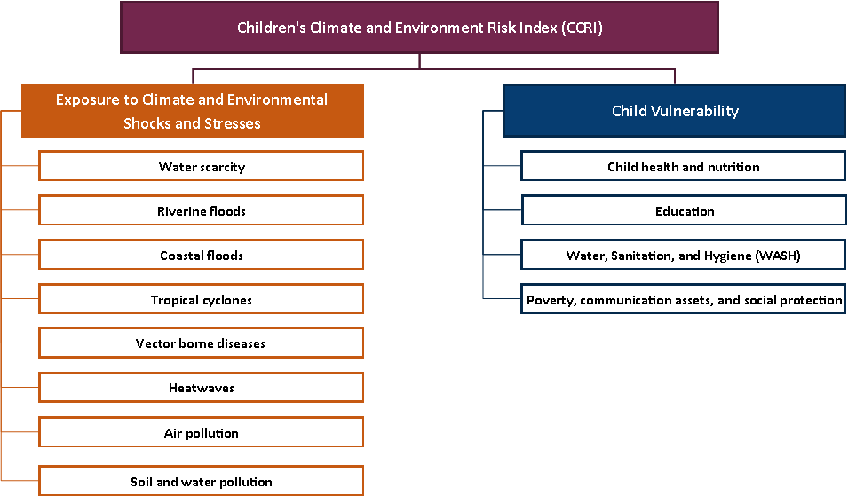
CCRI conceptual model:
Pillars and components
Notes:
I would like to share that we are using the HEHC framework and the the Children's Climate Risk Index or CCRI which we discussed throughout our series. The CCRI is one of the first comprehensive reviews of children’s exposure and vulnerability to the impacts of climate change. It analyzes different climate and environment shocks, and stresses (outlined here in the left orange column), against the vulnerabilities children face as they grow and develop (which you see on the right blue column).

Slide 4
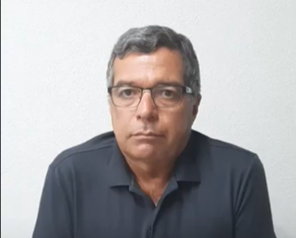
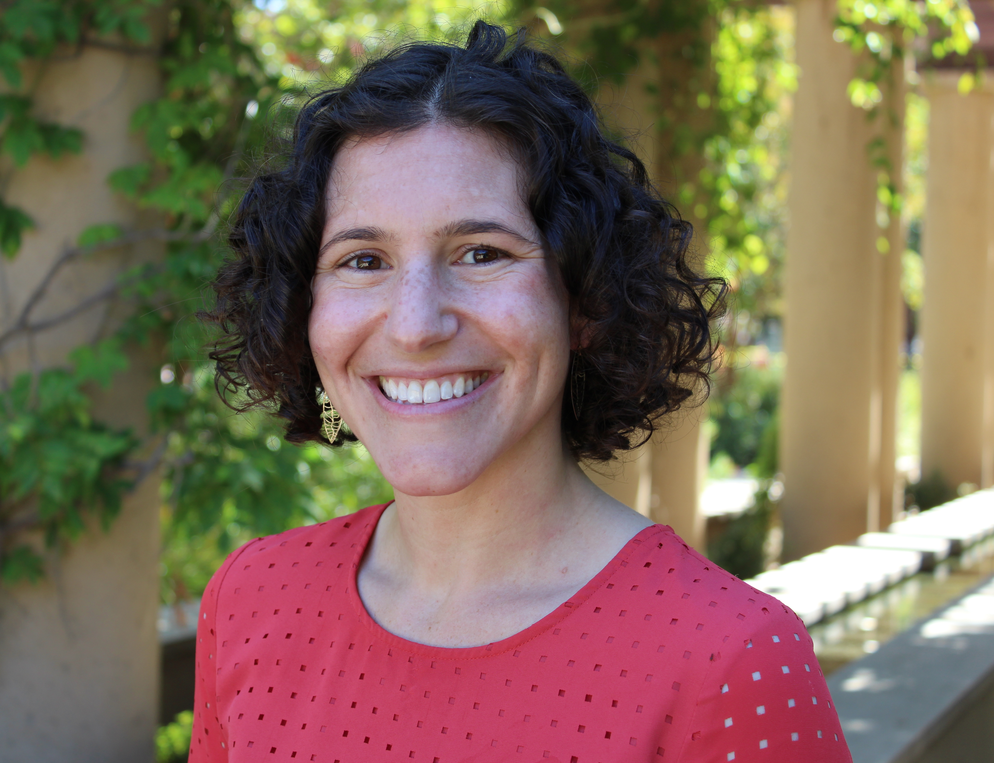

Presenters
Dr. Kleber Giovanni Luz
Pediatrician and Infectious Disease Specialist
Associate Professor IV at Federal University of Rio Grande do Norte, Brazil
Dr. Jamie Caldwell
Associate Research Scholar
High Meadows Environmental Institute
Princeton University
Dr. Sandra Mattos
Pediatric and Fetal Cardiologist
Medical Director of Maternal-Fetal Cardiac Unit at the Royal Portuguese Hospital
President of Heart Circle

Slide 5
Climate Effects on Arboviruses and Child Health
Kleber Luz - Rio Grande do Norte Federal University – Brazil/ PAHO/WHO.

Slide 6
Conflict of interests
No conflicts.

Slide 7
Dengue, Chikungunya, Zika, Yellow-fever, Oropouche, Mayaro and others diseases.
Arthropod-borne vírus diseases.
These vírus are founded in a sylvatic, periurban or urban environment.
All are related with the mosquitos ( Aedes, Haemagogus, others).
The climate changes increase the mosquitos population and increases mosquito lifespan.

Slide 8
Chikungunya.
Fever.
Artralgias.
Artrites.
May be severe with death causing by organ failure.
Children under 1y, may have Shock.

Slide 9
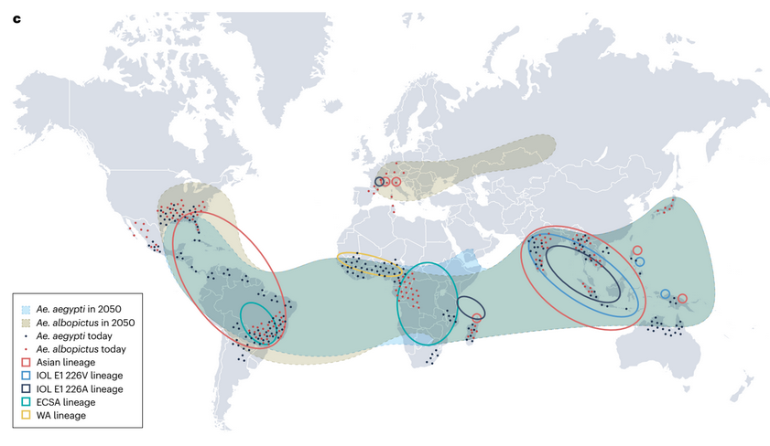
World map showing the spread of CHIKV lineages and the dominant Aedes mosquito vectors. Dotted patterns indicate contemporary presence of Aedes mosquitoes and projected spread by 2050 is indicated by coloured area shading.
Kraemer MUG, Reiner RC Jr, Brady OJ, Messina JP, Gilbert M, Pigott DM, Yi D, Johnson K, Earl L, Marczak LB, Shirude S, Davis Weaver N, Bisanzio D, Perkins TA, Lai S, Lu X, Jones P, Coelho GE, Carvalho RG, Van Bortel W, Marsboom C, Hendrickx G, Schaffner F, Moore CG, Nax HH, Bengtsson L, Wetter E, Tatem AJ, Brownstein JS, Smith DL, Lambrechts L, Cauchemez S, Linard C, Faria NR, Pybus OG, Scott TW, Liu Q, Yu H, Wint GRW, Hay SI, Golding N. Past and future spread of the arbovirus vectors Aedes aegypti and Aedes albopictus. Nat Microbiol. 2019 May;4(5):854-863. doi: 10.1038/s41564-019-0376-y. Epub 2019 Mar 4. Erratum in: Nat Microbiol. 2019 Mar 21;: Erratum in: Nat Microbiol. 2019 Apr 8;: PMID: 30833735; PMCID: PMC6522366.

Slide 10
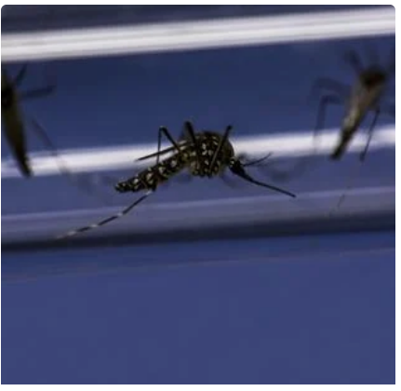
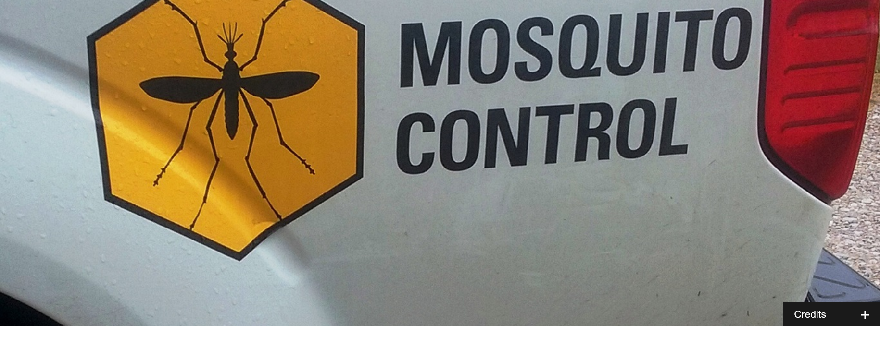
Climate changes.
Only after this period of 5–15 years are climate change factors, mainly increased temperatures, expected to drive further Aedes mosquito habitat expansions. Figures from WHO.

Slide 11
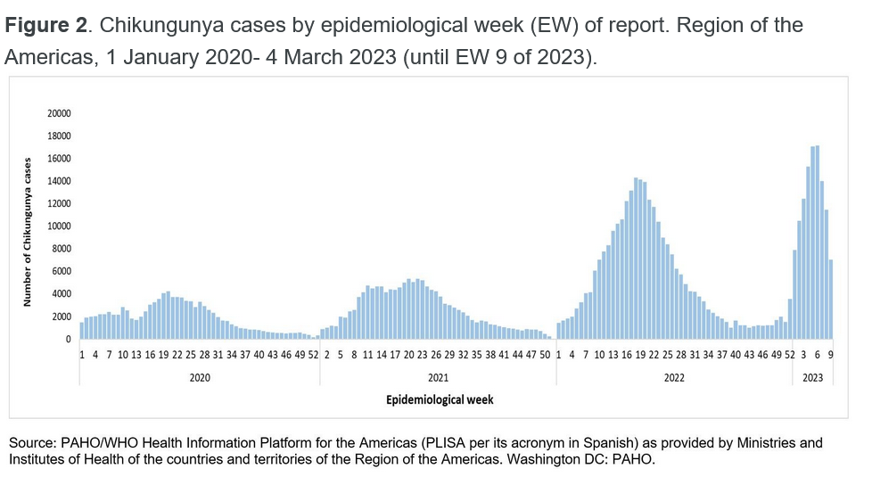

Slide 12
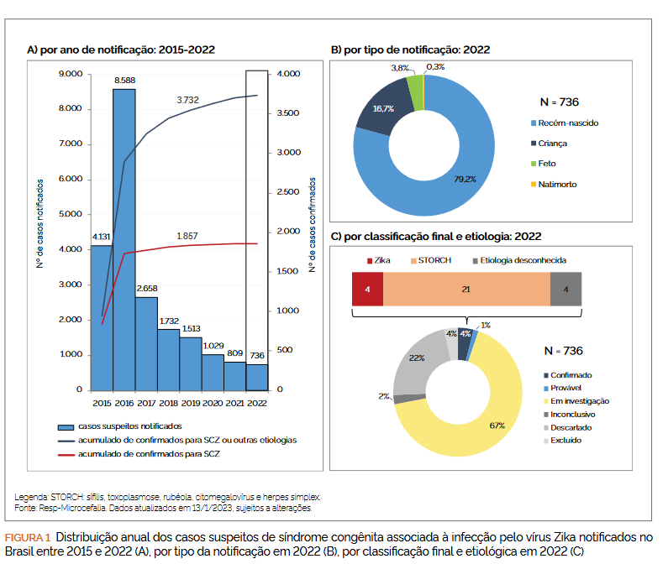
Zika cases in Brazil 2015 – 2022.

Slide 13
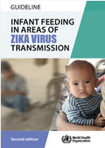
Zika.

Slide 14
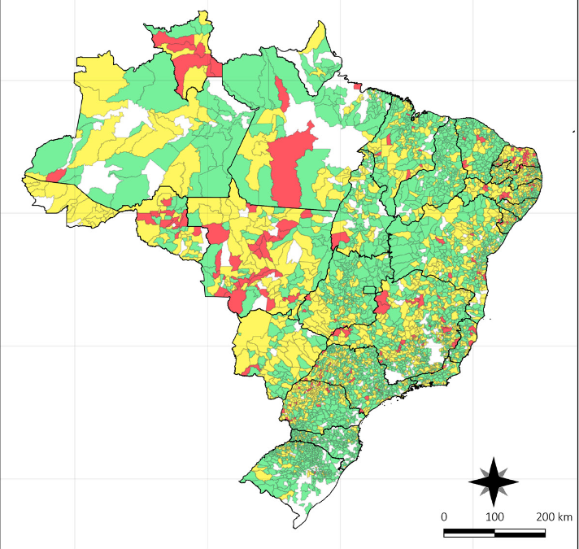
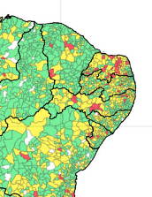
Dengue in Brazil - 2023.

Slide 15
Dengue.
The most importante arbovírus diseases in he world.
In Brazil more than 1,000 deaths in 2022.
No antivírus drug for treatment.
Important gap in Africa.

Slide 16
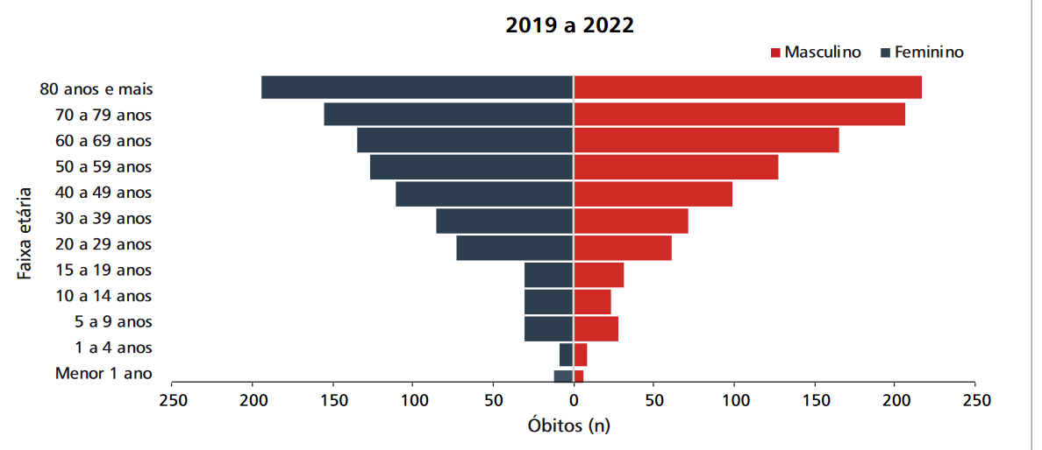
Dengue death cases Brazil, age distribution 2019 – 2022.

Slide 17
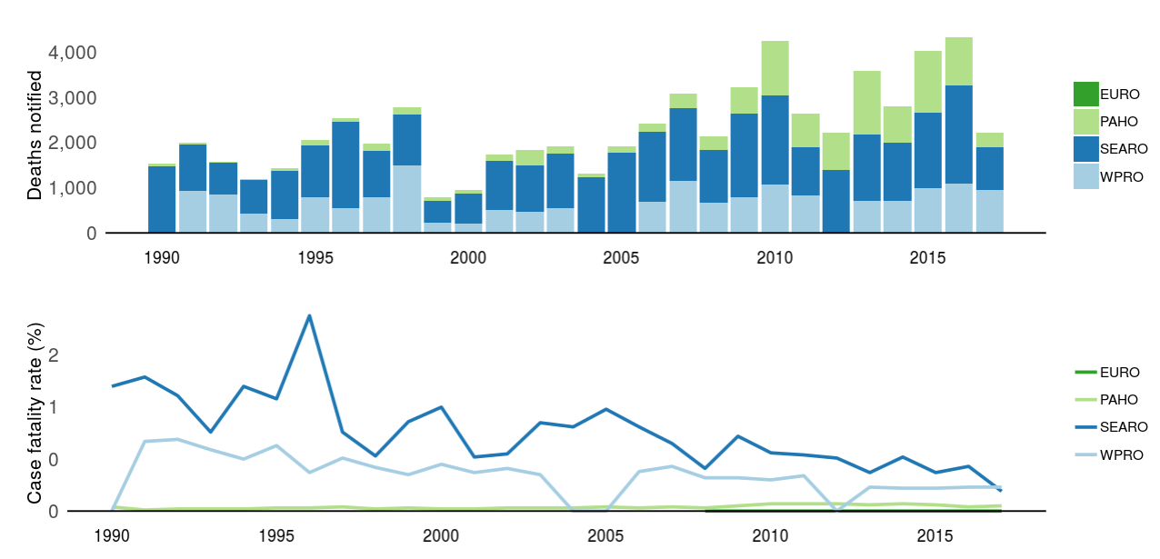
Dengue deaths.
PAHO – Pan American Helath Organization
SEARO - World Health Organization South-East Asia Region
WPRO - WHO Western Pacific Region
EURO - Europe (travel-associated cases)
https://www.who.int/denguecontrol/epidemiology/dengue_data_application/en/

Slide 18
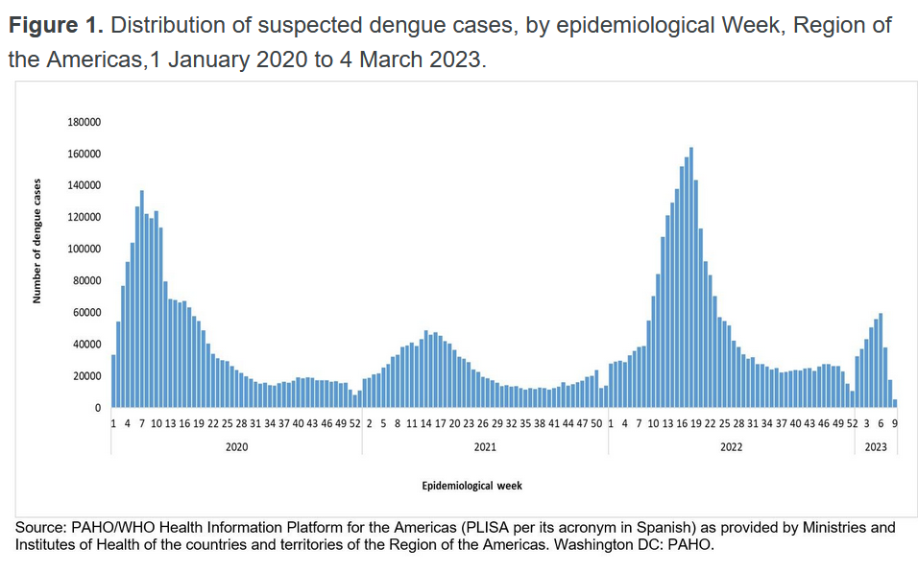

Slide 19
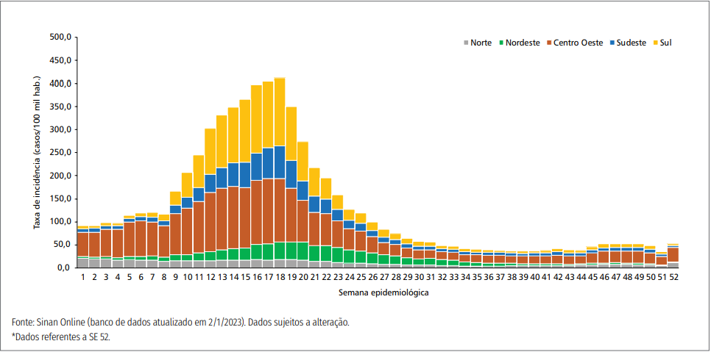
Incidence of dengue in Brazil by regions.
https://www.gov.br/saude/pt-br/centrais-de-conteudo/publicacoes/boletins/epidemiologicos/edicoes/2023/boletim-epidemiologico-volume-54-no-01/@@download/file/Boletim_epidemiologico_SVS_1_v2.pdf

Slide 20
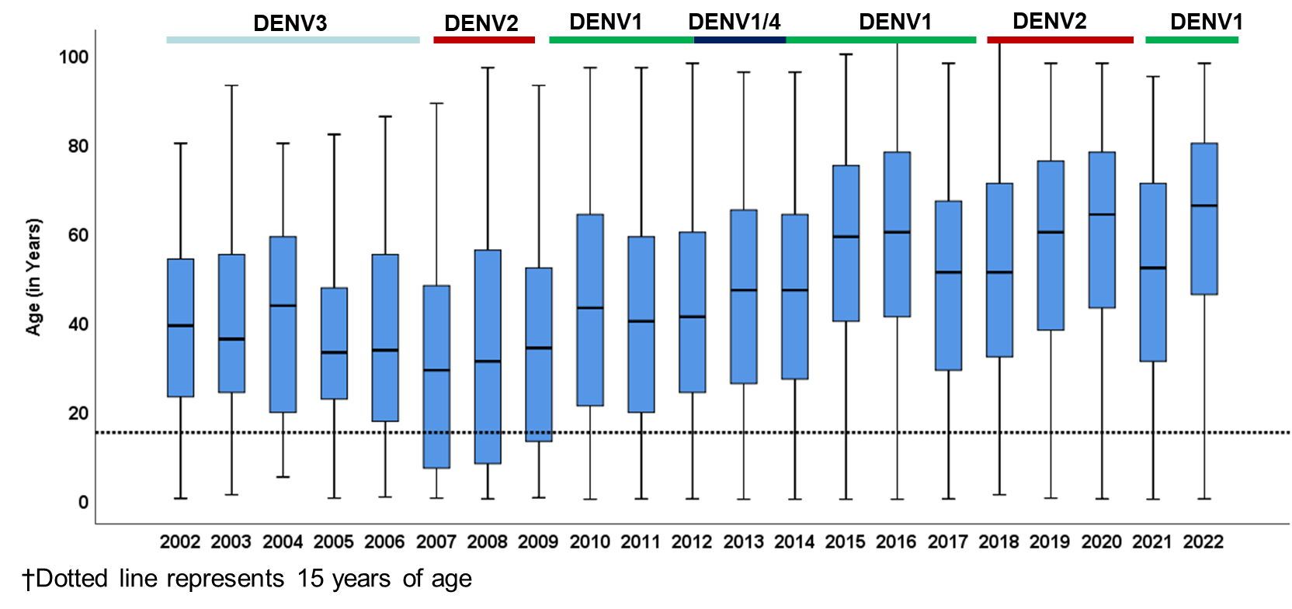
Óbitos por dengue Dengue, Brazil, 2002 – 2022†
Source: Notifiable Diseases Information System (Sinan/SVS).
Data updated and expanded from http://plataforma.saude.gov.br/anomalias-congenitas/boletim-epidemiologico-SVS-33-2020.pdf
Notes:
17:51
Teixeira MG, et al. Emerg Inf Dis 2008
JBS to add more recent data
2007 – dengue 2. Severe infection not seen since then; moved to dengue 1 and older adults

Slide 21
Dengue.
Dengue is a viral infection caused by the dengue virus (DENV), transmitted to humans through the bite of infected mosquitoes.
About half of the world's population is now at risk of dengue with an estimated 100–400 million infections occurring each year.
Dengue is found in tropical and sub-tropical climates worldwide, mostly in urban and semi-urban areas.
While many DENV infections are asymptomatic or produce only mild illness, DENV can occasionally cause more severe cases, and even death.
Prevention and control of dengue depend on vector control. There is no specific treatment for dengue/severe dengue, and early detection and access to proper medical care greatly lower fatality rates of severe dengue.
WHO.

Slide 22
Dengue.If symptoms occur, they usually begin 4–10 days after infection and last for 2–7 days. Symptoms may include:
high fever (40°C/104°F)
severe headache
pain behind the eyes
muscle and joint pains
nausea
vomiting
swollen glands
rash.

Slide 23
Dengue. Severe dengue/ dengue with warning signails symptoms often come after the fever has gone away:
severe abdominal pain
persistent vomiting
rapid breathing
bleeding gums or nose
fatigue
restlessness
blood in vomit or stool
being very thirsty
pale and cold skin
feeling weak.
Shock, respiratory distress, organ failure.
WHO.

Slide 24
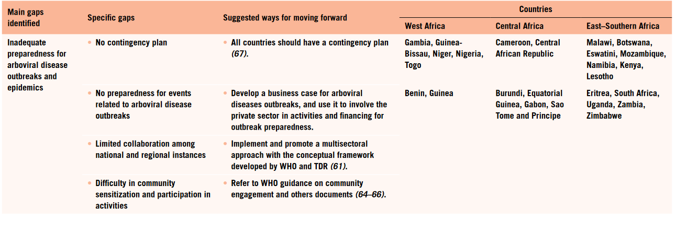
In Africa – gaps.
Surveillance and control of arboviral diseases in the WHO African region: assessment of country capacities.
Geneva: World Health Organization; 2022. Licence: CC BY-NC-SA 3.0 IGO.

Slide 25
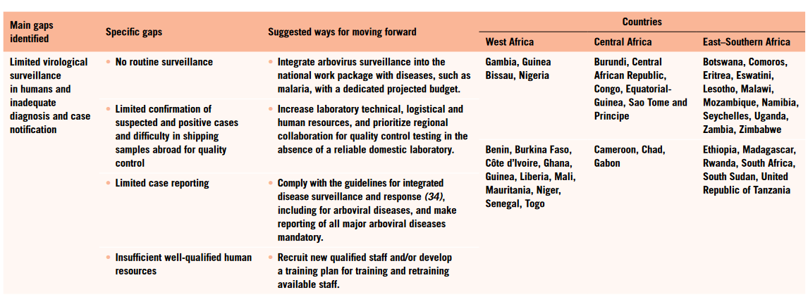
In Africa - gaps.
Surveillance and control of arboviral diseases in the WHO African region: assessment of country capacities.
Geneva: World Health Organization; 2022. Licence: CC BY-NC-SA 3.0 IGO.

Slide 26
Thanks.

Slide 27

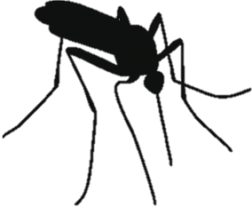
Global change & the ecology of arboviral diseases
Jamie Caldwell, PhD
Notes:
thinking about disease not just as it affects people but the broader context which allows diseases to emerge and spread at a given location and time.

Slide 28







Pathogens are embedded in ecological communities
Hosts and vectors
Environment
Pathogens
Notes:
Environmental component is changing rapidly…

Slide 29
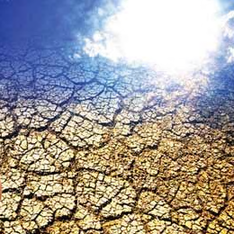

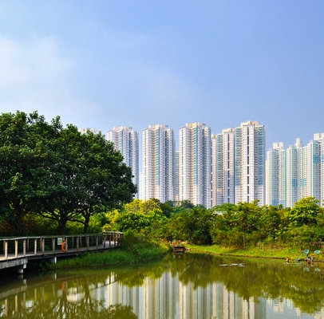
Environment
Hosts and vectors
invasive species
Pathogens
Notes:
…in the form of climate change, population growth, and urbanization, by understanding how these three components interact we can start to understand how changes in one component such as environment can change the other components

Slide 30
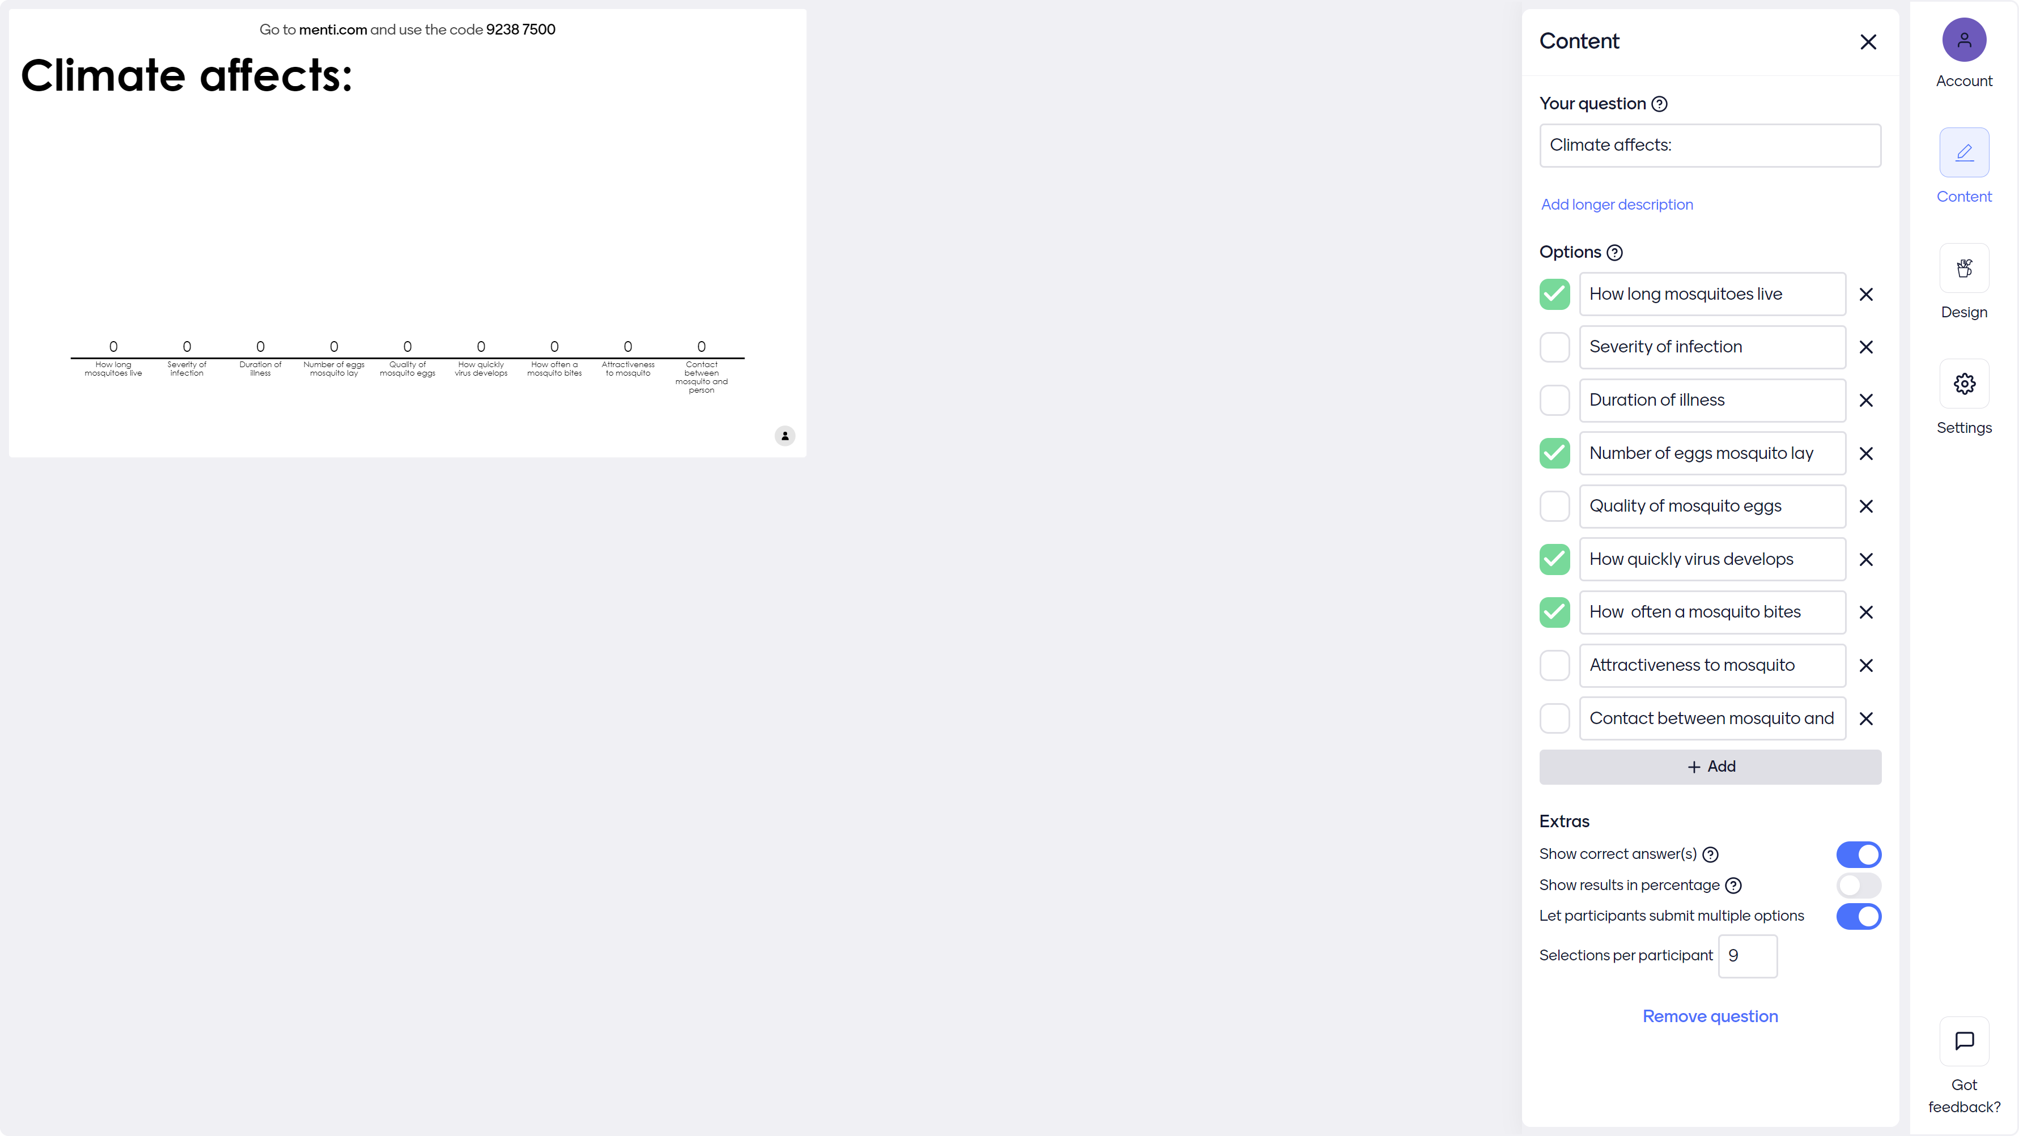

Slide 31
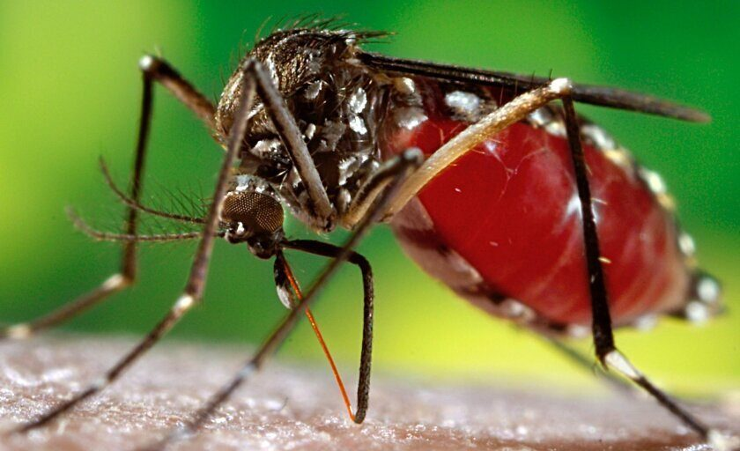
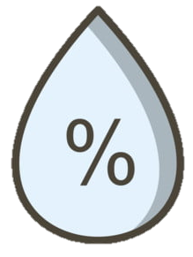

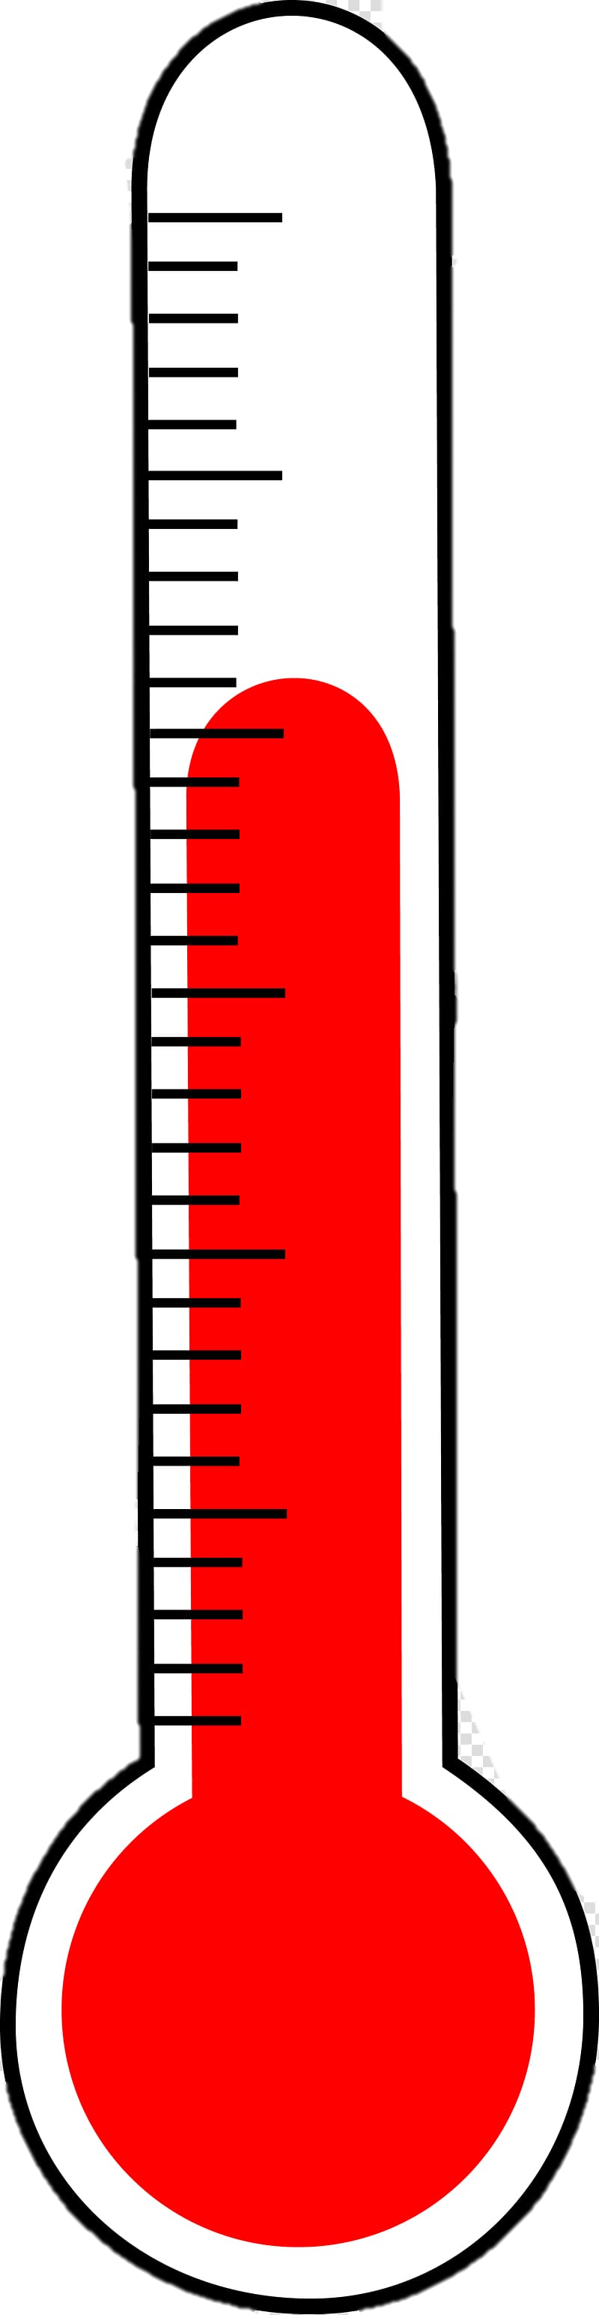
Image: Vector Disease Control International
Notes:
Ecology of Ae. Aegypti specifically

Slide 32
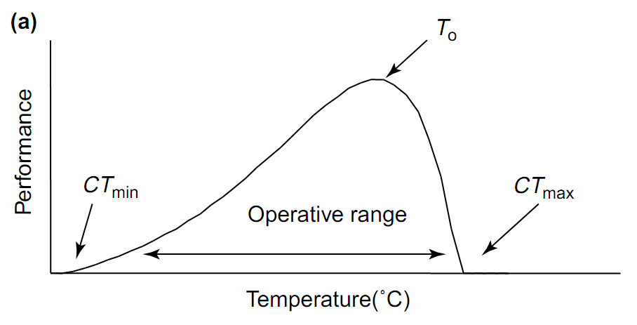

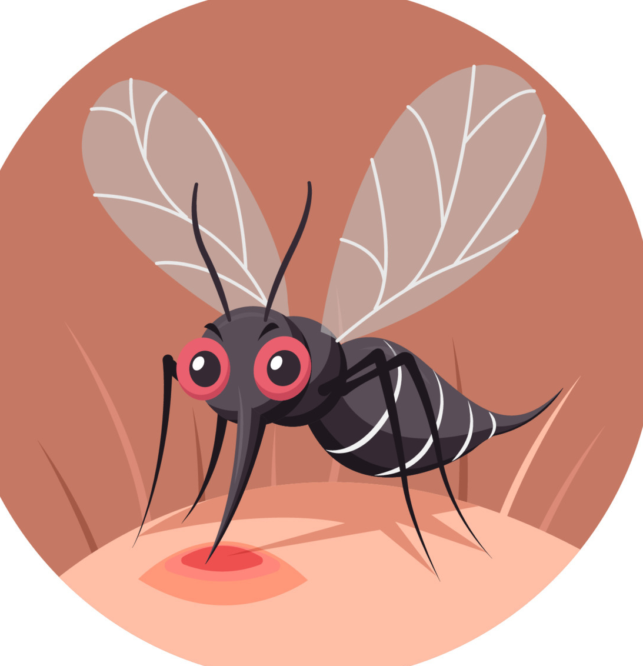
Metabolic traits linked to temperature
Dell et al. 2011, Thomas & Blanford 2003, and many others
Notes:
https://journals.plos.org/plosntds/article?id=10.1371/journal.pntd.0005568
Ectotherms can’t regulate their own temperature

Slide 33
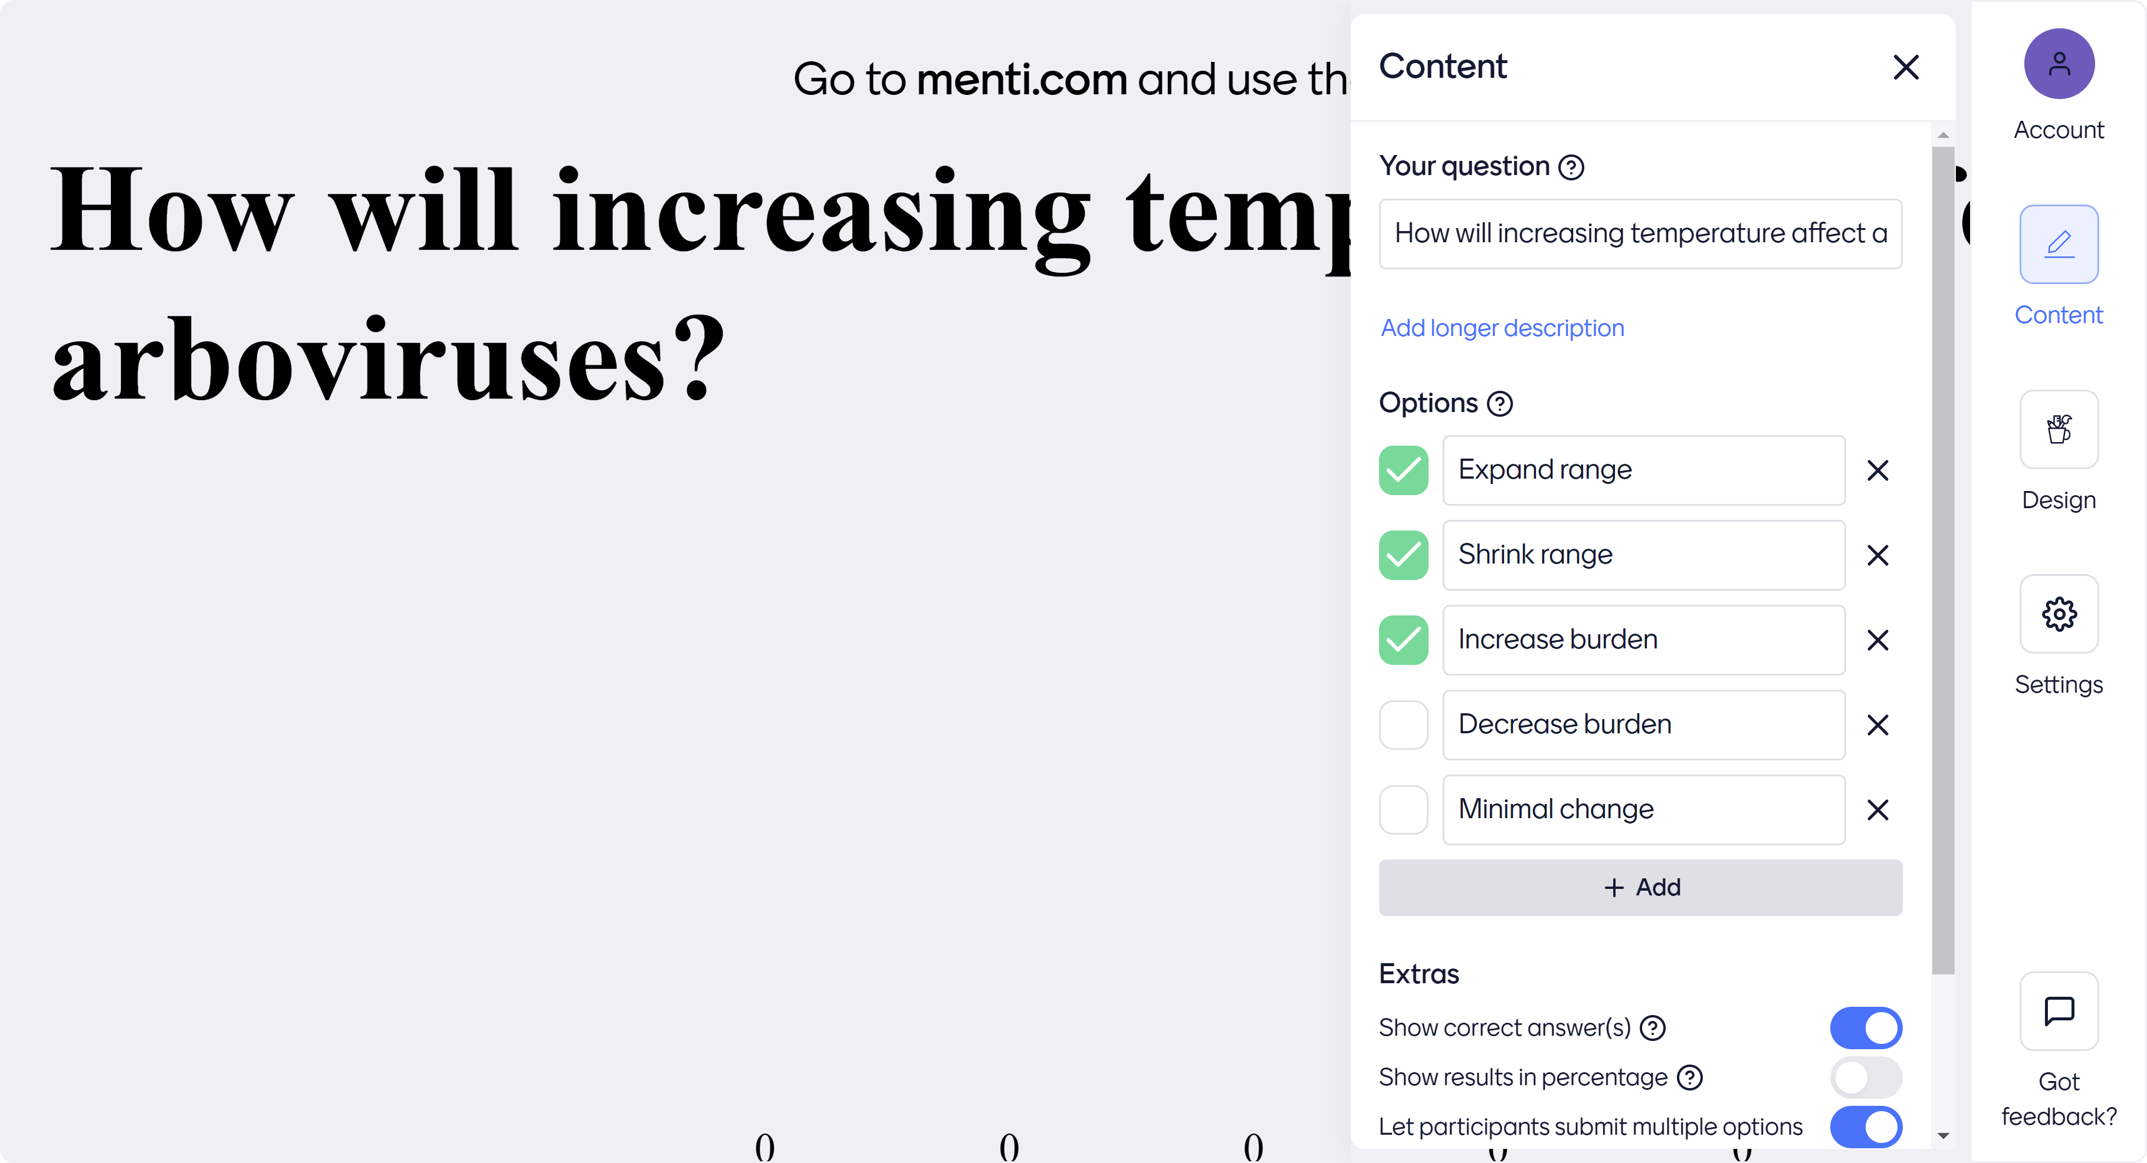

Slide 34
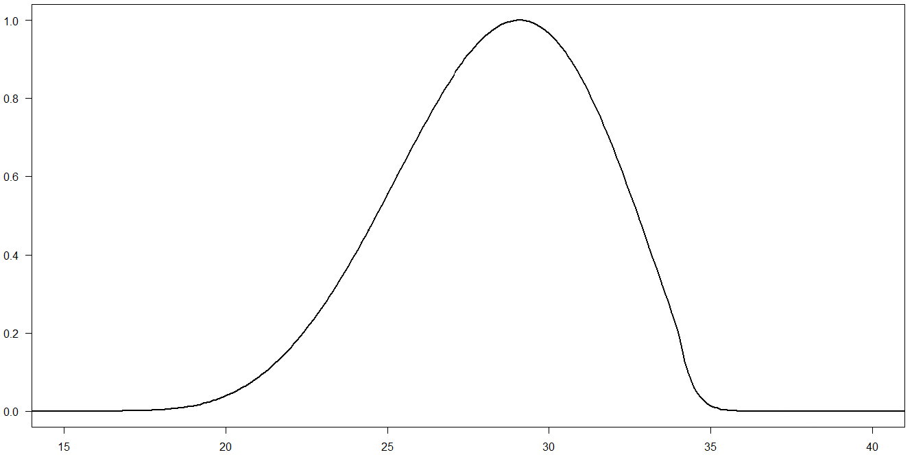
Transmission linked to temperature
1.0
Too cold
Too hot
0.5
Transmission potential
0.0
15
20
25
30
35
40
Temperature (°C)
Notes:
Use model to transform changes in temperature into changes in transmission

Slide 35
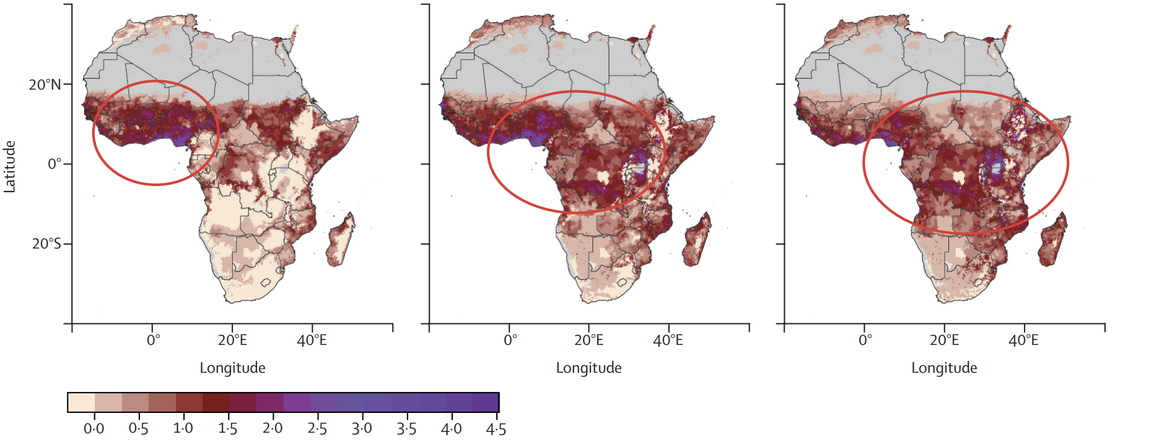
Climate suitability should expand for arboviruses
Current
2050
2080
Highly suitable months/year
Notes:
https://www.sciencedirect.com/science/article/pii/S2542519620301789
Shift in burden, but doesn’t necessarily mean fewer people at risk because expansion is happening in places with greatest rates of population increase and urbanization

Slide 36
Key take-aways
Arboviruses are sensitive to climate because of mosquito and virus physiology
Climate affects all traits important for growth, development, and transmission
Because these traits are non-linear, future burden will be context-dependent

Slide 37

“If you think you’re too small to make a difference… try sleeping with a mosquito in the room”
- Dalai Lama
Notes:
These tiny organisms have a disproportionately important impact on our society today and will continue to do so in the future

Slide 38
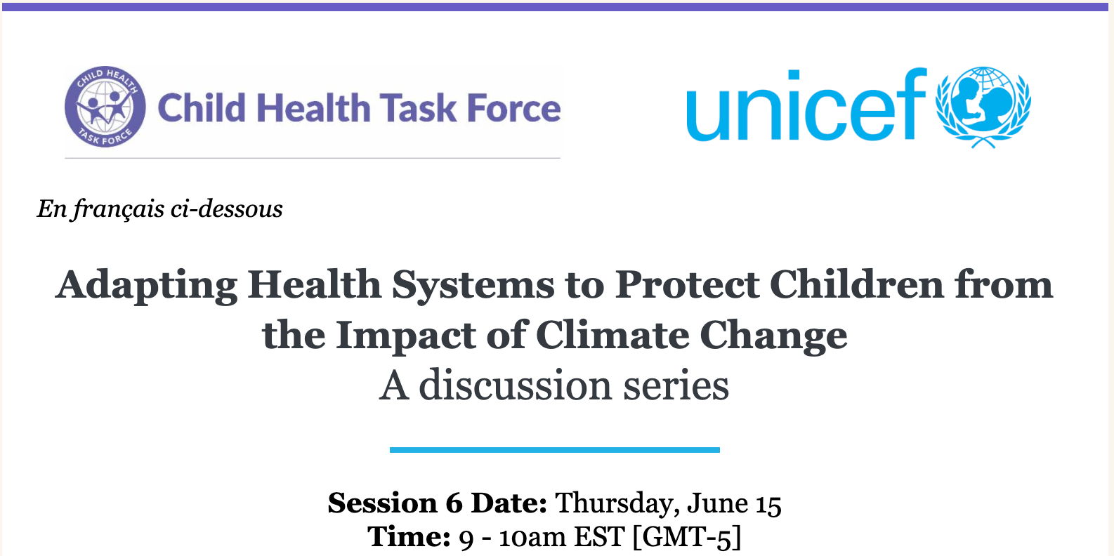
LEGOS (Lead by Empowering Groups to Optimize Solutions)
A Pediatric Cardiology Network from Northeast Brazil
Sandra S. Mattos, MD PhD
ssmattos@cardiol.br
@dra.sandramattos

Slide 39
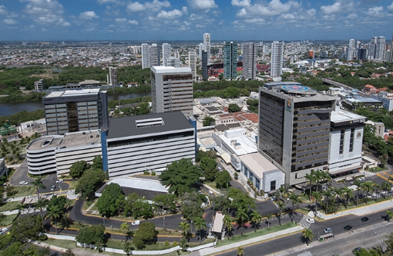

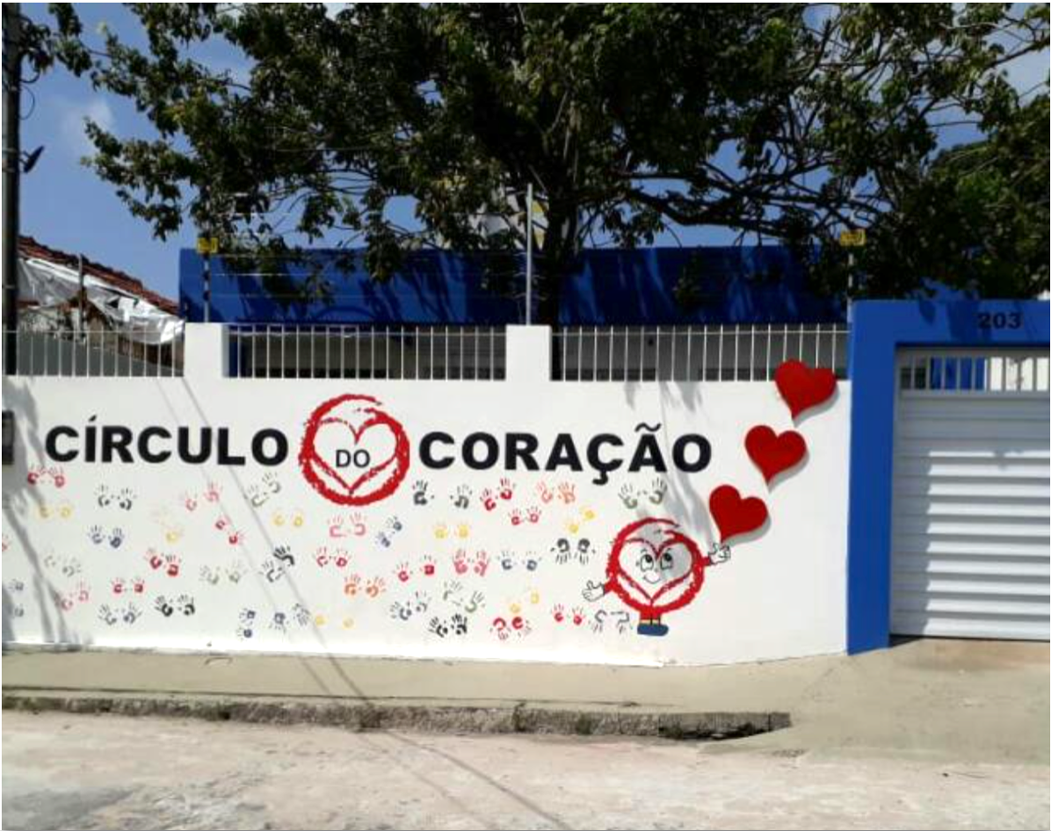




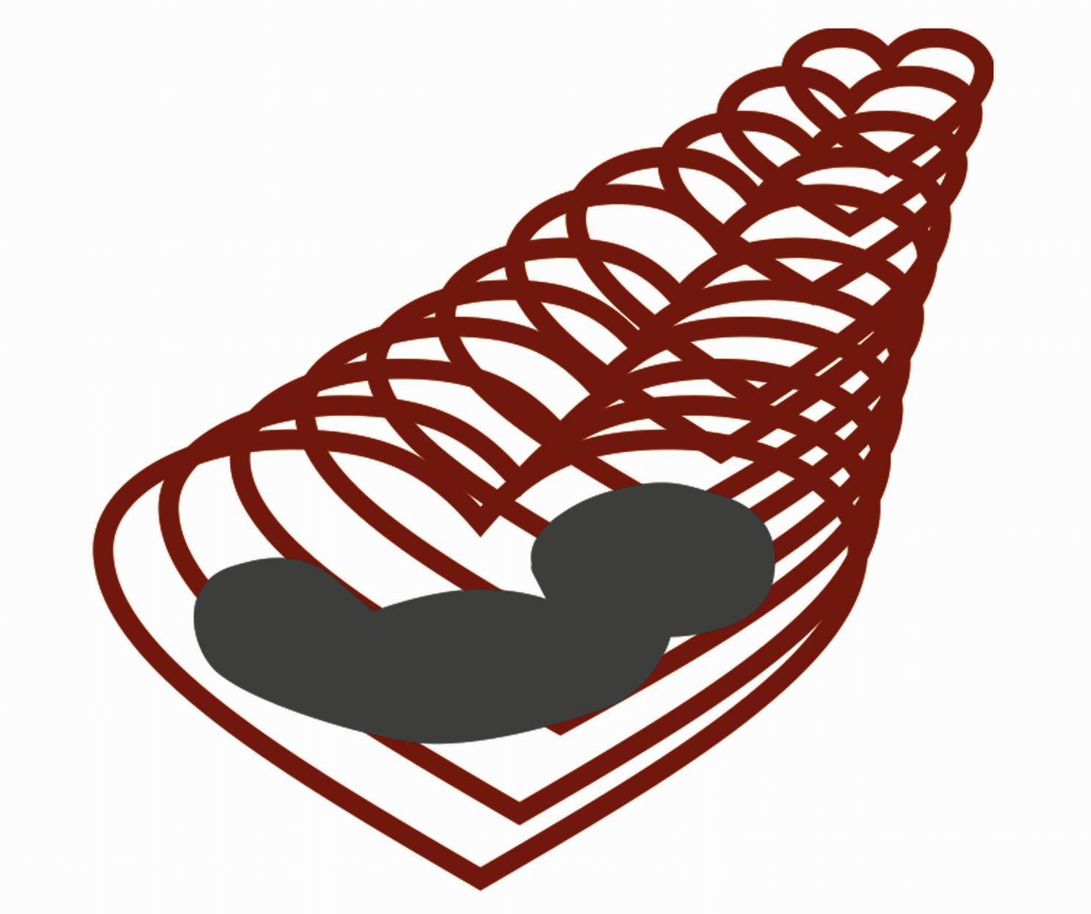


C
C
C
C
C
C
Célula C
UCMF-CADUCEUS-CIRCOR
Desde 1994, uma equipe que trabalha com o coração
HEALTH CARE
EDUCATION
SOCIAL RESPONSABILITY
UCMF
CADUCEUS
CIRCOR

Slide 40
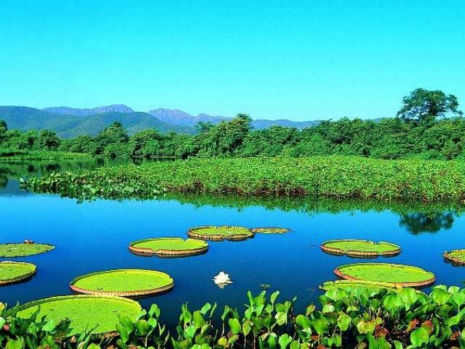
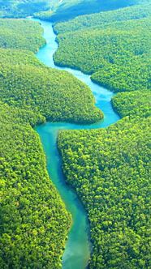
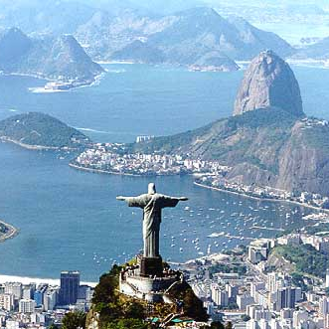
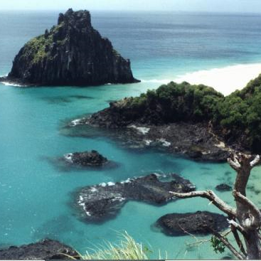
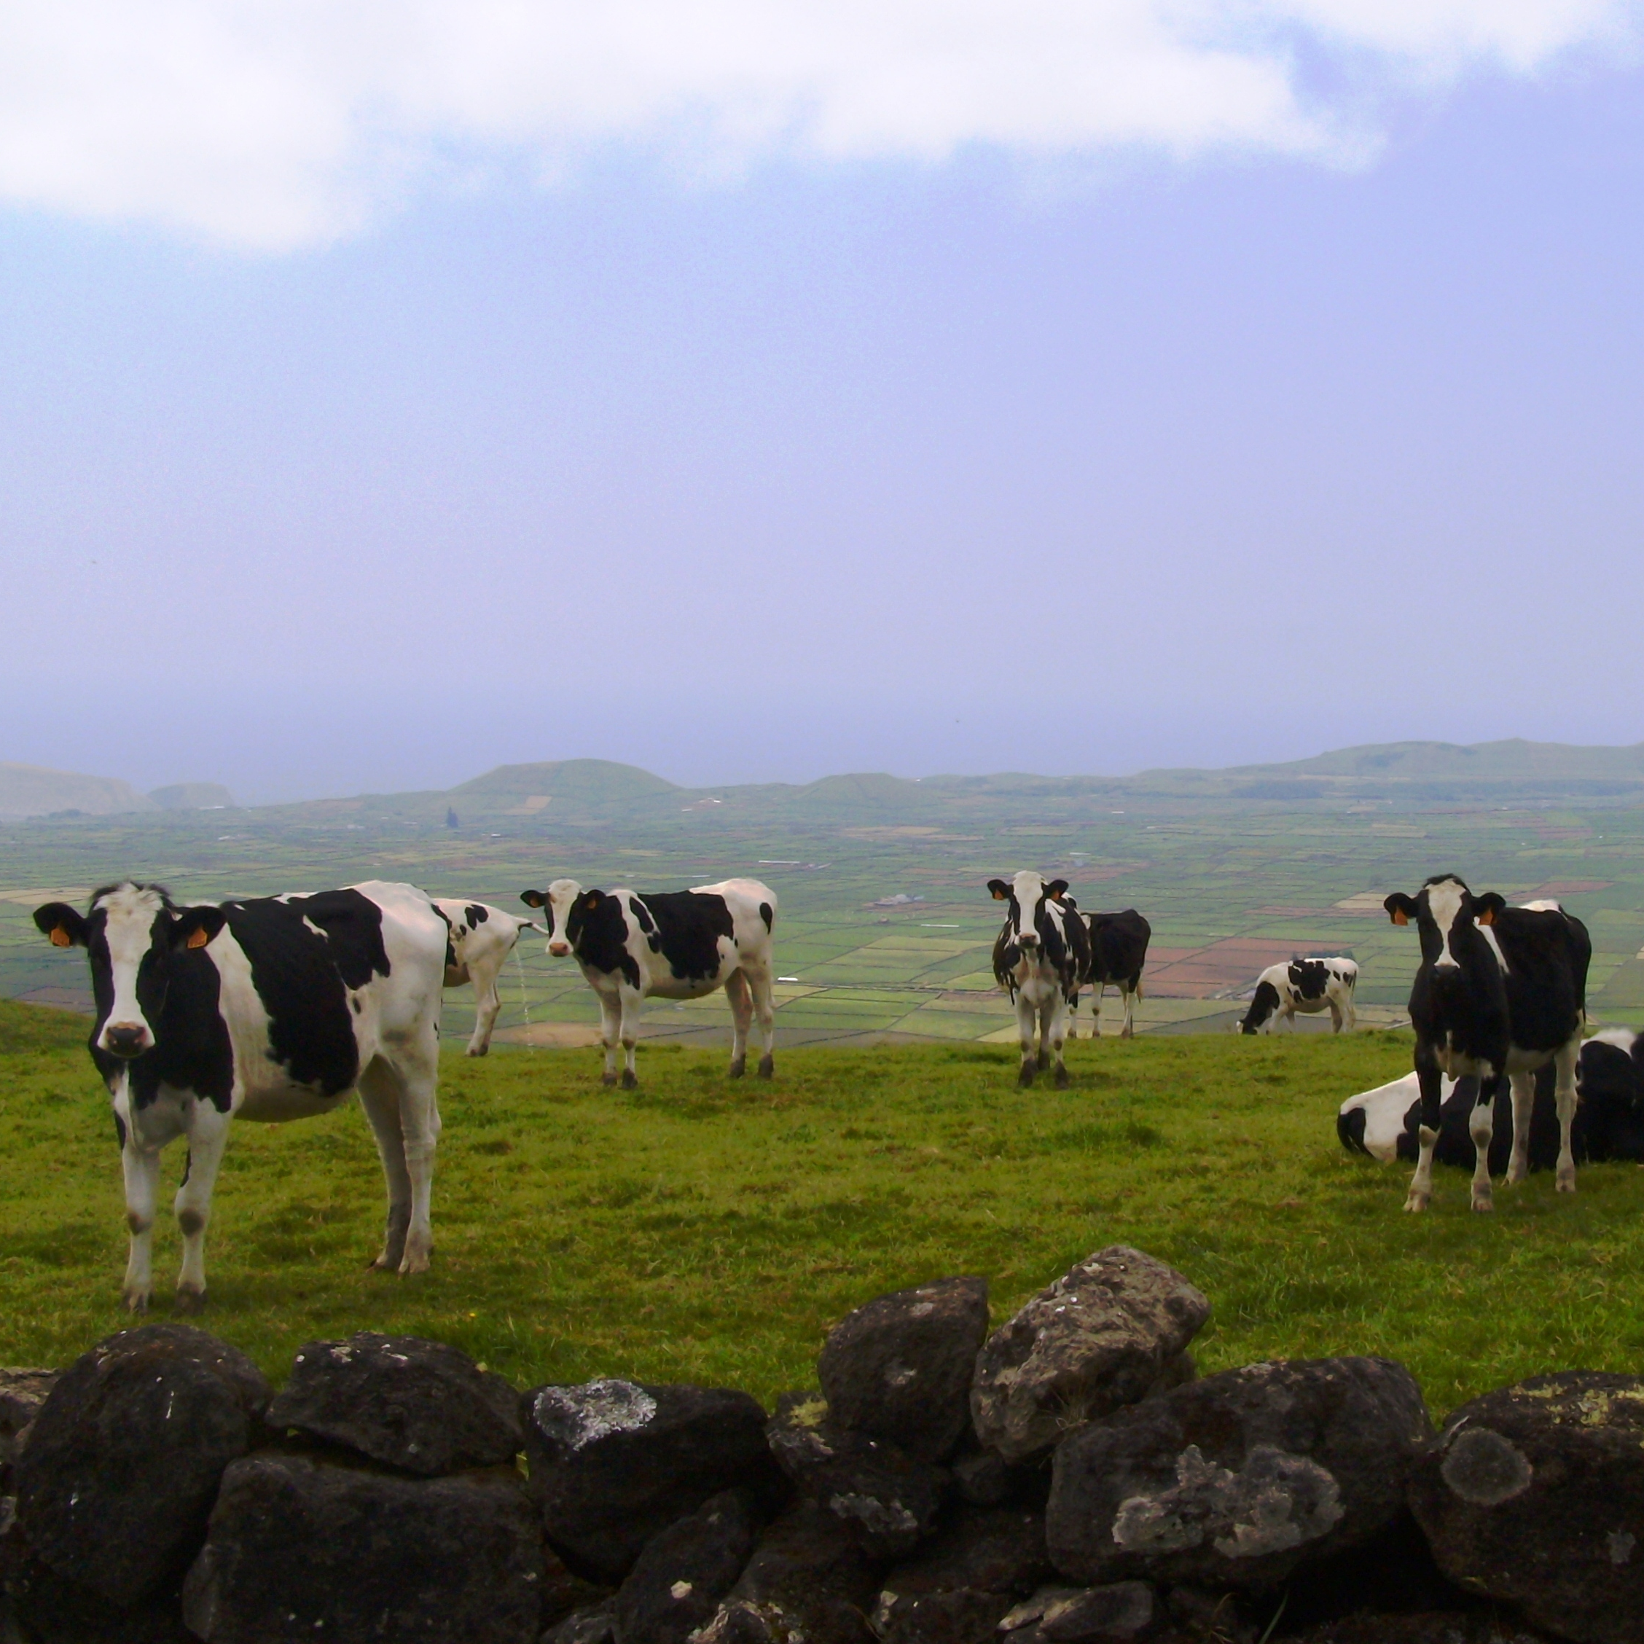
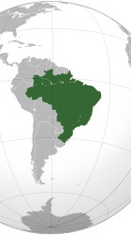
Brazil

Slide 41
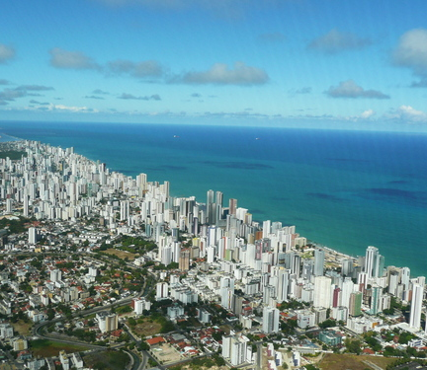
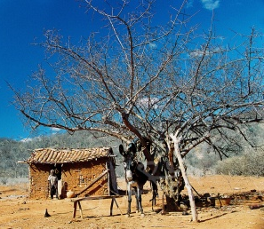
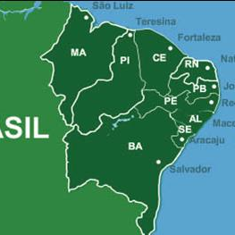
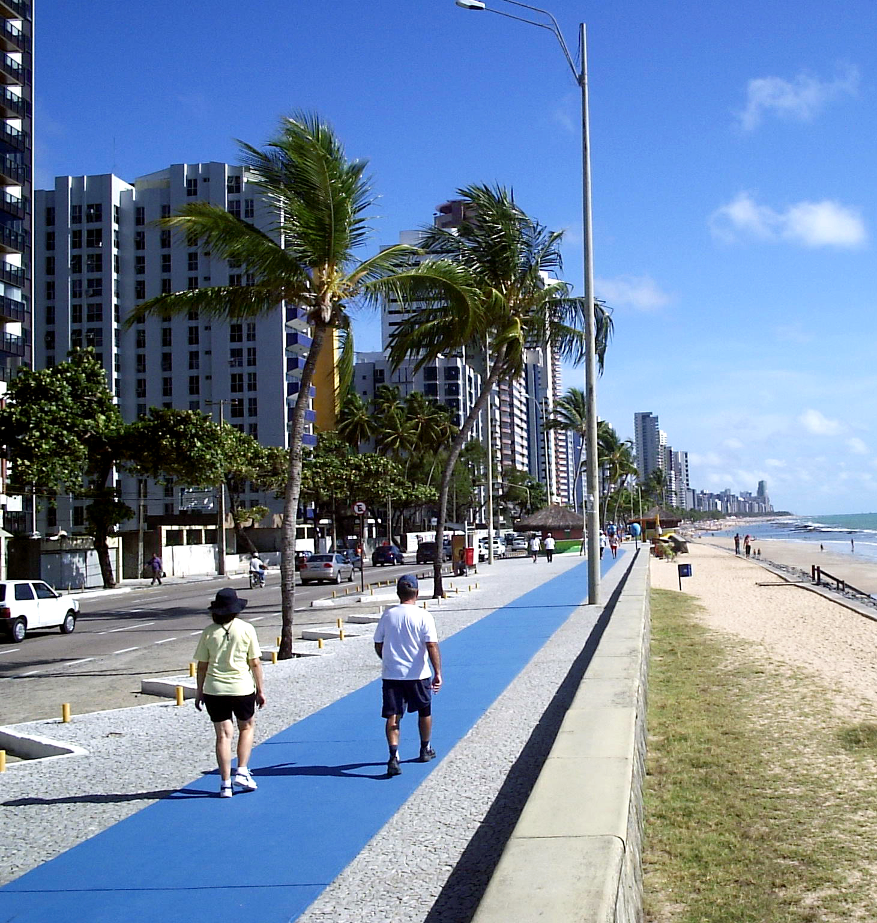
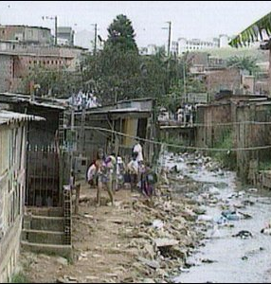

Slide 42
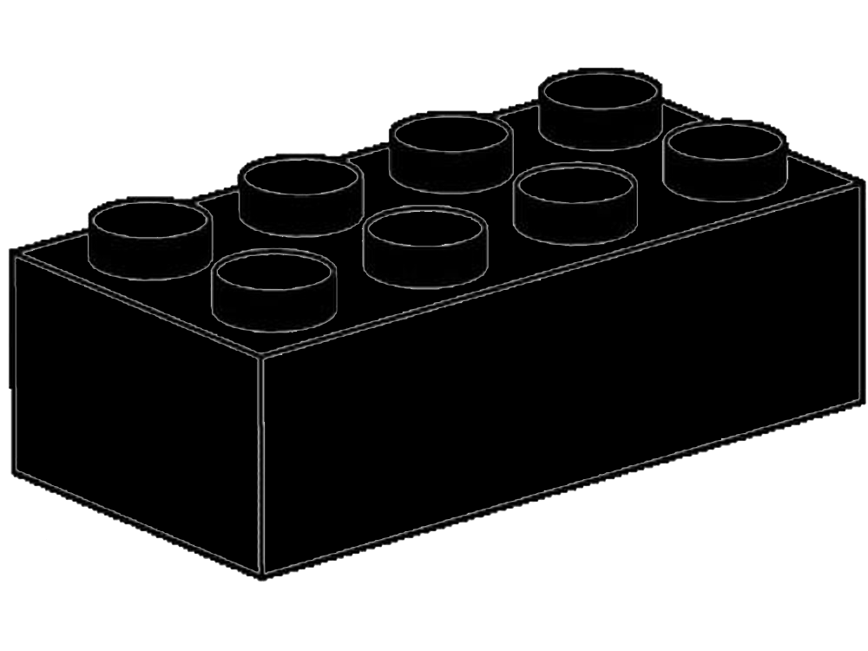



Challenge
Problem
COMPLEX
HIGH COST
LACK OF RESOURCES
CONGENITAL
HEART
DISEASE
42

Slide 43
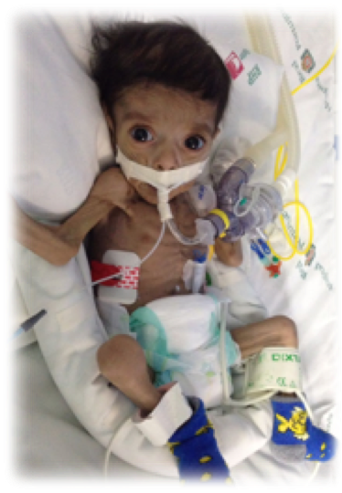
Challenge
Problem
COMPLEX
HIGH COST
LACK OF RESOURCES
LONG WAITING LISTS
TRANSFERRALS
CLINICAL DETERIORATION
LEGAL ACTION
EXTRA ECON & HUMAN COSTS
LATE DIAGNOSES
POORER RESULTS
Elevated morbidity and mortality
of children with CHD
43

Slide 44
Challenge
Problem
44

Slide 45
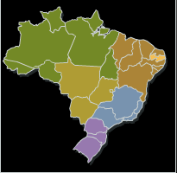
LEGOS experience in Northeast Brazil
Paraíba - João Pessoa
Pop. 3,815,171
Size: 21,847.4 sq mi
223 municipalities
14 Health Districts
Pernambuco – Recife
Pop. 8,931,028
Size: 37,958.327 sq mi
185 municíppalities
12 Health Districts

Slide 46

Proposed solution
Solution
Screening
Care
Continuous Health
Education

Slide 47


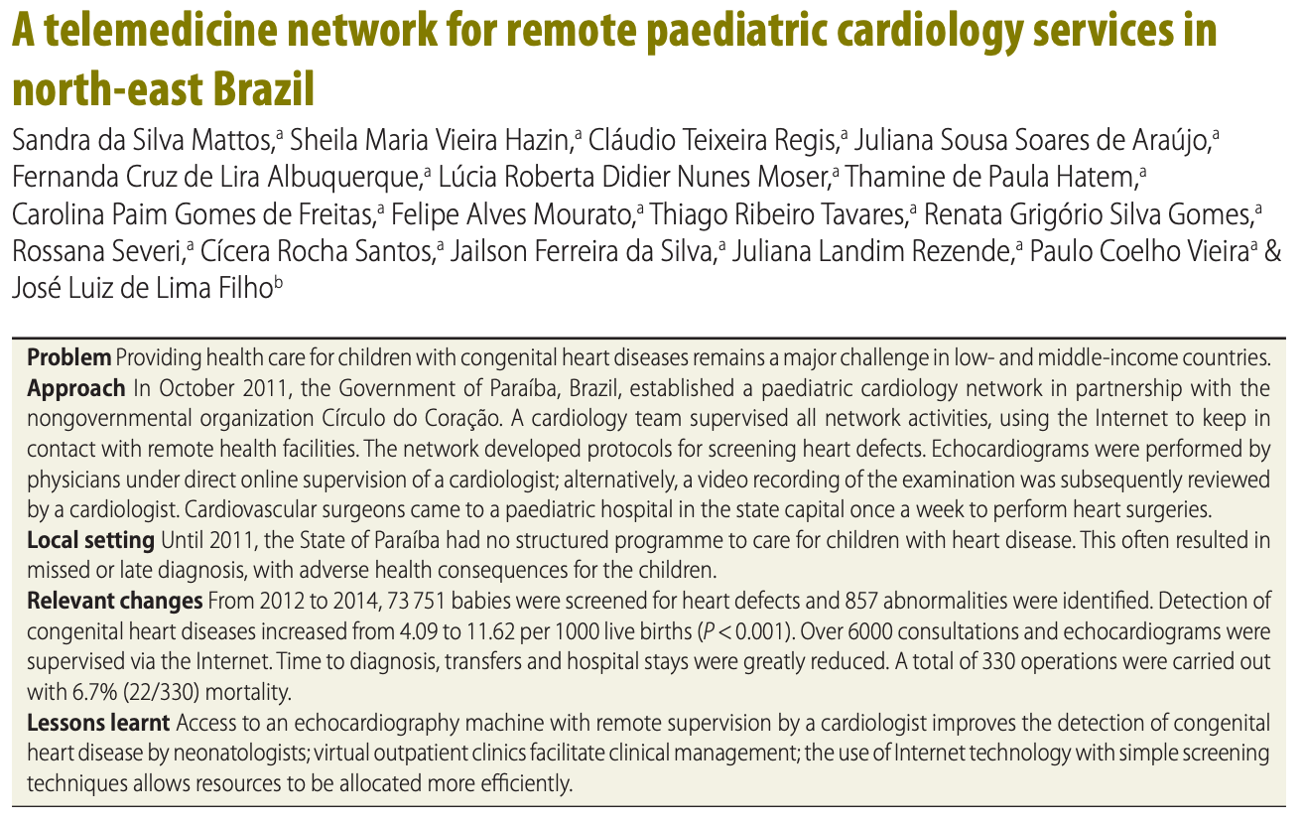

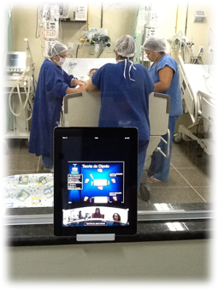







Methods
Empower
Lead
Web database/services
Network of Services
CARE
Cardiologists
on-call online
24/7
L2 Screen
ECHO
L1 Screen
PE+APO
NETWORK
PROTOCOLS
Mattos et al. Bull World Health Organ 2015;93:881–887

Slide 48





Results
Solution
ªAraújo et. al. Rev Bras Cardiol. 2014;27(1):13-19
^{b}Mattos et al. Bull World Health Organ 2015;93:881–887

Slide 49

Challenge
Group
Problem
How to identify older children with heart disease?

Slide 50





Heart Caravans
Solution
Solution
Solution
Empower
Lead
1. Active search for children with heart disease
2. Training local professionals and educating patients
3. Expansion into other health activities
2013
36 volunteers
2018
120
volunteers
2013
≈ 500 pat. 0 trainees
2018
≈ 2000 pat.
≈ 2000 tr.

Slide 51
Challenge
Group
Problem
How to facilitate access to care and help patients adhere to protocols?

Slide 52

Heart Rooms and Echo Taxis
Empower
Lead

Slide 53

Heart Rooms and Echo Taxis
Empower
Lead

Slide 54


Heart Rooms and Echo Taxis
Empower
Lead

Slide 55


Heart Rooms and Echo Taxis
Empower
Lead

Slide 56
Heart Rooms and Echo Taxis
Empower
Lead

Slide 57
Heart Rooms and Echo Taxis
Empower
Lead

Slide 58
Heart Rooms and Echo Taxis
Empower
Lead

Slide 59
Heart Rooms and Echo Taxis
Empower
Lead
4 weeks – 12 new OPC

Slide 60


Heart Rooms and Echo Taxis
Solution
Empower
Lead
4 weeks – 12 new OPC

Slide 61


Pediatric Cardiac Surgeries
Solution
Empower
Lead

Slide 62

PC Network
Empower
Lead
Current version: 21 maternities and a hospital

Slide 63
Results
Empower
Lead
1-2 CHD
Network of Services
CARE
Leve II screening 13.283
5 in each 100
Leve I screening
215.573
> 96% newborns
LII SCREENING
LI screen.
NETWORK
PROTOCOLS
> 8.000 trainnes

Slide 64


Other challenges
Group
Problem
Can the Network help in the microcephaly outbreak?
Soares de Araújo J et al. Bull World Health Organ 2016;94:835–840

Slide 65


Other challenges
Group
Problem
Can the Network help in the microcephaly outbreak?
Multidisciplinary teamcall
Soares de Araújo J et al. Bull World Health Organ 2016;94:835–840

Slide 66
LEGOS NETWORK results
Over 200.000 children screened for HD
Detection rates (4.09 to 14.93 per 1000; p < 0.001)
Operations 532 local; over 800 referrals
Time to diagnosis, transferals and hospital stays
No legal action
EchoTaxi => 12 new OPC per month – local follow-up
Expanded to cover other public health needs
Continuous Health Educational Program in Paraíba
Technology used in remote sites
Decrease in neonatal mortality

Slide 67

LEGOS NETWORK results
Over 200.000 children screened for HD
Detection rates (4.09 to 14.93 per 1000; p < 0.001)
Operations 532 local; over 800 referrals
Time to diagnosis, transferals and hospital stays
No legal action
EchoTaxi => 12 new OPC per month – local follow-up
Expanded to cover other public health needs
Continuous Health Educational Program in Paraíba
Technology used in remote sites
Decrease in neonatal mortality

Slide 68
CLIMATE
CHANGE
ARBOV
CHD
ssmattos
LEGOS

Slide 69
LEGOS
NETWORK
CONGENITAL
HEART
DISEASE
ARBOVIROSES
MATERNAL
HEALTH
CLIMATE CHANGE
PERINATOLOGY
ssmattos
LEGOS

Slide 70
LEGOS
Financial
Medical
Academic
Thank you

Slide 71

Collection of resources can be found on our events page
Series webpage: https://www.childhealthtaskforce.org/events/2022/11/adapting-health-systems-protect-children-impact-climate-change-series

Slide 72


Climate Change and
Child Health Discussion Series
Engage with the moderators:
Cara Endyke Doran: cendykedoran@globalcommunities.org
Swathi Manchikanti: smanchikanti@unicef.org
Reach out to the Child Health Task Force Secretariat: childhealthtaskforce@jsi.com
Healthy Environment Healthy Children Framework: https://www.unicef.org/media/91631/file/Healthy-Environments-for-Healthy-Children-Global-Programme-Framework-Summary.pdf
CCRI:
https://www.unicef.org/reports/climate-crisis-child-rights-crisis
Subgroup information, recordings and presentations from previous webinars are available on the subgroup page of the Child Health Task Force website: www.childhealthtaskforce.org/subgroups/expansion

Slide 73
The Child Health Task Force is managed by JSI Research & Training Institute, Inc. through the USAID Advancing Nutrition project and funded by USAID and the Bill & Melinda Gates Foundation.
This presentation was made possible by the generous support of the American people through the United States Agency for International Development (USAID), under the terms of the Contract 7200AA18C00070 awarded to JSI Research & Training Institute, Inc. The contents are the responsibility of JSI and do not necessarily reflect the views of USAID or the U.S. Government.

