Slide 1



PMI IMPACT MALARIA
Showcasing the
iCCM Institutionalization Toolkit
Child Health Task Force Webinar
September 19, 2023
PMI Impact Malaria is the flagship global service delivery project of the U.S. President’s Malaria Initiative (PMI)
Photo credit: Mwangi Kirubi, PMI Impact Malaria

Slide 2

Why is the iCCM Institutionalization Toolkit needed?
iCCM remains a key strategy to address child morbidity and mortality in areas with limited health facility access
Achieving UHC and reaching the child health SDG targets will require strong PHC systems
Institutionalization is crucial to achieving these goals

Slide 3

Why is the iCCM Institutionalization Toolkit needed?
Few countries have scaled-up, integrated and sustained iCCM services to date
Few resources are tailored specifically to advancing institutionalization
Stakeholders are interested in new ideas and learning from other countries
Overcoming longstanding challenges to iCCM institutionalization requires engagement by a diversity of stakeholders
Photo Credit: USAID Nigeria

Slide 4
Purpose
Provide country level influencers with guidance, resources and tools to progress through the process of institutionalization:
Assessing the landscape and strategizing approaches appropriate to a particular country context;
Inspiring new ways of thinking about influencing health system change.
Intended Audience
Country level policy makers, national program mangers and other key influencers:
Primarily government officials from Ministries of Health, Finance and others as relevant;
Professional associations and other technical agencies with national influence;
Health sector partners in supportive roles;
+ Encouraging engagement of actors beyond traditional iCCM project oriented initiatives.

Slide 5
Process of Development
Phase 1: Preparatory Phase
Review of existing iCCM literature and tools
Develop definition + framework
Stakeholder consultations to validate definition + framework
Critical analysis of existing iCCM tools and gaps in available tools to support institutionalization
Oct. 2021
Apr. 2022
Sept. 2023
Phase 2: Development Phase
Formation of iCCM Institutionalization Toolkit Advisory Group
Toolkit design + content development
Iterative stakeholder consultations and feedback
Digitization + finalization
Global webinar

Slide 6
iCCM Institutionalization Toolkit Advisory Group
Ajay Gambhir, National Board for Quality Promotion (NABQP), India
Amsalu Zeleke, WHO/Ethiopia
Anaclet Ngabonzima, JSI/USA, MOMENTUM Integrated Health Resilience
Annē Linn, USAID/HQ, iCCM Subgroup Co-Chair
Camlus Odhus, UNICEF/Kenya
Dyness Kasungami, JSI/USA, Child Health Task Force Secretariat
Ephraim Kumi Senkyire, Ministry of Health Ghana
Humphreys Nsona, Ministry of Health, Malawi, iCCM Subgroup Co-Chair
Megan Christensen, UNICEF/HQ, iCCM Subgroup Co-Chair
Nefra Faltas, USAID/HQ
Seynabou Gaye Faye, Ministry of Health, Senegal
Tigist Daniel, Ministry of Health, Ethiopia
Yvette Ribaira, JSI/USA, MOMENTUM Integrated Health Resilience
Notes:
The toolkit was developed by the U.S. President's Malaria Initiative (PMI) Impact Malaria Project in collaboration with the Child Health Task Force (CHTF). Guidance and input was provided throughout by the iCCM Institutionalization Toolkit Advisory Group, which was comprised of members of the CHTF’s iCCM Subgroup, emphasizing inclusion of those working at a country level, particularly officials from Ministries of Health. There has been sustained engagement of the Advisory Group from June 2022 – September 2023 with ≥12 meetings to review and provide input to progressive iterations of toolkit content, design and tools.

Slide 7
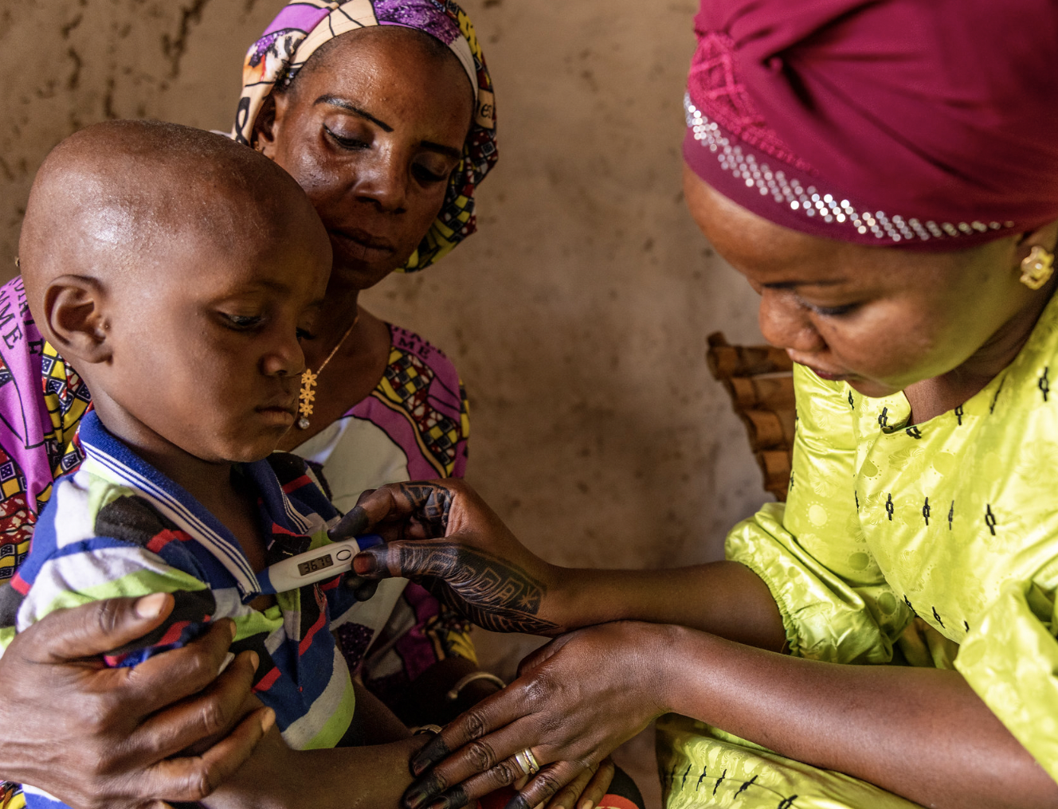

iCCM Institutionalization Definition
“A process and end state by which iCCM becomes an integral, routine and stable part of both community and health systems.”
Photo Credit: Mwangi Kirubi, PMI Impact Malaria
& Munia Ismail, PMI/MSH

Slide 8
iCCM Institutionalization Framework
Institutionalization Drivers:
Core Values; Leadership & Governance; Resources; Policy.
iCCM Essential Components:
Coordination & Policy Setting;
Costing & Financing;
Human Resources;
Supply Change Management;
Service Delivery and Referral;
Comms and Social Mobilization;
Supervision and Quality Assurance;
M&E/HMIS.
Notes:
Institutionalization Phases:
Awareness: recognizing need to change approach for management of childhood illnesses and option of iCCM.
Experimentation: testing what works with the iCCM approach through projects or other small-scale initiatives.
Expansion: increasing scale of iCCM implementation (i.e. cases managed, geographic/population coverage);
Consolidation: strengthening implementation modalities/support functions and integrating into standard operations;
Maturity: iCCM is integrated into the structure and function of the health system at all levels, including the community (i.e. integral, routine and stable).

Slide 9
Toolkit Overview: Structure
Total of 8 modules structured according to components of the iCCM Institutionalization Framework:
#1: Introduction to iCCM Institutionalization
#5: Policy
#3: Core Values
#6: Resources
#4: Leadership & Governance
#8: Assessing Progress & Adapting
#7: iCCM Essential Components
#2: Preparing for Institutionalization
Notes:
The iCCM Institutionalization Toolkit is intended to be a flexible resource that can be used by a wide range of stakeholders at a country level across a range of country contexts and stages of iCCM introduction or institutionalization. The toolkit is not intended to be a training course nor an implementation guide for institutionalization of iCCM. Instead, the iCCM Toolkit is intended to be a repository of existing resources, distilled guidance from relevant country implementation experience and research as well as bespoke tools developed to support stakeholders in assessing their own country context, identifying priorities and devising strategies to advance iCCM institutionalization. This means that the toolkit will include links to many resources that provide relevant background on the essentials of ICCM; relevant research and existing tools. Additionally, tools and approaches that can be used to assess and shift the enabling environment (i.e. core values, leadership, policy and resources) will be adapted or newly developed. Finally, country case study examples based on existing research and documentation as well as inputs from consultations and the toolkit advisory group inputs will be developed to better highlight key concepts and approaches used to institutionalize iCCM.

Slide 10



Toolkit Overview: Structure
Each module includes:
Introduction to key concepts;
Distilled guidance from country experience and research;
Links to relevant resources (i.e. guidance documents; research papers; adapted and newly developed tools; learning courses);
Country case study examples;
Multimedia and interactive components to communicate key information and provide opportunities for reflection.

Slide 11

Toolkit Overview: Module Content
Preparing for Institutionalization
Determine your country’s iCCM institutionalization starting point;
Identify factors that might enable or inhibit iCCM institutionalization;
Analyze stakeholder positions and resources;
Legitimize change and build constituencies of support.

Slide 12
Toolkit Overview: Module Content
Core Values
Identifying, influencing and leveraging core values within organizations, wider health sector and government.
Leadership & Governance
Defining a vision for iCCM and leading change; recruiting and supporting champions; establishing and leveraging governance mechanisms.
Policy
Mapping the policy environment to identify constraints and gaps; creating a plan to influence policy and leveraging research for policy change.
Resources
Integration with national systems; progressing towards diversified, domestic financing as well as rationalized, recognized and supported CHWs.

Slide 13

Toolkit Overview: Module Content
iCCM Essential Components
Maintaining quality, addressing technical challenges and underlying gaps across the essential components with existing technical guidance and tools;
Considering how advancing institutionalization can support across essential components.
Assessing Progress & Adapting
Institutionalization as an iterative/non-linear process;
Tracking progress and adjusting strategies;

Slide 14
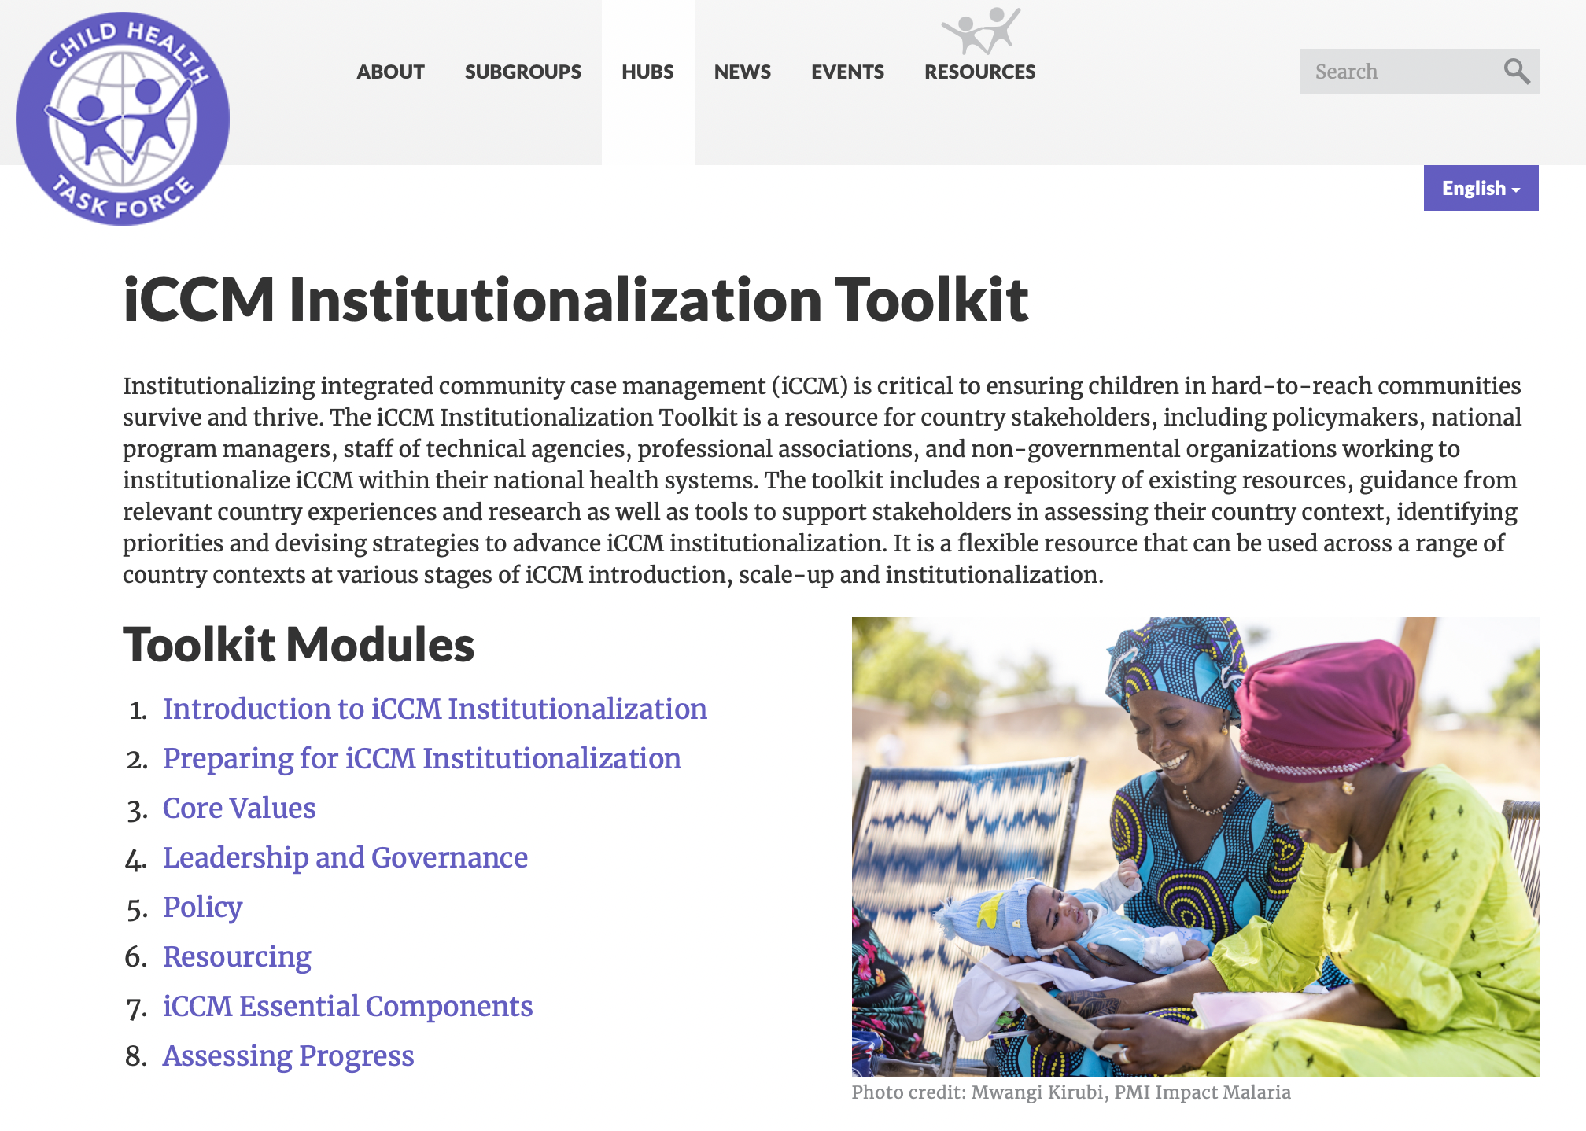
Where to find the toolkit…
Hosted on the Child Health Task Force website: https://www.childhealthtaskforce.org/hubs/iccm/toolkit

Slide 15

How can the toolkit be used?
Can be used by a diversity of individuals, beyond those traditionally engaged in iCCM programs
Can be used formally and informally
Can be used flexibly
Ultimately, meant to advance institutionalization of iCCM within the context of primary healthcare
Photo Credit: Mwangi Kirubi, PMI Impact Malaria

Slide 16
Q&A
PMI Impact Malaria is the flagship global service delivery project of the U.S. President’s Malaria Initiative (PMI)

