Slide 1
CHILD SURVIVAL ACTION
A Results Framework for Accountability, Advocacy and Action
April 2024
Acknowledgements to: Countdown to 2030, Global Financing Facility, JSI, London School of Hygiene & Tropical Medicine, MOMENTUM, PRB, Save the Children, UNICEF, USAID, and WHO

Slide 2
Outline
1
Section 1
Introduction to CSA
2
Section 2
Development of the CSA Results Framework
3
Section 3
CSA Results Framework
Core Set of Indicators
Learning agenda
Equity and Quality
Implementation milestones and indicators
4
Section 4
Next Steps

Slide 3
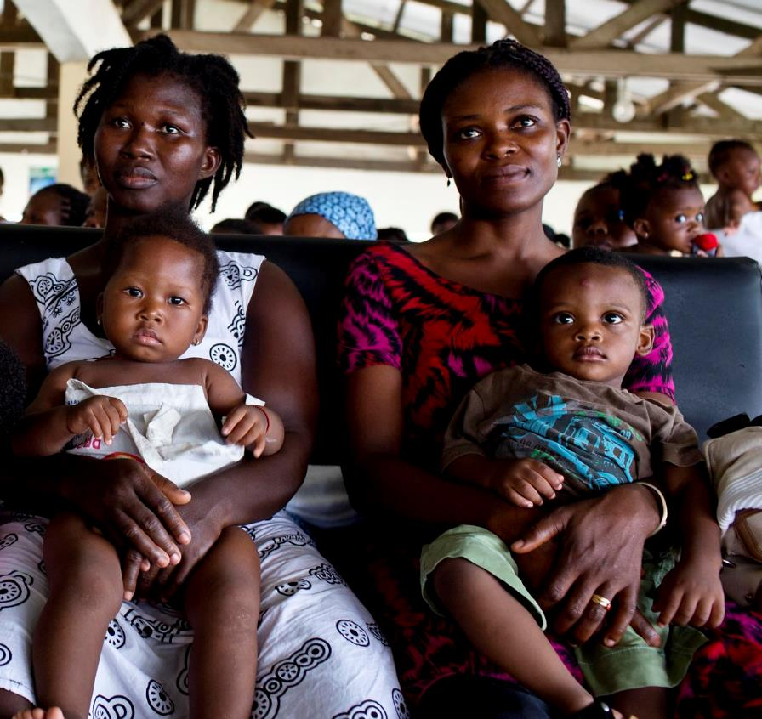
Section 1 Introduction to CSA
Photo: Kate Holt/MCSP Ghana

Slide 4
CSA’s Goal: End preventable child deaths, with focus on children 1–59 months of age
The CSA initiative is a call to partners to address the challenges that have hampered progress in ending preventable child mortality with a focus on high burden countries
Focuses on the countries, over 75% in Africa, that urgently need accelerated efforts to achieve the SDG3 2030 target on child mortality of 25 deaths or fewer per 1000 live births (as of April 2024).
Reaches the children being left behind and at risk from leading killers - pneumonia, diarrhea, and malaria - due to malnutrition, lack of access to quality health services including immunization, unsafe water and sanitation, air pollution, conflict and humanitarian disasters, and other key risks to children’s health and survival.
Strengthens primary health care in facilities and communities to more effectively prevent, diagnose, and treat these causes of child death, and to promote good health and nutrition for all children.
Builds effective partnerships between governments, local partners, civil society, private sector, regional and global organizations, as part of renewed commitment to child survival.
Mobilizes required resources from domestic and international sources and sectors to deliver on this renewed vision for children’s health, nutrition, and survival.

Slide 5
Child Survival Action
Our Goal: End preventable child deaths, with focus on children 1–59 months of age
Accelerate action to reduce mortality throughout the life course continuum
Ending preventable maternal mortality (EPMM)
Every newborn action plan (ENAP)
Child Survival Action (CSA)
Align with efforts by other sectors and programmes
Air pollution

Slide 6
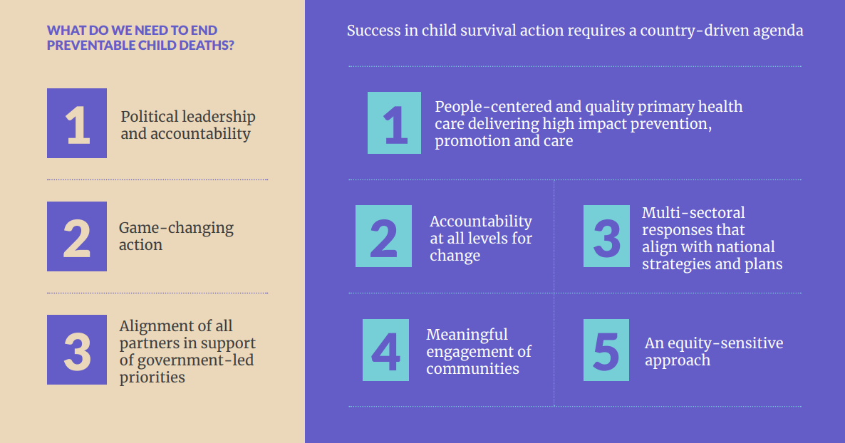
What are the strategies of the Child Survival Action?

Slide 7
Section 2 Development of the CSA Results Framework
Photo: MOMENTUM; IMA World Health

Slide 8
Why a CSA Results Framework?
Advocacy & Accountability
Action
Use impact and coverage indicators to raise awareness and financing at the global and country levels
Engage and coordinate with partners in countries to collectively work toward common goals
Plan programming, inform resource allocation, and track implementation

Slide 9
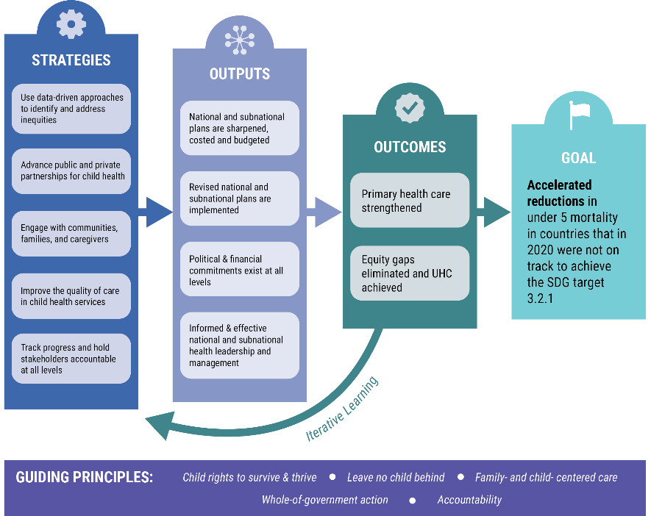
Child Survival Action: Theory of Change (TOC)

Slide 10
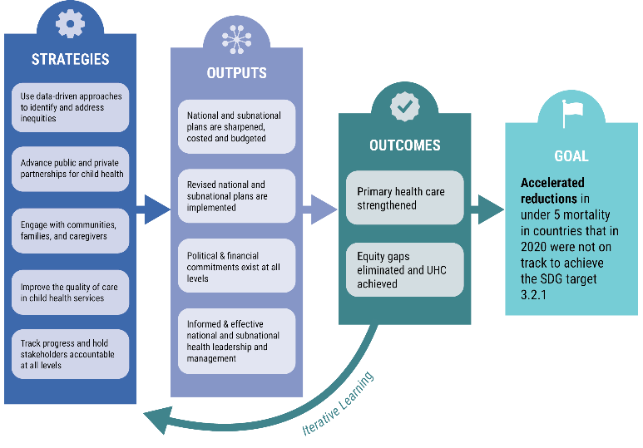
Map of CSA TOC to Results Framework TOC
CSA TOC
Structures/ inputs
Outputs
Outcomes
Impact
Processes
CSA Log Frame
Implementation milestones & indicators
Quality
Coverage
Equity
Nutrition outcome
Mortality

Slide 11
CSA follows ENAP and EPMM approach to a global results framework
Implementation milestones and country-specific implementation indicators
Structures/Inputs
Processes
Outputs
Limited number of validated indicators
Outcomes
Promote, Prevent & Treat
Impact
Coverage ● Quality ● Equity

Slide 12
CSA Outcome Indicators: Coverage, Equity, Quality
CSA Theory of Change
CSA Results Framework Log Frame
Strategies
Structures/Inputs
Outputs
Processes and Outputs
Outcomes
Outcomes
Outcome Categories
Nutrition
Illness Prevention
Illness Management (including Diagnosis & Treatment)
Primary health care strengthened
Coverage
Quality
Equity gaps eliminated and UHC achieved
Equity
Impact
Impact
Mortality & Nutritional status
Accelerated reductions in under 5 mortality in countries that in 202 were not on track to achieve SDG target 3.2.1

Slide 13
Principles in results framework development
Overarching principles of CSA
Child’s rights to survive and thrive ● Leave no child behind ● Family- and child- centered care ● Whole-of-government action ● Accountability
Build on other global tracking initiatives such as SDGs, Countdown to 2030, and Child Health and Well-Being dashboards to highlight and advocate rather than recreate and duplicate
Leverage existing data in countries to reduce data collection and reporting burden
Focus on main causes of mortality in children 1-59 months of age in countries off-track to reach SDG 3.2.1
Direct causes: Malaria, pneumonia, and diarrhea
Underlying causes: Nutrition
Contextual factors that contribute to mortality
Select validated indicators (Child Health Accountability and Tracking [CHAT] technical advisory group review) aligned to WHO observatory

Slide 14
Processes to date in CSA results framework development
Mapped existing indicators from global recommendations and initiatives to TOC
Global Initiatives Mapped to
CSA TOC/Framework
CHAT core indicators and mapping (WHO)
Child health & well-being dashboards (WHO & UNICEF)
Countdown to 2030
WHO Core 100 Indicators
UNICEF WHO WASH JMP
ENAP
EPMM
WHO’s paediatric QoC in health facilities indicators
Nurturing Care Framework
PHC measurement framework
GFF
Immunization Agenda 2030
WHO District Level HMIS data use
ALMA
QoC Network
CAP2030
Impact and Outcome/Coverage Indicators
Preliminary indicator set derived from CHAT recommendations and other global initiatives
Selected indicators vetted by CSA working groups
Selected indicator definitions refined in consultation with external technical groups and with CHAT (e.g., MERG, JMP, TEAM/DataDENT, WUENIC)
Implementation Milestones and Indicators
Domains proposed based on ENAP/EPMM and mapping to CSA TOC, other global frameworks, and Implementation Bottlenecks identified in Sierra Leone
Continue iterations, gather feedback, engage with countries → revise and finalize

Slide 15
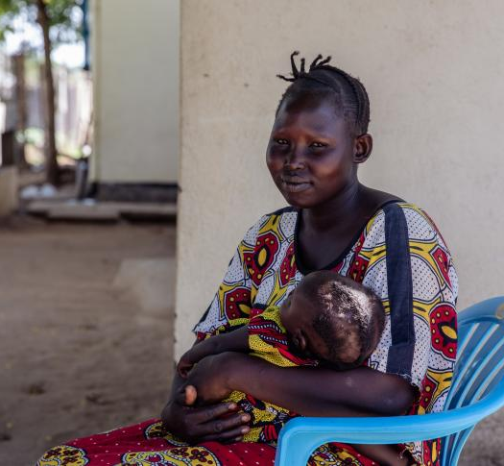
Section 3.1 CSA Results Framework: Core Set of Indicators
Photo: MOMENTUM; Hadjara Laouali Balla

Slide 16
Process for selecting the core set of indicators
1
2
Mapping of indicators on child survival from all major global and regional initiatives
Develop Criteria for selecting core indicators
CHAT, Countdown to 2030, WHO 100 indicators, Nurturing Care Framework, CAP 2030 Child Health and Well-being Dashboards, JMP indicators, Monitoring guide for HMIS/Pink Book, QED catalogue, WHO Pediatric quality of care metrics, PHC measurement framework, TEAM for nutrition, IA2030 for immunization, Global Action Plan for the Prevention and Control of Pneumonia and Diarrhea
Reference to ENAP-EPMM to ensure continuity
3
4
Iterative process for consensus on core indicators
Presentation to Child Health community at the CHTF event in June 2023
Regular convenings of the Results and Accountability WG
Consultations with other groups in the CSA governance structure (face to face meeting in the spring 2023, discussions with the CSA partner group and with the Steering Committee)
Consultations with expert groups
Nutrition (WHO, UNICEF, TEAM, Data Dent)
Immunization (WHO, UNICEF, GAVI, IA2030)
Malaria (WHO, UNICEF)
WASH (WHO, UNICEF, JMP)
GFF Results team
Countdown to 2030
2 consultations with CHAT to finalize list
5
Finalization of list

Slide 17
Four types of Core Indicators
Indicator Type
Impact (Mortality and Nutrition)
Outcome: Nutrition (Promote)
Outcome: Illness Prevention (Prevent)
Outcome: Illness Management (Treat)
Contextual Factors
We have also developed the following:
Learning agenda
Approaches for measuring equity for the selected indicators
Accompanying quality of care metrics for the core outcomes are under development

Slide 18
CSA Core Impact Indicators: Mortality
Indicator | Associated Global Target | Global target and initiatives alignment
Under-five Mortality | Reduce child under-5 mortality rate to at least as low as 25 deaths per 1 000 live births by 2030 | Global target is SDG target 3.2. and SGD Indicator 3.2.1. Indicator is aligned with major child health global initiatives.
Mortality 1 month-59 months | Child 1 to 59 months mortality rate at least as low as 13 deaths per 1,000 children aged 28 days by 2030 | Proposed global target. Indicator aligned with UNIGME reporting 2024 and mortality estimates dashboard.
*CSA advocacy products will also include analyses of the leading causes of deaths in children 1-59 months in the off-track countries

Slide 19
CSA Core Impact Indicators: Nutrition
Indicator | Associated Global Target | Global target and initiatives alignment
Wasting prevalence (moderate/severe) | By 2025, 5% or less prevalence of childhood wasting; By 2030, 3% or less prevalence of childhood wasting | Global target is SDG Target 2.2.2. Target is included in the Global Action Plan on Child Wasting and the Global Nutrition Monitoring Framework endorsed by WHO's Member States as target number 6. Target for 2030 proposed by nutrition community. Indicator consistent with these and other initiatives.
Stunting prevalence (moderate/severe) | By 2025, achieve a 40% reduction in the number of children who are stunted By 2030, achieve a 50% reduction in the number of children who are stunted | Global target is SDG Target 2.2.1, and included in the Global Nutrition Monitoring Framework, endorsed by WHO's Member States as target number 1. Target for 2030 proposed by nutrition community. Indicator consistent with these and other initiatives.
Note: Wasting and stunting prevalence are reported on the WHO Global Health Observatory dashboard, UNICEF nutrition dashboards, the WHO Global Nutrition Monitoring Framework dashboard, and in the country profiles at Countdown to 2030.

Slide 20
CSA Core Coverage Indicators: Nutrition (promote)
Indicator | Associated Global Target | Global target and initiatives alignment
1. Exclusive breastfeeding | By 2025, at least 50% of infants are exclusively breastfeeding in the first 6 months By 2030, at least 70% of infants are exclusively breastfeeding in the first 6 months | Global target is stated in the Global Nutrition Monitoring Framework, endorsed as target number 5. Target also included in the Global Action Plan on Child Wasting and Global Action Plan for Prevention and Control of Pneumonia and Diarrhea. Target for 2030 proposed by nutrition community. Indicator consistent with these and other initiatives.
2. Minimum dietary diversity | N/A | Indicator aligned with indicator in the Global Nutrition Monitoring Framework and recommended by the TEAM advisory group.
3. Vitamin A supplementation (second dose) | N/A | Indicator aligned with indicator in indicator in the Global Nutrition Monitoring Framework and recommended by the TEAM advisory group.

Slide 21
CSA Core Coverage Indicators: Illness Prevention (prevent)
Indicator | Associated Global Target | Global target and initiatives alignment
1. ITN use | N/A | Indicator aligned with WHO World malaria report , Roll Back Malaria recommendations, and SDG 3.3.
2. Diphtheria, tetanus and pertussis (DTP3) immunization coverage | By 2030, 90% global coverage of immunization for DTP3 | DTP3 indicator and target are aligned with SDG 3.b.1 and the Immunization Agenda 2030 goals and targets.
3. Measles immunization coverage (second dose) | By 2030, 90% global coverage of immunization for MCV2 | MCV2 indicator and target are aligned with SDG 3.b.1 and the Immunization Agenda 2030 goals and targets.
4. Zero dose (absolute number) | By 2030, 50% reduction in the number of zero dose children at country, regional and global levels | Zero dose indicator and target are aligned with the Immunization Agenda 2030 goals and targets.

Slide 22
CSA Core Coverage Indicators: Illness Management (treat)
Indicator | Associated Global Target | Global target and initiatives alignment
1. Diarrhea treatment with oral rehydration salt solution (ORS) and zinc | By 2025, 90% access to appropriate diarrhea case management (with 80% coverage in every district) | Global target stated in Global Action Plan for Prevention and Control of Pneumonia and Diarrhea. Indicator aligned with WHO 100 Core Health Indicators, SDG 3.8.1, and other initiatives.
2. Malaria diagnostics usage | N/A | Indicator aligned with Roll Back Malaria recommendations and SDG target 3.3.
3. Care seeking for symptoms of ARI | By 2025, 90% access to appropriate pneumonia case management (with 80% coverage in every district) | Related global target stated in Global Action Plan for Prevention and Control of Pneumonia and Diarrhea; GAPPD target and indicator differ. Indicator is aligned with measurement of SDG 3.8.1 and included within the Universal Health Coverage index (3.8.1).
4. Care seeking for fever | N/A | Indicator aligned with Roll Back Malaria recommendations.
5. Malaria treatment (children under the age of five diagnosed with malaria who received ACT (or other first-line treatment according to national policy) | N/A | Indicator aligned with WHO World malaria report , Roll Back Malaria recommendations, and SDG 3.3.

Slide 23
Contextual Indicators
1
Population using basic drinking water services* (SDG 6.1.1)
2
Population using basic sanitation services* (SDG 6.2.1)
3
Population with basic handwashing facilities at home*
4
Food Insecurity Experience Scale (SDG 2.1.2)
5
Gender/Women’s empowerment (SDG 5.1.1.)
* Indicator recommended by the WHO/UNICEF Joint Monitoring Programme for Water Supply, Sanitation and Hygiene (JMP)
¥

Slide 24
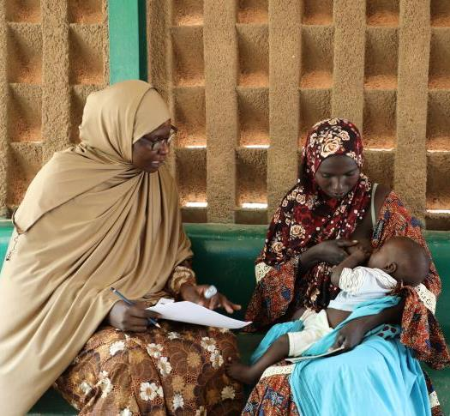
Section 3.2 CSA Results Framework: Learning agenda
Photo: MOMENTUM; Hadjara Laouali Balla

Slide 25
CSA Results Framework Learning Agenda
Protect Measures:
Work with the nutrition community on improving measurement of nutrition counseling interventions and other interventions delivered through the health system, such as management of acute malnutrition
Examine and improve indicators related to air quality and links with childhood asthma and respiratory disease
Prevent Measures:
Consider measures for the malaria vaccine rolls out
Improve measurement around DTP3 drop-out rates
Examine whether identification and measurement of zero-dose children can identify children missing out on other services
Illness Management Measures:
Examine ways to improve indicators of pneumonia and malaria treatment, especially within the context of antibiotic and antimicrobial resistance
Improve the measurement of disease severity for fever, diarrhea, etc. related to careseeking and treatment indicators
Equity Measures:
Improve measurement of important, but difficult to capture equity categories such as disability status, ethnicity/race, more granularity by age, etc.

Slide 26
Section 3.3 CSA Results Framework: Equity and Quality
Photo: MOMENTUM; Hadjara Laouali Balla

Slide 27
Equity in the CSA Results Framework
Impact and outcome indicators should be disaggregated by key equity factors such as rich-poor, urban-rural, geography, and mother’s education
Recommended equity analyses
Compare equity patterns across countries using national estimates and equity patterns within countries using subnational estimates
Examine progress towards mortality targets at the national level and amongst the poorest quintile
Calculate coverage gap between wealthiest and poorest quintile
Compare coverage level in the poorest quintile to the national average
Examine progress towards coverage targets between poorest, wealthiest, and national average
Use maps and equiplots to visualize the data
Consider other equity indicators for specific analyses, such as child food poverty measures
Note: Gender equity captured through relevant disaggregation (e.g., women’s education) and context indicator for Gender/Women's empowerment SDG 5.1.1

Slide 28
Incorporating Quality of Care Indicators in the CSA Results Framework
Rationale:
Processes:
Key Resources:
Quality of Care (QoC) is an important outcome in reducing child mortality. QoC measures are considered both as outcomes and processes within the CSA Results Framework. There are limited standard child health QoC measures collected and available across countries.
Drawing from global recommendations and resources, CSA will develop a recommended menu of prioritized QoC indicators for countries to consider tracking at national and sub-national levels, based on their specific programs to improve child health and survival.
The following global resources include QoC measures pertinent for child health and survival
WHO QoC Standards and Core and menu of pediatric QoC indicators
WHO Analysis and use of facility data –2023 recommendations for MNCAH programme managers
Indicator and monitoring framework for the Global Strategy for Women’s, Children’s and Adolescents Health
Network for Improving quality of care for maternal, newborn and child health –core indicators in monitoring framework

Slide 29
Section 3.4 CSA Results Framework: Implementation Milestones
Photo: MOMENTUM; Hadjara Laouali Balla

Slide 30
Development of Implementation Milestones: Mapping of domains across similar initiatives
1
CSA Theory of Change
2
ENAP-EPMM milestones and results framework
3
WHO Primary Health Care Monitoring framework & indicators
4
WHO Quality of Care Network Leadership, Action, Learning and Accountability
5
CSA country engagement learnings. For example, Sierra Leone identified a set of country-specific bottlenecks potentially relevant to all countries in implementation

Slide 31
Development of Implementation Milestones: Criteria to identify suitable milestones
Indicates the quality of program implementation
Signals importance to countries for accountability, tracking, advocacy and dialogue
A menu of milestones and further resources that countries can use and adapt
Some milestone areas may need data that are not routinely collected and reported
ENAP Milestones seen as “best fit” for CSA to use as its model

Slide 32
CSA Implementation Milestone Categories*
1. Governance & accountability, national plans, & financing ● National & district governance structures ● National vision, strategy & operation plan(s) ● Advocacy & mobilization strategy ● Civil society engagement & social accountability mechanisms ● Standards & policies for QoC ● Financing & allocation of resources
2. Service delivery systems ● Health Workforce with adequate resources, deployment, training, and support ● Availability of Medicines, Diagnostics & Other Products ● Adequate facilities & physical infrastructure ● Models of Care with referral systems & care pathways ● Structures for empowering and supportive experience of care
3. Community & Family engagement ● Community, civil society and other stakeholder involvement ● Parents’ voices and champions
4. Data & Evidence ● Minimum child health data set, including service delivery/coverage, equity & quality ● Institutionalized CRVS &child health death surveillance & response ● Research, development, & learning for innovation, implementation & adaptation ● Prioritized & coordinated research agenda
5. Partnerships ● Public-private partnerships leveraged & aligned ● Multi-sectorial partnerships & partnership platforms ● Partnership and coordination with private sector services
Coverage ● Quality ● Equity
*Categories and domains may change slightly pending further work

Slide 33
Section 4 The Way Forward
Photo: MOMENTUM; Allison Shelley

Slide 34
CSA Results Framework: the way forward
The CSA Results Framework as presented here is a “living document.” A more detailed report on the development and details of the CSA Results Framework will be forthcoming.
Future iterations of the CSA Results Framework will include:
Consideration of additional targets
Implementation milestones and relevant guidance materials
Incorporation of quality of care measures
Data analysis and use plans

