Slide 1
Centre of Excellence in
Women and Child Health
Aga Khan University
Advancing newborn and Child Health Agenda: Role of Academia in fostering Public-Private Partnerships and Community engagement

Slide 2
Outline
AKU’s contribution towards advancing Newborn & Child Health through:
Evidence Generation & Knowledge Synthesis
-Translational Research
-Research to Policy implications
Capacity Building & Service Delivery
Innovation in Newborn & Child Care
Community Engagement and Partnerships
Collaboration and Partnerships in Emergency & Conflict Settings
Advancing Research: Next Generation of Scientists

Slide 3
Outline
Public - Private Partnerships
Community Kangaroo Mother Care –Community Engagement and Advocacy
Possible Serious Bacterial Infection - Primary and Community Health Program (Knowledge Synthesis & Impact)
Reducing Malnutrition – Evidence Synthesis and Policy Implications

Slide 4
AKU Publications in Peer Reviewed Journals
2013 to 2023
Impact Factor (IF) of Journals with AKU Publications in 2023:
Median IF =3.84
Manuscripts published in journals with IF ≥ 5 = 22.9% of AKU publications in 2023
1571
1476
Manuscripts published in journals with IF ≥10 = 9.5% of AKU publications in 2023
1362
1274
1125
1050
884
889
AKU faculty members have published at least 160 books since inception.
739
12 books and 70 book chapters were published in 2023.
2015
2016
2017
2018
2019
2020
2021
2022
2023

Slide 5
Societal Impact & Public Discourse:
2023 Research Impact
Aga Khan University research has been mentioned 25,654 times online, in a variety of forums in
2023.
Our research was mentioned in over 3,023 news stories in 113 countries, including:
56 stories in MSN news
30 stories in Medscape
29 stories in The Conversation
11 stories in CNN News
9 stories in Washington Post
AKU research influenced 531 policy documents in 30 countries, including:
411 documents from WHO
16 documents from Food and Agriculture
Organisation
16 documents from UNICEF
8 documents from Centers for Disease Control and Prevention

Slide 6
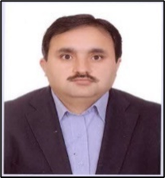
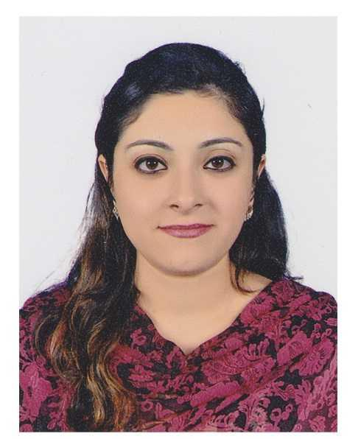
Core Team
Prof. Dr. Zulfiqar Ali Bhutta
Founding Director COE-WCH
Prof. Dr. Sajid Soofi
Assoc. Director COE-WCH
Dr. Shabina Ariff
Imtiaz Hussain
Imran Ahmed
Dr. Shah Muhammad
Yaqub Wasan
Gul Nawaz Khan
Arjumand Rizvi
Muhammad Umer
Shanila Nooruddin
Owais Rupani
Hina Thobani

Slide 7
Public-Private Partnerships
National Partners:
Ministry of National Health, Pakistan
National Program for Family Planning and Primary Healthcare
Expanded Program on Immunization
Maternal, Newborn and Child Health Program
Benazir Income Support Program
Trust for Vaccines and Immunizations

Slide 8
Global collaborations
United Nations International Children's Emergency Fund
The NIHR Global Health Research Unit on Respiratory Health
United Nations Population Fund
World Health Organization
Action against Hunger
International Atomic Energy Agency
Centers for Disease Control and Prevention
World Food Program

Slide 9
Academia
Johns Hopkins Boston University University of Sydney IAEA
University of Edinburgh
All India Institute of Medical Sciences
Harvard University
Oxford University
University of Melbourne

Slide 10
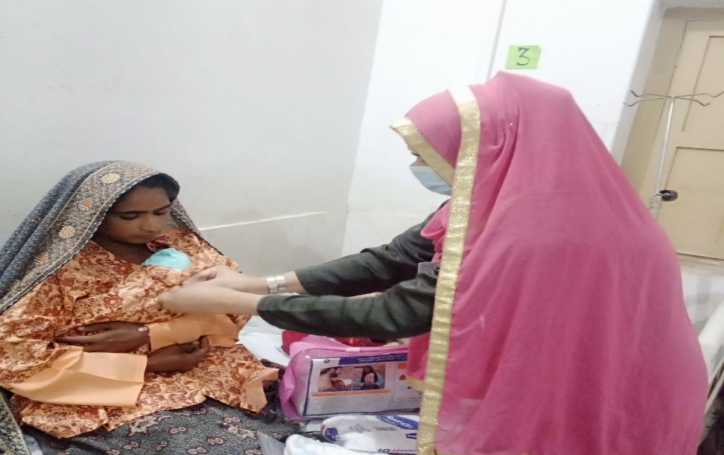
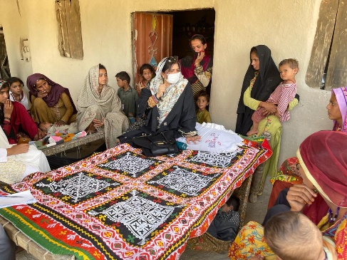
AKU’s Contribution Towards Advancing Maternal and Child Health

Slide 11
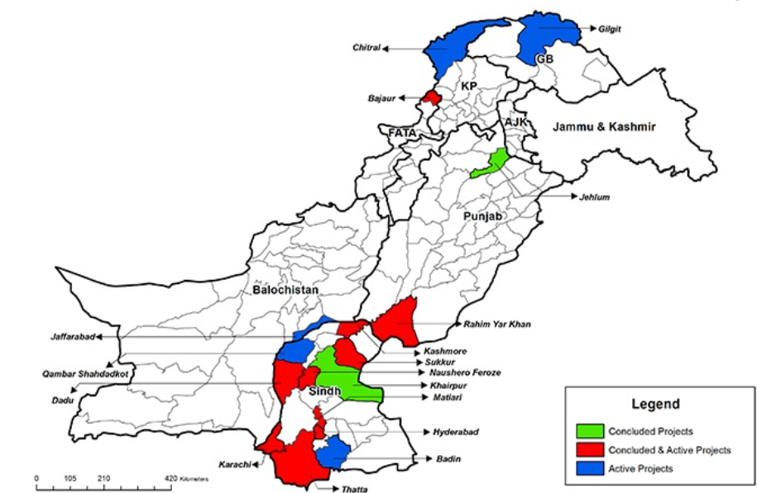
Evidence Generation
Research footprint of COE-WCH in Pakistan
Notes:
Ownership
Awareness Sessions
Trust Building
Stakeholder Meetings

Slide 12
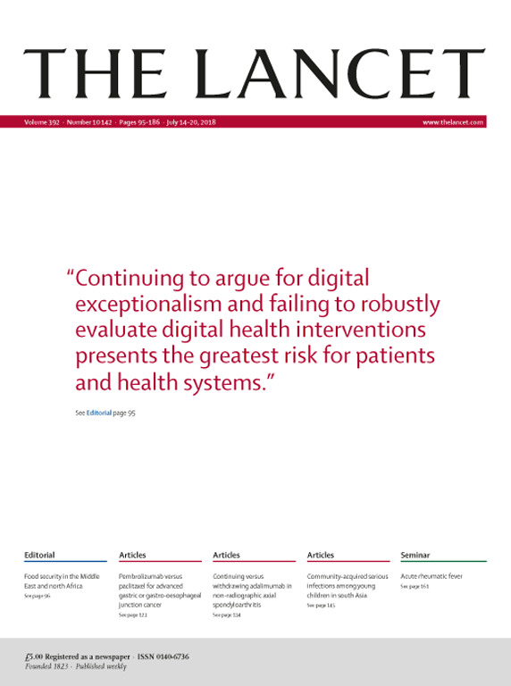
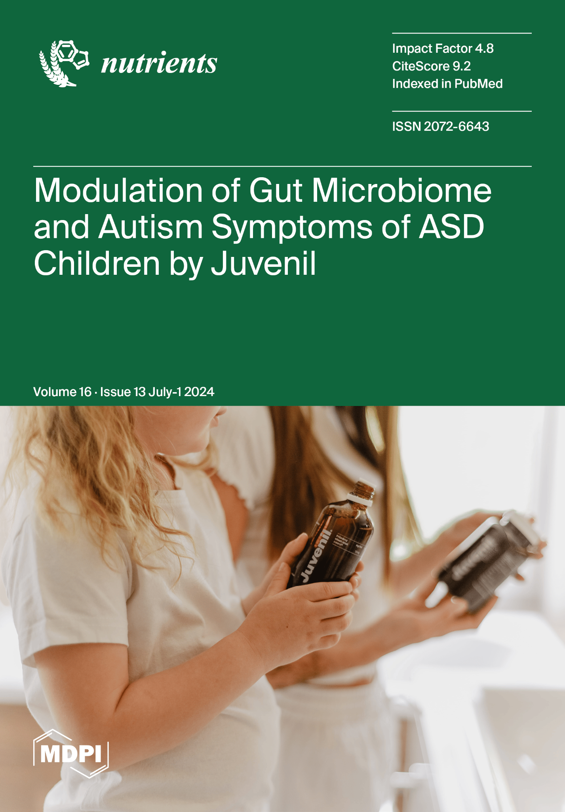
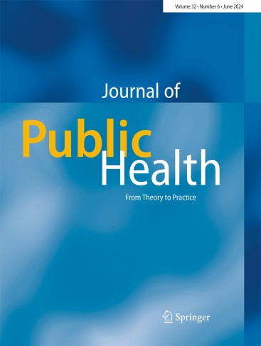
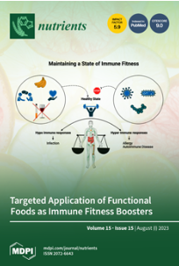
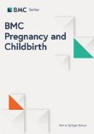
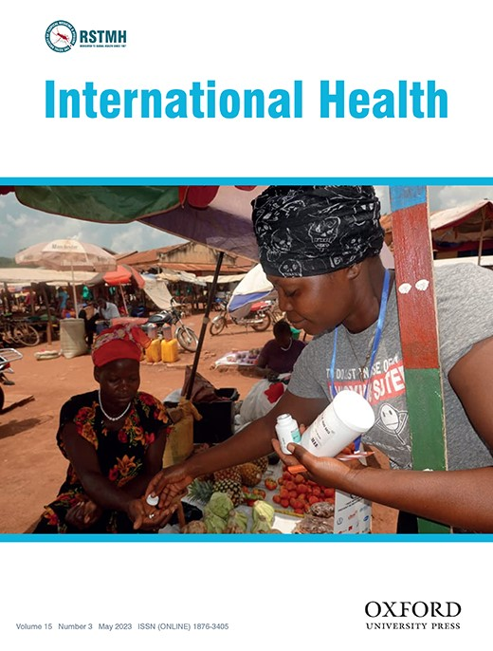
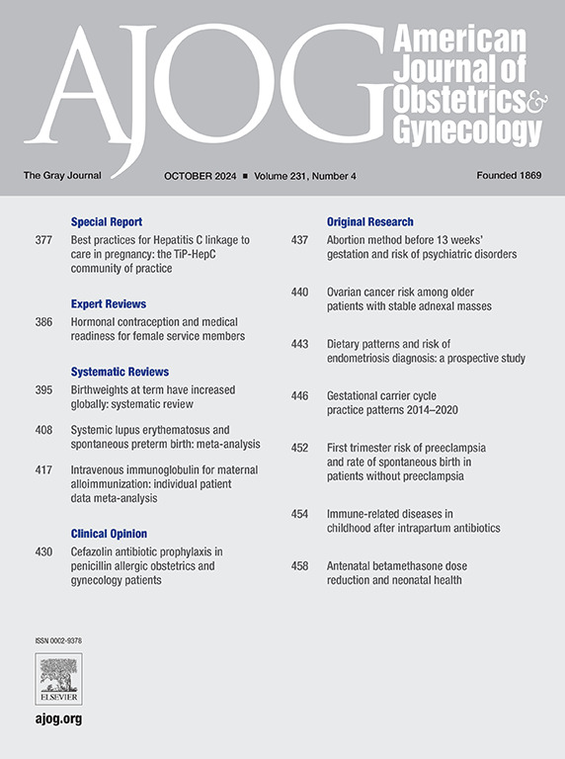
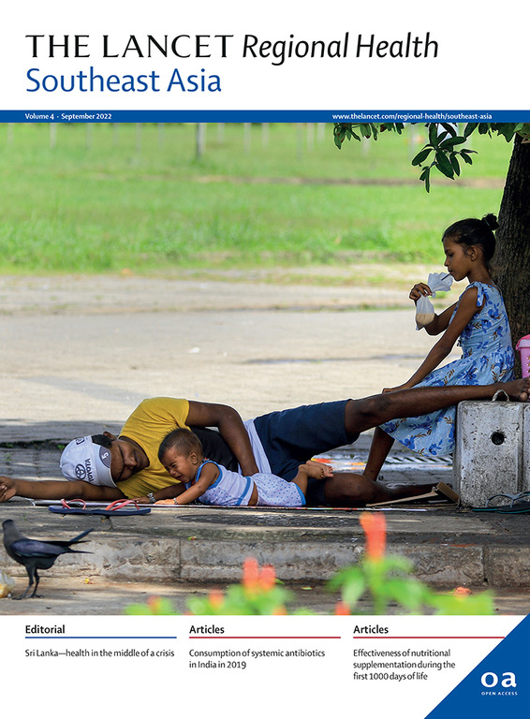
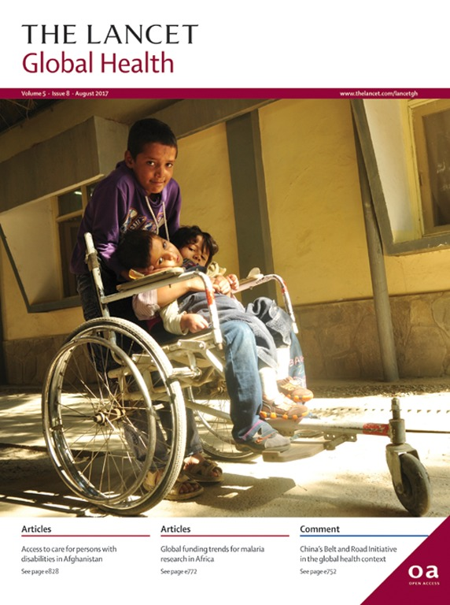
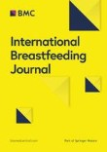
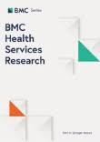
Publications
Causes and incidence of community-acquired serious infections among young children in south Asia (ANISA): an observational cohort study. 2018
World Health Organization recommendations for care of preterm or low birth weight infants: health policy.
- Effect of Community-Based Kangaroo Mother Care Package on Neonatal Mortality Among Preterm and Low Birthweight Infants in Rural Pakistan: Protocol for a Cluster Randomized Controlled Trial 2021
- Understanding Perceptions and Practices for Designing an Appropriate Community-Based Kangaroo Mother Care Implementation Package: Qualitative Exploratory Study. 2022
The Effectiveness of Nutritional Interventions Implemented through Lady Health Workers on the Reduction of Stunting in Children under 5 in Pakistan: The Difference-in-Difference Analysis. 2024
Impact of a community-based intervention package delivered through community health workers on post-partum care practices: a cluster randomized controlled trial. 2024
The World Health Organization ACTION-I (Antenatal CorTicosteroids for Improving Outcomes in preterm Newborns) Trial.
1000+ publications by CoE WCH
Determinants of Stunting among Children under Five in Pakistan. 2023
Effect of Maternal and Newborn Care Service Package on Perinatal and Newborn Mortality: A Cluster Randomized Clinical Trial. 2024
Improved accessibility of emergency obstetrics and newborn care(EmONC) services for maternal and newborn health: A community based project 2013.
Quality improvement initiative using transcutaneous bilirubin nomogram to decrease serum bilirubin sampling in low-risk babies. 2019
Maternal vaccination against COVID-19 and neonatal outcomes during Omicron: INTERCOVID-2022 study.
Determinants of infant and young child feeding practices by mothers in two rural districts of Sindh, Pakistan: a cross-sectional survey. 2017
Evaluation of health workforce competence in maternal and neonatal issues in public health sector of Pakistan: an Assessment of their training needs
Risk factors for acute diarrhoea in children between 0 and 23 months of age in a peri-urban district of Pakistan: a matched case–control study
Effectiveness of nutritional supplementation during the first 1000-days of life to reduce child undernutrition: A cluster randomized controlled trial in Pakistan. 2022
Effect of provision of home-based curative health services by public sector health-care providers on neonatal survival: a community-based cluster-randomised trial in rural Pakistan. 2017

Slide 13
Community Engagement
The COE in Women and Child Health has been working to improve the health of women and children in Pakistan by creating synergies among various stakeholders including the community members.
Awareness
Engagement & Ownership
Trust Building
AKU introduced the idea of KMC champions to promote peer-to-peer learning amongst community members.
Village Health Committees & Women Support Groups were developed during the Umeed-e-Nau project to encourage community ownership.
AKU conducts regular stakeholder meetings and dissemination activities to build trust among community members and partners.

Slide 14
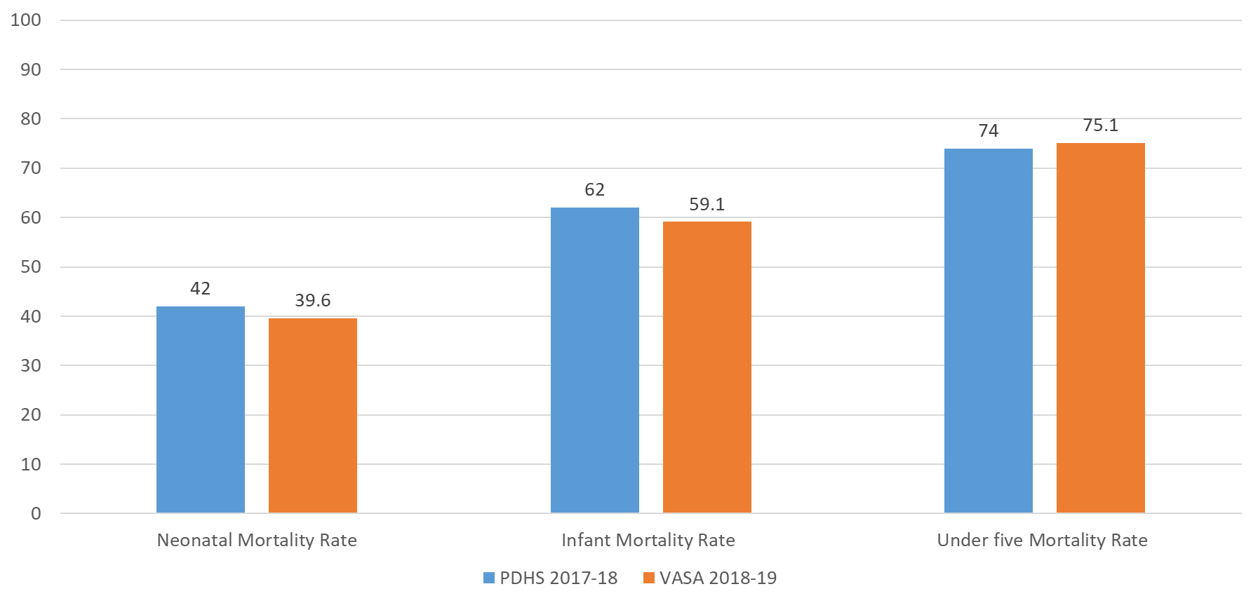
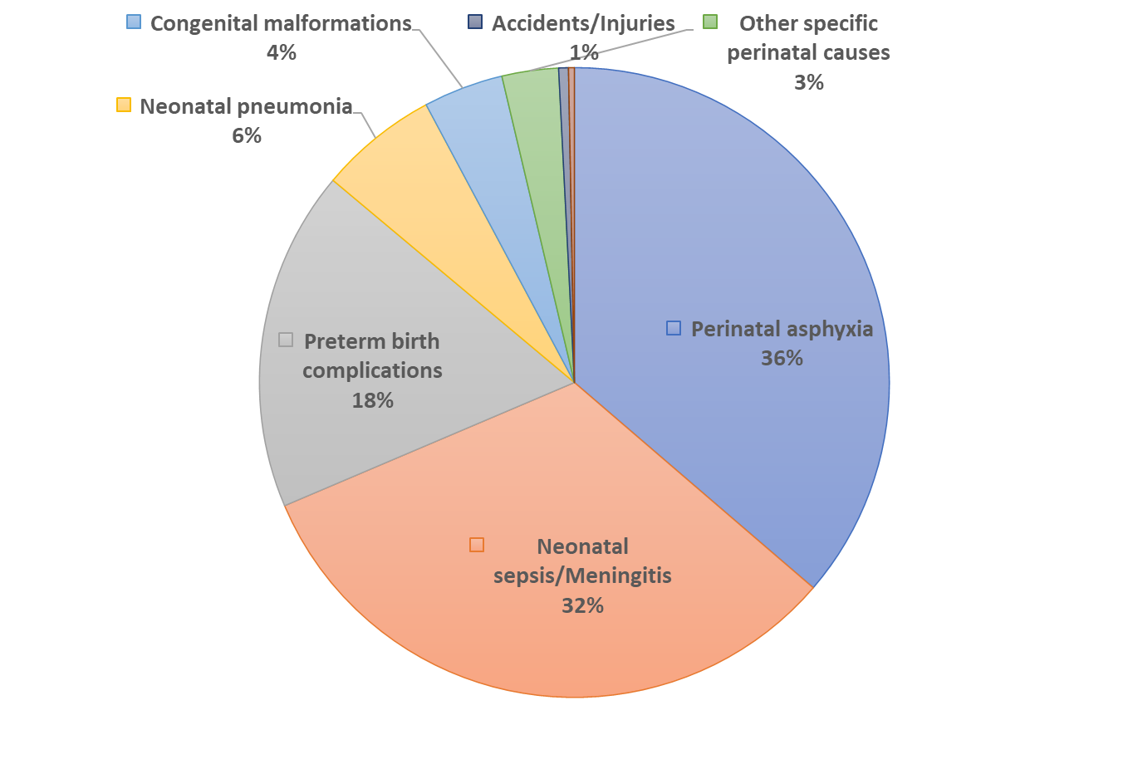
Evidence Generation & Knowledge Synthesis
Population based Verbal and Social Autopsy Study to Estimates burden and Causes of Mortality in Pakistan
Comparison of Mortality Rates
PDHS Data vs VASA
Causes of Neonatal Mortality (n=2088)
VASA

Slide 15
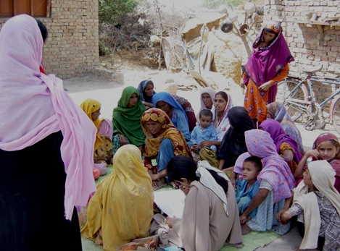
Evidence Generation & Community Engagement
Impact of Community-based Interventions Package on Perinatal & Newborn Mortality delivered through LHWs & TBAs in Rural Pakistan:
A Cluster-Randomized Effectiveness Trial
LHW Delivering a Session to Community Members

Slide 16
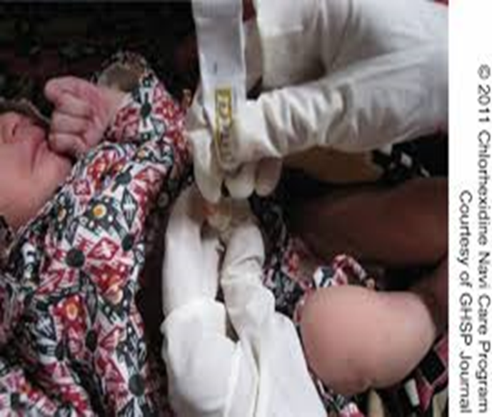
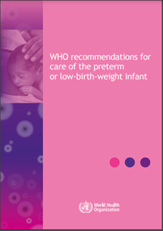
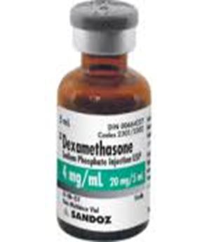
Innovations and Impact through Knowledge Synthesis
Notes:
Established safety and efficacy of ACS in LMICs
Informed WHO’s recommendations for ACS use in LMICs
ACS use is now recommended in women at risk of delivering <34 weeks’ gestation
ACTION III (ongoing): Assess the benefits and possible harms of ACS, when given to pregnant women at risk of late preterm birth (34+0 to 36+5 weeks gestation) in hospitals in low resource settings

Slide 17
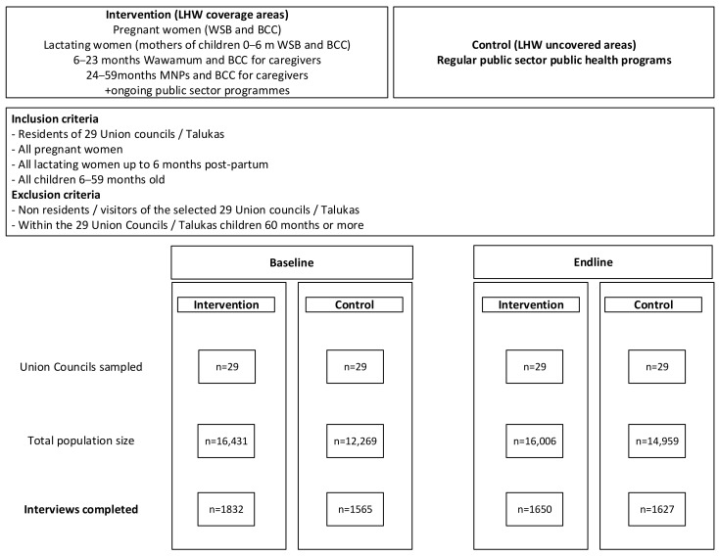
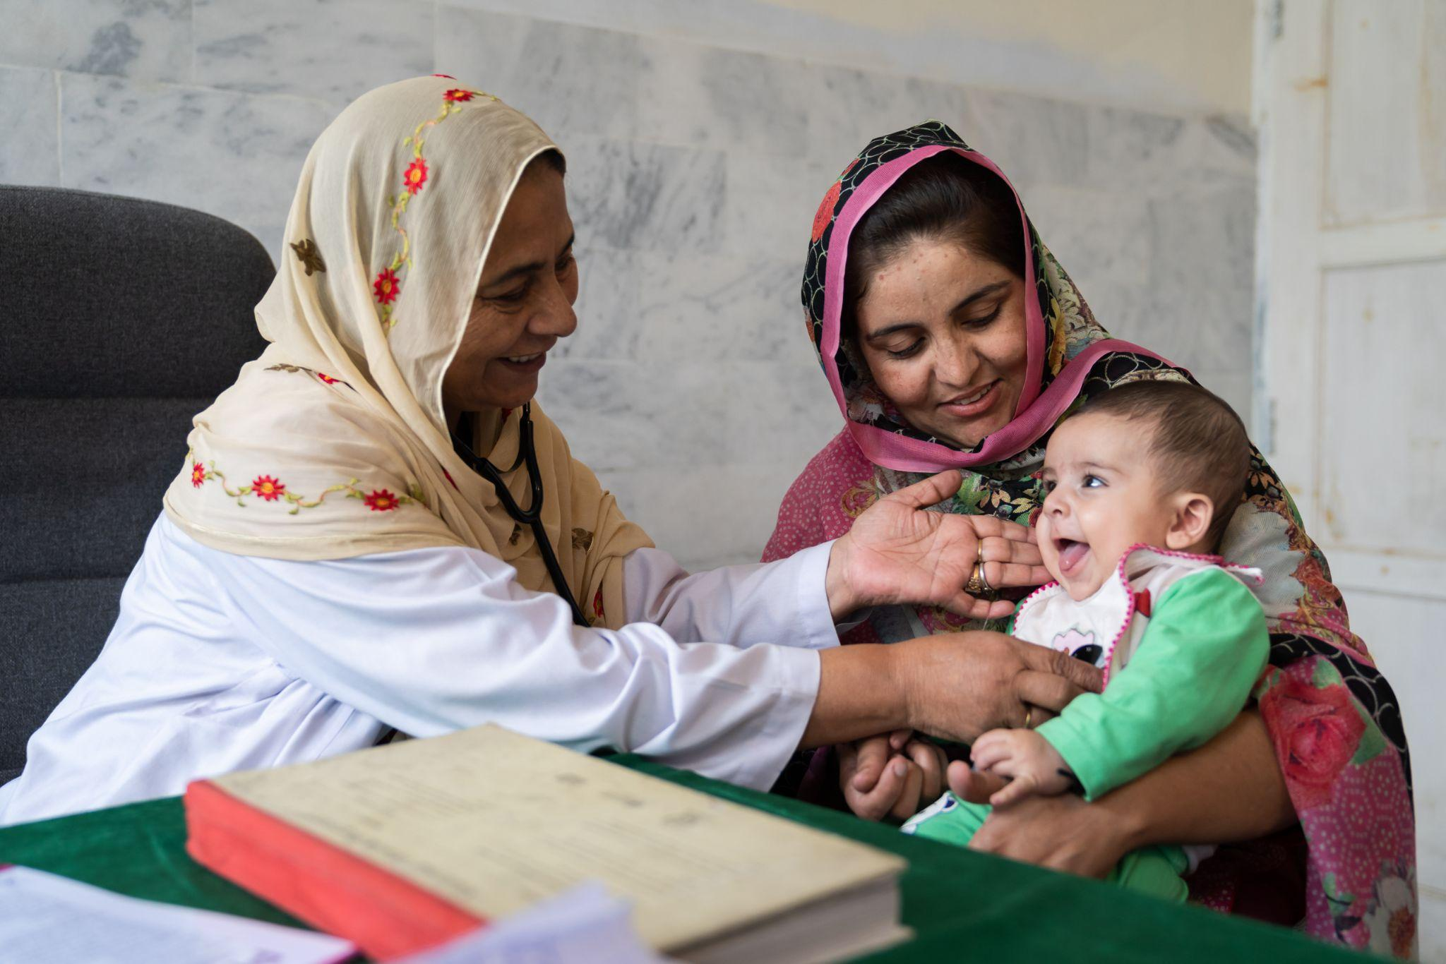
Evidence Generation & Knowledge Synthesis
The Effectiveness of Nutritional Interventions Implemented through LHWs on the Reduction of Stunting in Children under 5 in Pakistan: The Difference-in-Difference Analysis

Slide 18
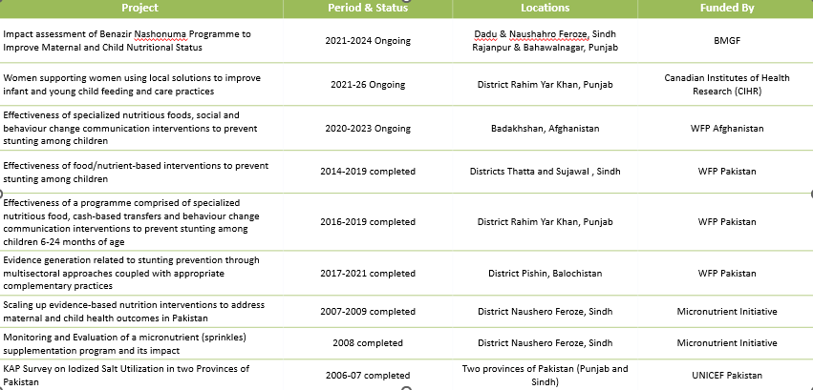
Collaboration with RMNCH -UNICEF -WFP
Nutritional Interventions

Slide 19
Contributions in global research
The COE - WCH regularly works towards expanding its research footprint and generates evidence that can advance maternal and child health globally.
Systematic Reviews
We have conducted systematic reviews focused on evaluating treatment strategies and interventions for on maternal newborn and children with specific health conditions.
Effectiveness of probiotics for diarrhoea,
DKA
Delivering nutrition interventions to women and children in conflict settings: a systematic review.
Pneumonia and pulse oximetry
Climate change policy and impact on Asthma & COPD

Slide 20
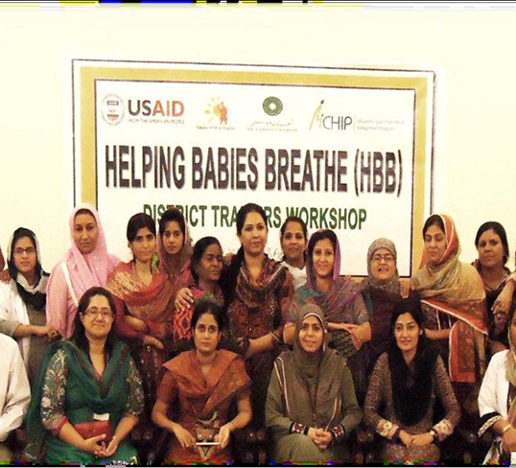
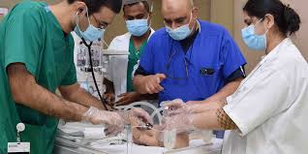
Newborn resuscitation HBB -Capacity Building
Helping Babies Breathe (HBB)
AKU CIME Neonatal Resuscitation Program
Simplified educational tool for newborn resuscitation through primary health care providers in low and middle income settings
Ensure the presence of skilled care provider
Early recognition of intrapartum asphyxia
Management through ventilation (Bag & Mask)
Stabilization of the newborn
Referral when required
Recognise the signs and symptoms of a neonate in cardio respiratory distress.
Explain the indication for and perform the steps of neonatal resuscitation.
Perform effective airway management.
Explain the indication and contraindications of medications used during neonatal resuscitation.​

Slide 21
Capacity Building & Service Delivery
Capacity building of facility-based HCPs and community-based HCPs (lady health supervisors (LHS) and LHWs) was conducted to roll out maternal and child health interventions in
09 Districts
Review of the existing training curriculum to identify gaps
HCPs and LHS trained as Master Trainers and mentors for LHWs
Revised and Updated Sindh LHWs curriculum
User-friendly curriculum/guide developed against existing large content
Quality assessment of training using pre- and post tests
Notes:
UeN

Slide 22
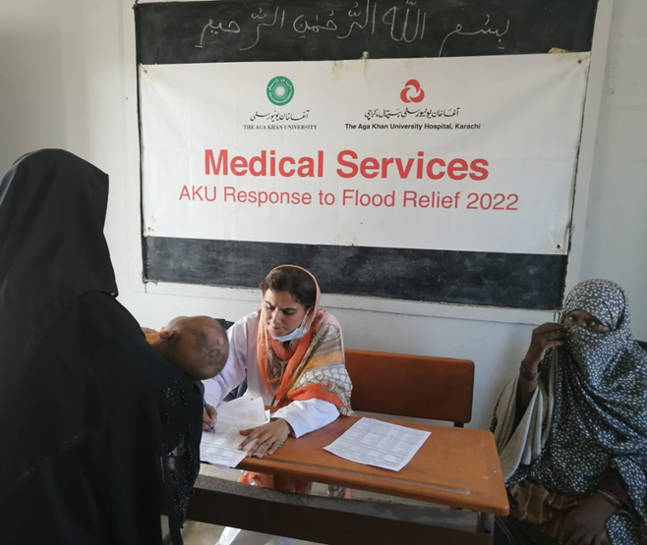
Service Delivery in Emergency Settings
Playing a crucial role in crisis response, ensuring continuous healthcare delivery during emergencies like COVID-19 and floods through collaboration and mass-scale collaboration.
In 42 flood-affected districts of Pakistan, 1,059 camps provided 314,635 outpatient services, treating 76,425 women, and 70,461 under five. 39,087 children were vaccinated for essential immunization
General health screening, treatment and provision of medicines
Advocacy sessions on prevention of water-borne diseases and menstrual hygiene management were conducted

Slide 23
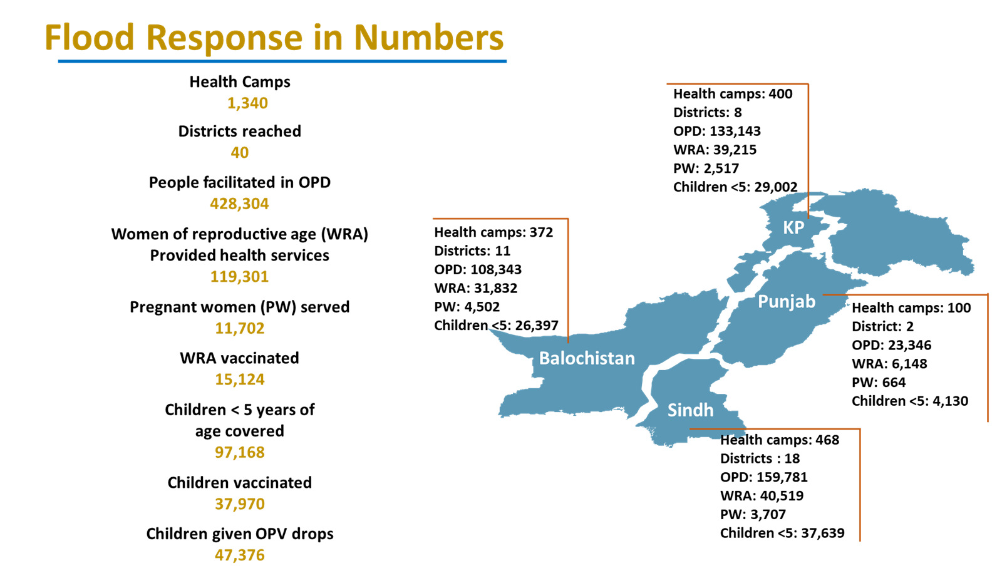
Service Delivery in Emergency Settings

Slide 24
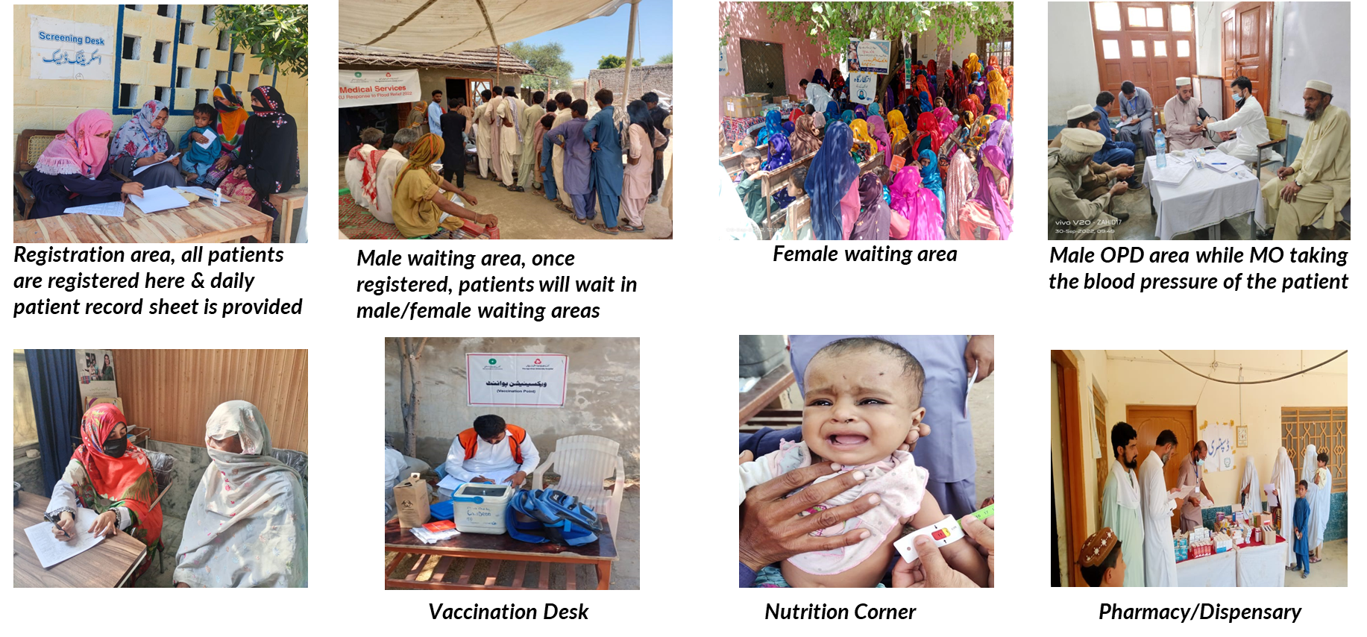
Service Delivery in Emergency Settings

Slide 25
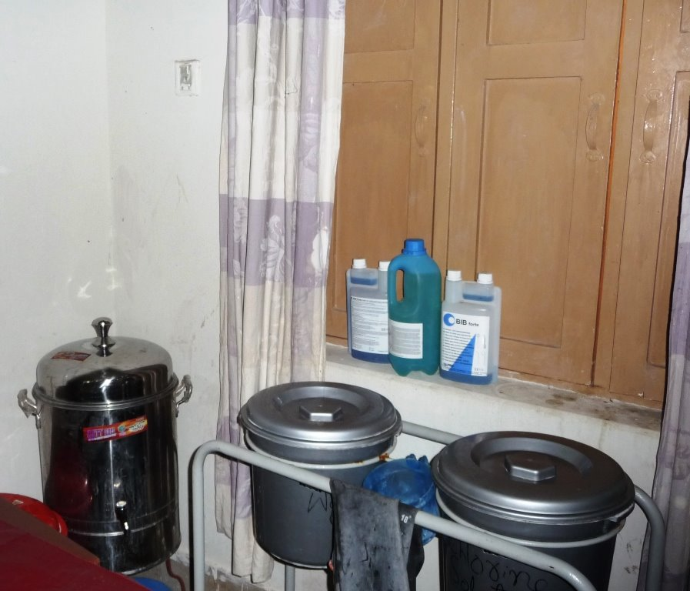
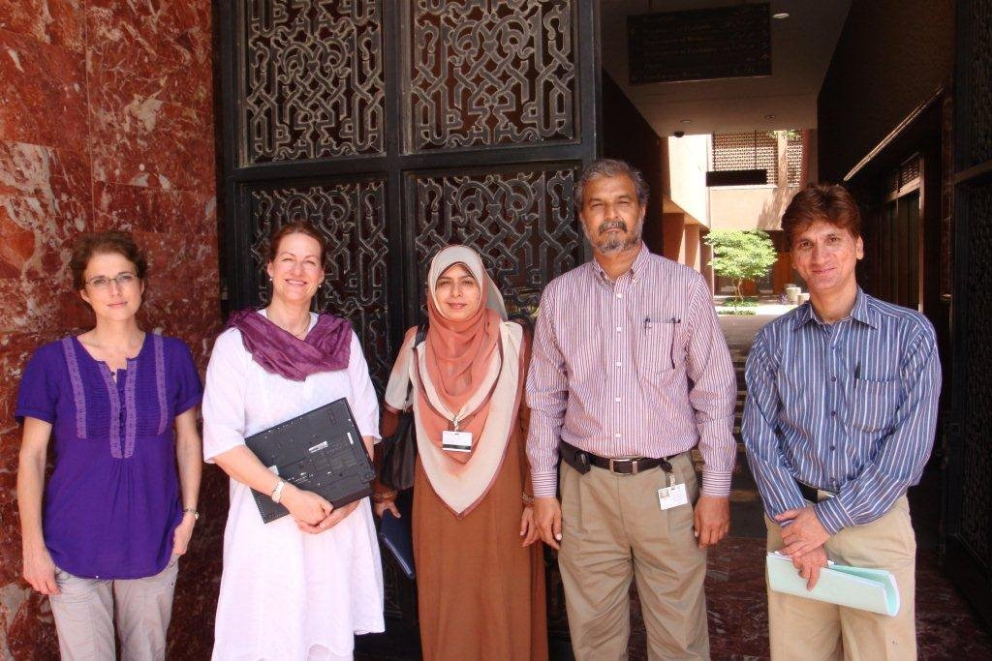
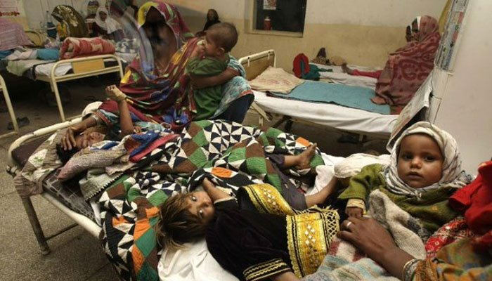
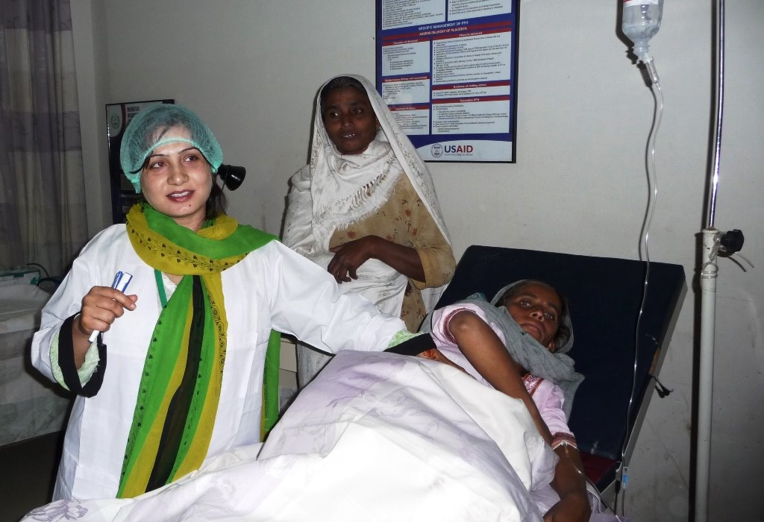
District Dadu-Flood Affected-SRC X AKU
Notes:
District Dadu was badly affected by the devastating floods of 2011​
The health infrastructure was lost and in some areas there was barely any health services ​
Swiss Red Cross approached the Aga Khan University to support the flood affected population of Taluka KN Shah in district Dadu​
AKU accepted the opportunity and developed and implemented a comprehensive intervention package for MNCH improvement​ titled, MNCH project in Dadu-Sindh -2011-2022​
District Dadu was badly affected by the devastating floods of 2011​
The health infrastructure was lost and in some areas there was barely any health services ​
Swiss Red Cross approached the Aga Khan University to support the flood affected population of Taluka KN Shah in district Dadu​
AKU accepted the opportunity and developed and implemented a comprehensive intervention package for MNCH improvement​ titled, MNCH project in Dadu-Sindh -2011-2022​

Slide 26
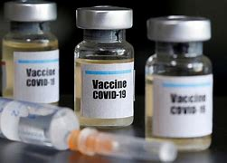
Pandemic SARS
Pregnancy outcomes and vaccine effectiveness during the period of omicron as the variant of concern, INTERCOVID-2022: A multinational, observational study
Maternal and Neonatal Morbidity and Mortality Among Pregnant Women With and Without COVID-19 Infection-global study
KARACHI: Pregnant women who contract Covid-19 are 22 times more likely to die and 50 per cent more likely to experience pregnancy-related complications than expecting women unaffected by Covid-19, says a global study of over 2,100 pregnant women across 18 countries, including Pakistan, published in JAMA Paediatrics.

Slide 27
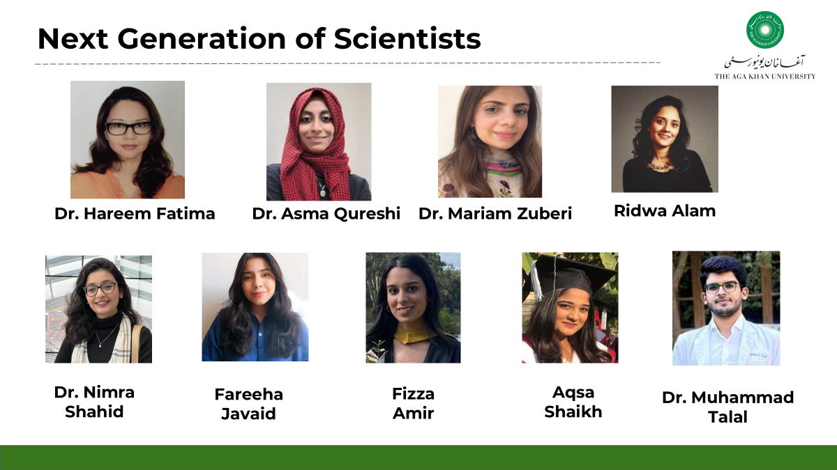
Next Generation of Scientists
Dr. Hareem Fatima
Dr. Asma Qureshi
Dr. Mariam Zuberi
Ridwa Alam
Ahmad Khan
Dr. Nimra Shahid
Fareeha Javaid
Fizza Amir
Aqsa Shaikh
Notes:
Ownership
Awareness Sessions
Trust Building
Stakeholder Meetings

Slide 28
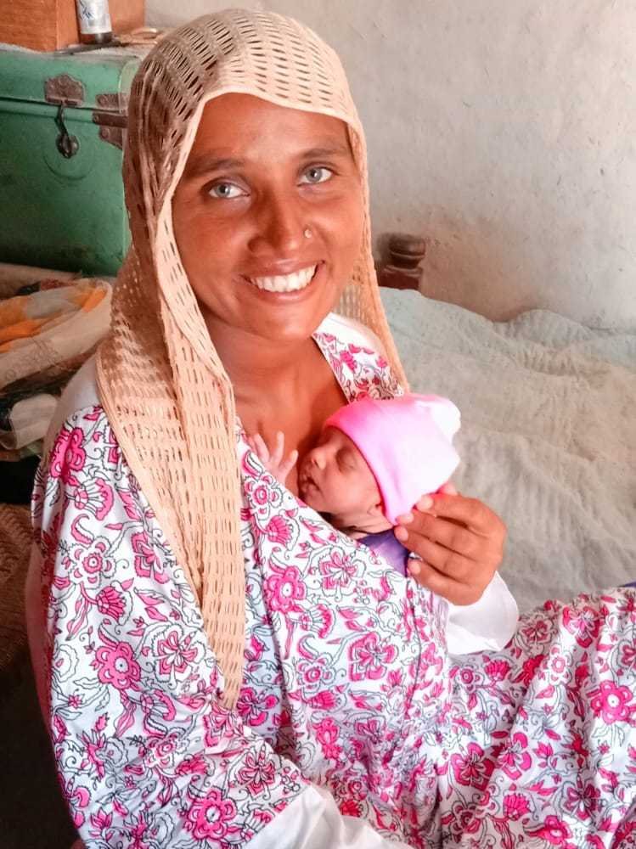
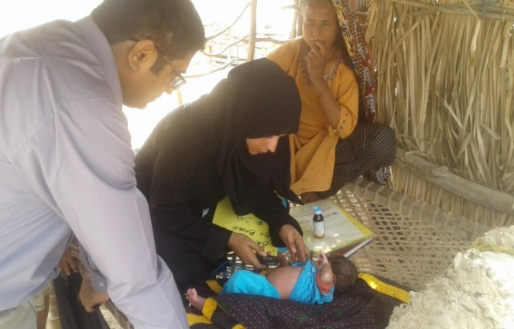
Successful Models of community engagement

Slide 29
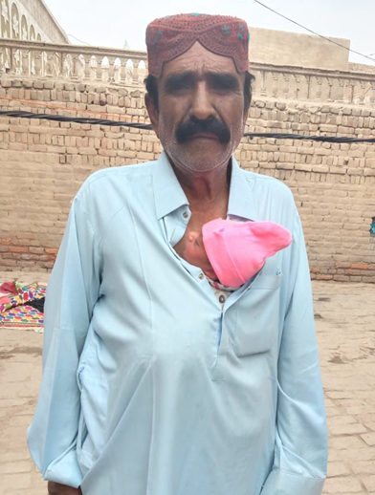
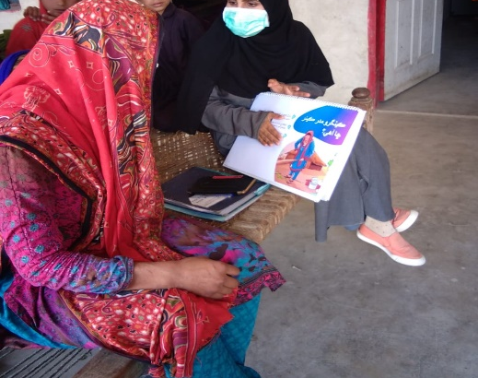
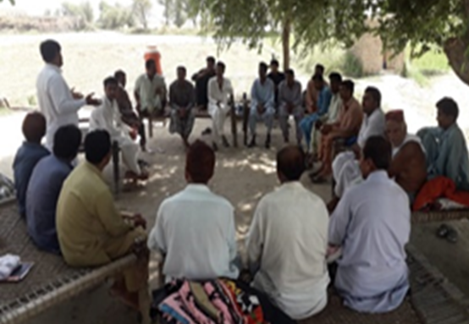
c-KMC - Community Mobilization
As part of community mobilization:
Trainings of Community and Facility-level Providers was conducted
One-to-one and group sessions with flip-cards, wall mounts, and self-explanatory video to maximize use of KMC in intervention clusters. Peer to peer learning through KMC champions was also practiced in the intervention clusters.

Slide 30
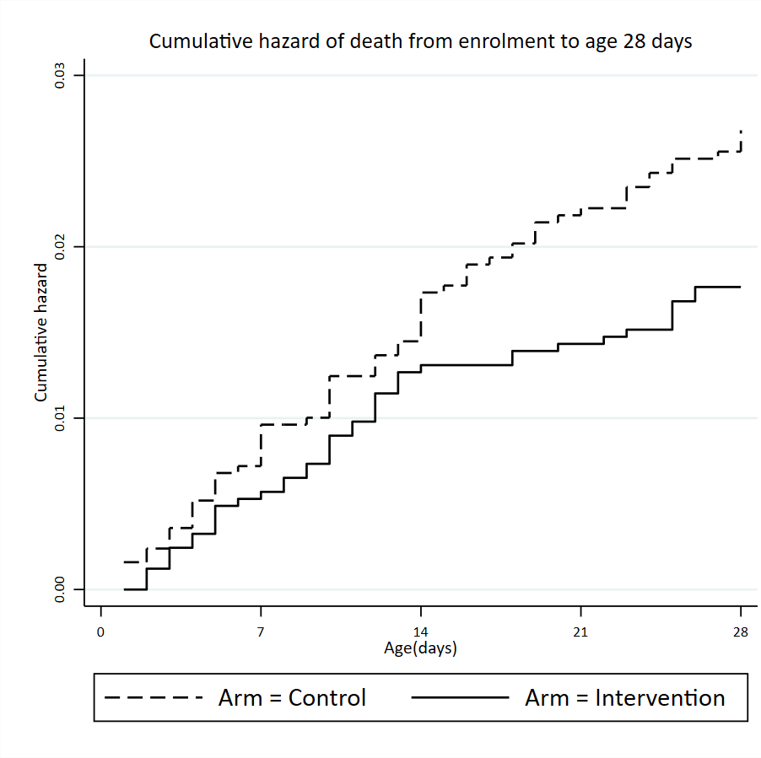
c-KMC - Impact
Neonatal deaths,
-In intervention clusters: 43 (1.7%)
-In control clusters: 66 (2.6%)
The risk of neonatal mortality was lower in intervention clusters (HR:0.66, 95% CI:0.44-0.99, p=0.045)
Neonates who received KMC had 59% lower risk of PSBI at 28 days than neonates who did not receive KMC
Notes:
Ownership
Awareness Sessions
Trust Building
Stakeholder Meetings

Slide 32
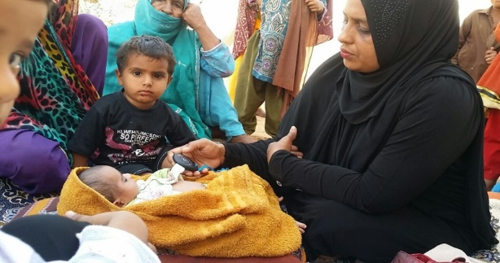
PSBI - Introduction
PSBI, in the neonatal and young infant are a global health issue and a major cause of mortality
An estimated 6.9 million newborns identified and treated for PSBI each year in sub–Saharan Africa, Latin America and South Asia ,and over 500000 deaths globally
The incidence of PSBI reported in the urban settings of Pakistan is∼112 per 1000 live births
The standard management of PSBI by WHO includes inpatient care using injectable antibiotics (penicillin or ampicillin plus gentamicin for 7–10 days)
Not feasible for resource limited settings, including Pakistan, refusal to hospital referral may be as high as 75%
Notes:
Ownership
Awareness Sessions
Trust Building
Stakeholder Meetings

Slide 33
PSBI - Challenges
Inadequate Physician Performance and Lack of Adherence to Guidelines
Antibiotic Resistance
Reluctance to Use Intramuscular Injections
Limited Access to Health Care Facilities
Lack of Awareness & Delayed Care-Seeking Behaviour
Unavailability of PSBI Services & Treatments

Slide 34
PSBI - Recommended Solutions
Public Private Partnerships
Continuous Monitoring and Evaluation

Slide 35
AKU’s Efforts in Addressing PSBI
Implemented a successful public private partnership for Possible Severe Bacterial Infections.
Leverage resources and expertise from all stakeholders
Bridge gaps in funding, expand coverage and evidence generation at real life scenarios
Enhance the efficiency of delivering healthcare solutions where needed most.
Partners: PPHI, WHO, and the LHW Program

Slide 36
AKU’s Efforts in Addressing PSBI

Slide 37
PSBI - Outcomes of Partnership
Management of sick young infants with Possible Serious Bacterial Infection (PSBI) where referral is not possible.
Implementation Research
To identify 80% or more of sick young infants in the study area.
80% or more of sick young infants with PSBI should receive appropriate treatment.
How to achieve the above programmatic objectives within the existing primary health care system through public private partnership

Slide 38
Technical Support Units
Coordination amongst stakeholders
Capacity building of LHW
Capacity building of BHU staff
20% validation of case management
Monitoring and Evaluation
Evidence generation

Slide 39
Community Outreach Activities - LHW Program
Pregnancy surveillance and registration
Postnatal home visits (1, 3, 7 & 28 days of life)
Assessment of newborn and YI, recognition of danger signs
Referral to BHU if danger signs present
Follow up visits at household level
Community awareness sessions

Slide 40
Implementation Partner: PPHI
Service delivery at Primary Health Care (PHC)
Leadership, motivate staff and share examples of best practices
Assessment, diagnosis and treatment of PSBI cases and refer for inpatient care.
Administer pre-referral treatment if referral accepted.
Simplified antibiotic treatment if referral is refused.
Follow up at BHU on day 4, 8 and 14.
Counseling & reinforcement for compliance to treatment and follow up.

Slide 41
Technical Support: WHO
Share existing evidence
Technical support
Capacity building of all stakeholders
National level Training of Trainer model

Slide 42
Key Achievements
HCWs were able to recognize, classify and treat patients in ambulatory settings.
Patients were managed and treated at BHUs including patients with CSI (80.4%), Severe Pneumonia (93.8%), and Critical Illness (94.6%).
0% mortality recorded amongst treated patients.

Slide 43
PSBI Guideline Implementation
Post-research, PPHI scaled up the PSBI management to 303 BHU plus facilities across Sindh (all divisions except Karachi) in 2018 and 2019
AKU, in collaboration with PPHI assessed the capacity of target BHU plus facilities and identified barriers to scale up of PSBI guideline implementation
Notes:
Lessons learnt from 2017:
LHW’s can identify sick young infants at community and refer them to BHUs for care seeking.
High acceptance and coverage of PSBI management at PHC/BHU level when referral is not feasible
Outpatient treatment with simplified antibiotics regimen improves outcome of sick young infants
PSBI management guidelines feasible at PHC/BHU level without major investment.

Slide 44
PSBI Contribution Towards Policy Making
Implementation and scale-up of WHO PSBI guidelines:
Provided evidence on efficacy to policy makers and HCWs
Informed evidence on health systems requirements to implement outpatient treatment for PSBI
Formed the basis of policy dialogue by stakeholders at national level to implement outpatient treatment of PSBI thereby reducing neonatal and infant mortality resulting from infection.
Notes:
Lessons learnt from 2017:
LHW’s can identify sick young infants at community and refer them to BHUs for care seeking.
High acceptance and coverage of PSBI management at PHC/BHU level when referral is not feasible
Outpatient treatment with simplified antibiotics regimen improves outcome of sick young infants
PSBI management guidelines feasible at PHC/BHU level without major investment.

Slide 45
Interventions leading to the Prime Minister Stunting Initiative Program through Social Programs (Income Support Program for marginalized populations)
Effectiveness of Nutritional Supplementation during the First 1000 days of Life to reduce Child Undernutrition: A Cluster Randomized Controlled Trial in Pakistan

Slide 46
Objective
Primary Outcome
Reduction in the prevalence of child stunting at 24 months of age.
To assess the effectiveness of different nutrition-based supplements on nutritional outcomes in both women and their children during the first 1000-days of life.
Secondary Outcomes
Improvement in mean length, weight, length-for-age Z-scores, weight-for-age Z-scores, and weight-for-length Z-scores.
Reduction in the proportion of underweight and wasting.
Improvement in infant and young child feeding practices.

Slide 47
Intervention package and delivery
Pregnant women received a monthly supply of 5 kg of wheat soya blend plus (WSB+) during pregnancy and the first six months of their lactation period.
The WSB+ consisted of partially cooked wheat and soya beans fortified with vitamins and minerals.
Infants received lipid-based nutrient supplement - medium-quantity (LNS-MQ) between 6-23 months of age.
LNS-MQ was prepared with roasted chickpeas, vegetable oils, dry skimmed milk, sugar, vitamins, and minerals, recommended emulsifier, and antioxidants.
The intervention delivery was administered by LHWs, with counseling sessions during supplements distribution, community sessions, and home visits every month on maternal nutrition during pregnancy, IYCF and messages on usage and benefits of supplements.

Slide 48
Key Findings
Nutritional status of infants within 28 days of life

Slide 49
Prevalence Of Stunting Among Children At 0, 6, 12, 18 And 24 Months Of Age **
*Analysis is based on measurements for infants within 28 days of birth and accounted for clustering.
**The analysis is accounted for clustering using a linear regression model.

Slide 50
Conclusion
Provision of WSB+ and LNS-MQ during the first 1000-days of life improved child linear growth and reduced stunting in children at 24 months.
The risk of reduction in stunting (8.6%) and wasting among children aged 6-23 months was statistically significant, along with the weight gain in pregnant women (5.8%), which shows that an immediate improvement in nutrition indicators is indeed possible.
Stunting Prevention project has proved the plausibility of achieving nutrition gains in short term with a combination strategy of nutrient-based supplements and BCC messages delivered through the primary health care system.

Slide 51
Effectiveness of cash transfers combined with lipid-based nutrient supplement and/or behavior change communication to prevent stunting among children in district Rahim Yar Khan, Pakistan

Slide 52
Primary Objective
To assess that BISP cash transfers, specialized nutritious food (SNF) and/or social and behavioural change communication (SBCC) will result in a 20% reduction in the prevalence of stunting in children at the age of 24 months
Secondary Objectives
To assess reduction in the prevalence of wasting and underweight among children at 24 months of age
To assess improvement in the micronutrient status and infant and young child feeding practices among children at 24 months of age
To assess the cost-effectiveness of different intervention packages for the reduction in stunting among children at 24 months of age
Cash-based transfers
4,834 PKR, and then 5,000 PKR on quarterly basis was provided by BISP, Government of Pakistan
Lipid-based nutrient supplement (LNS) - Wawamum
Monthly ration of 30 sachets of 50g LNS provided to each child for 18 months during 6-24 months of age
Social & behaviour change communication (SBCC)
SBCC included monthly house-house visits, and quarterly community sessions with IEC materials by LHWs

Slide 53
Methods
Formative research to develop SBCC package
A 4-arm cluster randomized trial to determine the effectiveness of different intervention packages
Six-monthly Process evaluations to identify key bottlenecks, opportunities and improve program implementation
Cost effectiveness analysis to assess the cost of each intervention package
Study arms
UCT alone = 430
UCT + SBCC = 431
UCT + LNS = 426
UCT + LNS + SBCC = 430
Unit of randomization:
LHW catchment area as the unit of randomization to deliver the intervention package
Of the 1600 LHW catchment areas or clusters identified, a total of 200 clusters were randomly selected and assigned into 1 of 4 study arms

Slide 55
Pooled and adjusted prevalence of stunting, wasting and underweight in children 6-24 months of age
Variables | Stunting¹ | Wasting¹ | Underweight¹
 | (95% CI) | (95% CI) | (95% CI)
UCT | 41.7 (37.9, 45.4) | 9.5 (7.6, 11.3) | 21.9 (18.7, 25.2)
UCT + SBCC | 44.8 (40.3, 49.3) | 9.7 (7.8, 11.6) | 22.1 (18.5, 25.8)
UCT + LNS | 38.5 (34.3, 42.7) | 8.4 (6.5, 10.3) | 20.8 (17.3, 24.3)
UCT+LNS+SBCC | 39.3 (35.1, 43.4) | 8.6 (6.5, 10.7) | 21.6 (17.8, 25.4)
Percentage compliance to LNS (day consumed/days observed *100):
UCT + LNS = 82.7 (+11.2)
UCT + LNS + SBCC = 94.1 (+11.3)
P value = <0.001
# of LNS sachets shared with other family members:
UCT + LNS = 50.3 (+34.5)
UCT + LNS + SBCC = 15.3 (+34.6)
P value = <0.001
¹Accounting for cluster, gender and age
²P values were obtained from generalized linear model using a log link and binomial distribution

Slide 56
Conclusion
Use of UCT combined with LNS and SBCC were shown to be effective in reducing the prevalence of stunting in children at 24 months of age in low-and-middle-income setting
1
Scaling up of the UCT, in combination with LNS and SBCC sessions is recommended to improve the nutritional status of children living in marginalized populations
2
Cash with SNF and cash with SNF and SBCC are cost-effective interventions in reducing malnutrition in children at 24 months of age
3

