Slide 1


Social Media Basics
Bite-Size Skills-Building Session:
December 17, 2024
Suzanne Slattery
Senior Communications Advisor

Slide 2

Today’s Goals
This micro lesson intends to give you basic information on social media. By the end of the session, users will become more familiar with:
The professional benefits of social media
Popular platforms
Basic terminology
Types of content
Practical tips to get started

Slide 3

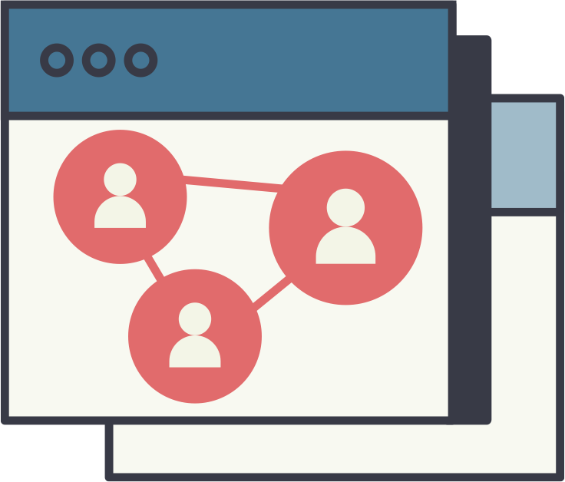
Social Media as a Professional Tool
Learning of /attending events
Sharing information & resources
Participating in topical discussions
Sector-specific information
Inspiration
Creating a personal brand
Notes:
Social media usage is rapidly expanding. In 2021, over half of the global population was using social platforms, and by 2027, it's projected that more than 6 billion people will be active users. While social media allows us to stay connected with friends and family, it also provides a valuable mechanism to disseminate important information and resources among global networks. As these platforms continue to grow, it's crucial to become proficient in using them—not only to observe and participate in relevant conversations but also to understand key topics, identify influencers, and engage meaningfully with specific communities.
Social networking sites allow individuals or organizations to set up a profile and connect with others who have a shared interest. While initially viewed as primarily for young people, today all age groups use social networking sites as a way to connect, share, and collaborate.

Slide 4




Social Media Landscape
Facebook
Owned by Meta, world’s biggest social media platform with reportedly 3 billion monthly users.
Versatile for marketing, building community groups, promoting events, and sharing articles, photos and videos.
LinkedIn
Largest professional networking site with over 1 billion users from 200+ countries.
Good for recruitment, sharing blogs, webinars, research results, and other professional content.
Instagram
Owned by Meta and began as a photo sharing app. Since evolved to a strategic platform for marketers and companies.
Primarily for sharing photos/videos. Limited for link sharing.
2+ billion monthly users; generally younger demographic.
X
Easy to follow hashtags and stay connected to topics of interest.
Shorter messages (280 character length).
Monthly users estimated 611 million.

Slide 5
Common Terminology
Direct Message (DM): Private way of chatting without others seeing.
Feed: Your main content stream where you will see the content of those you follow.
Follower: Someone who subscribes to your account on a platform.
Hashtag: Keyword or phrase you add to your social media posts. Way to tag and organize content. E.g. #ChildSurvivalAction
Impressions: Key metric; shows how often your content appears on users’ screens
Mention: When you tag or refer to another user on social media with the @ symbol
Reply: Users respond to comments, forming conversation threads.
Repost: When you share someone else’s content on your profile and a way to spread interesting content to your followers.

Slide 6

What is Content?
Many things can be content, including:
Project/program updates
Success stories
Events
Research
Presentations
Blog pieces about relevant topics in the news/media
Use what you have and repurpose it across platforms.
Invite engagement — respond to comments, post open ended questions to
invite discussion, encourage followers to share your post, interact with posts
from those you follow.

Slide 7



Repurposing Example
A report you co-authored was published
Instagram, Facebook, LinkedIn
LinkedIn, X, Facebook
Infographic on key insight/ takeaway (with caption that discusses significance)
News update, blog/thought piece

Slide 8
General Getting Started Tips
Know your purpose (have a plan/strategy).
  What are your goals? Are you looking to be observational (monitoring) or active?
  Use Forrester Research’s POST method: People Objectives Strategy Technology
Check your security preferences.
Be active! Check in once a day.
Prioritize the platforms that work best for your message and audience.
Use a variety of content. Don’t forget about resharing!
Look at the profiles of people you admire for inspiration.

Slide 9
Questions, Experiences, Insights?

Slide 10
Thank you!
Follow the Task Force on:
www.linkedin.com/company/child-health-task-force/
@ChildHealthTF
Questions? Email childhealthtaskforce@jsi.com

