Slide 1
Forum: Agricultural Resilience and Nutrition Session 3: Addressing Climate Change and Nutrition for Improving Health Outcomes January 23, 2025
Hosted by: The Child Health Task Force and Children Environmental Collaborative, UNICEF, Global Communities, Save the Children

Slide 2
Presenters
Chloe Angood
Nutrition Specialist, UNICEF, Eastern and Southern Africa Region
Nathalia Niño Giraldo
Junior Project Manager, KnowlEdge Srl & Associate in IISD
Liesbeth Casier
Lead, Public Procurement and Sustainable Infrastructure and Coordinator of the NBI Global Resource Centre, IISD
Tamene Taye
NSA CASE Project Director, Save the Children Ethiopia

Slide 3
Agricultural Resilience and Nutrition
Engage with the moderators:
Swathi Manchikanti: smanchikanti@unicef.org
Dr. Hayalnesh Tarekegn (Bissie): htarekegn@savechildren.org
Reach out to the Child Health Task Force Secretariate: childhealthtaskforce@jsi.com
Subgroup information, recordings and presentations from previous webinars are available on the subgroup page of the Child Health Task Force website: www.childhealthtaskforce.org/subgroups/expansion

Slide 4
The Child Health Task Force is managed by JSI Research & Training Institute, Inc. through the USAID M-RITE project and funded by USAID and the Bill & Melinda Gates Foundation.
This presentation was made possible by the generous support of the American people through the United States Agency for International Development (USAID), under the terms of the Cooperative agreement #7200AA20CA00017 awarded to JSI Research & Training Institute, Inc. The contents are the responsibility of JSI and do not necessarily reflect the views of USAID or the U.S. Government.

Slide 5
Introduction to climate change and nutrition
Chloe Angood, Nutrition Specialist UNICEF Eastern and Southern Africa Regional Office (ESARO)
© UNICEF/UN0123456
Notes:
Jane

Slide 6
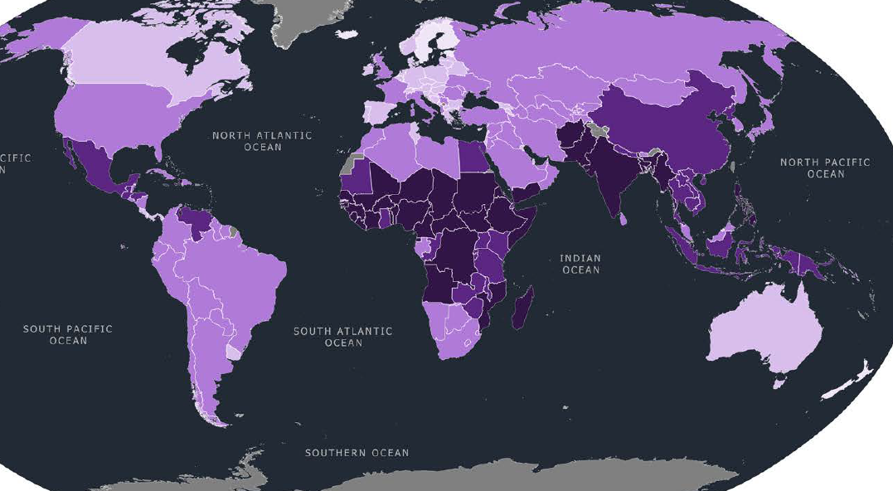
The Climate Crisis is a child crisis
Half of the world’s children (1 billion) live in extremely high-risk countries
Overlaps geographically with the countries in the world with the highest rates of child malnutrition
99% of all children are exposed to at least one major climate and environmental hazard, shock or stress
Notes:
CCRI = overlaying exposure to climate hazards with child vulnerability – where are children lacking access to basic services?
First time this was done, 2021 and Africa-focus in 2023
Climate crisis is multi sectoral
Children are overlooked and underfunded, our response is extremely important

Slide 7
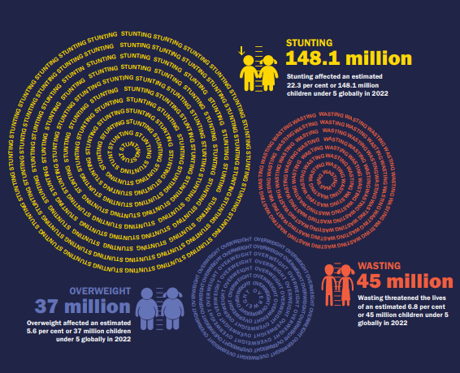
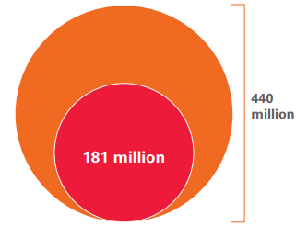
The Climate Crisis is a child nutrition crisis
440 million children < 5 live in child food poverty
181 million live in severe child food poverty
Climate change puts pressure on food, health, social protection, water and education systems that support child nutrition and malnourished populations are less resilient to climate change.
By 2050, it is predicted that an additional 40 million children will be stunted and 28 million wasted due to climate change.

Slide 8
Pathways to increased malnutrition
MATERNAL AND CHILD MALNUTRITION
DIETS
Insufficient food quantity and dietary diversity, and excessive consumption of ultra-processed foods.
HEALTH & CARE
Infectious and vector-borne diseases, dehydration and heat stress, and decreased physical activity.
FOOD
Reduced access to nutritious, affordable, safe and sustainable food and palatable drinking water.
PRACTICES
Reduced caregiver time and support for food preparation, child feeding, hygiene and care.
SERVICES
Inadequate access to effective nutrition, health, education, sanitation and social protection services, and unhealthy food environments.
RESOURCES
Livelihood/income losses; infrastructure damage; lower agrifood and fish/ aquaculture productivity and quality; biodiversity and ecosystem changes; and displacement and migration.
GOVERNANCE
Less sustainable economic growth; political commitment prioritized away from nutrition-relevant sectors; and reduced social sector budgets.
NORMS
Harmful gender and social norms increase vulnerability and reduce resilience to climate change (e.g., women’s high domestic and childcare responsibilities, and low incomes).
Climate change, variability, extremes and shocks
Greenhouse gas emissions from food and health systems
Greenhouse gas emissions

Slide 9
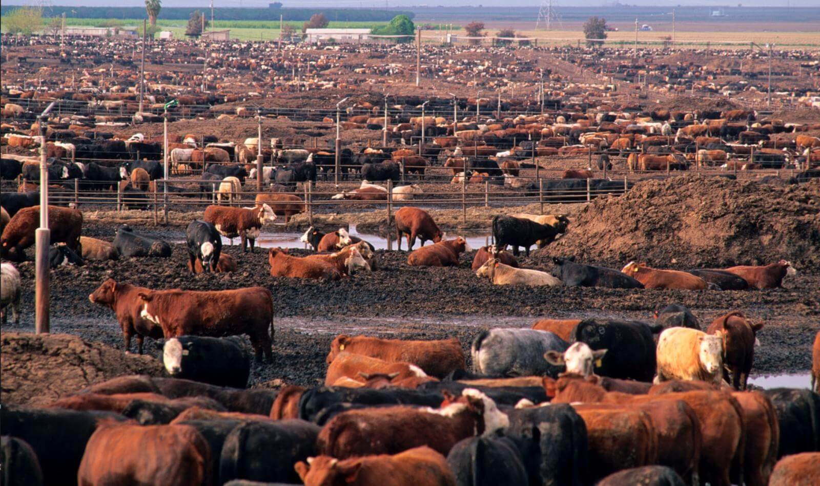
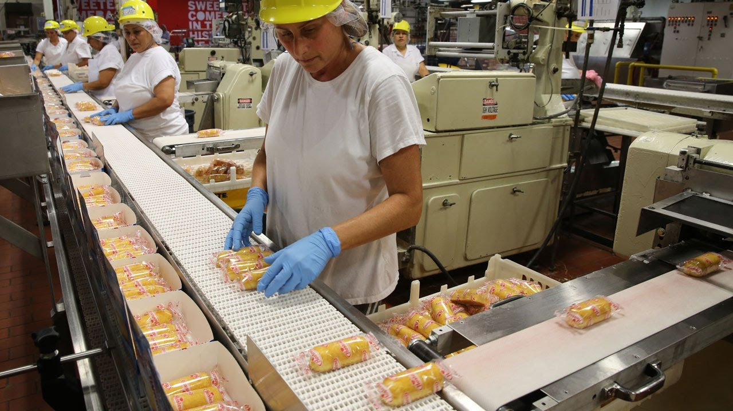
Food systems contribute to climate change
More than one-third (34%) of global greenhouse gas emissions caused by human activity can be attributed to the way we produce, process and package food.
Through…
Food production especially fertilizers, methane from livestock and rice cultivation, and food processing and packaging
Land use especially deforestation and soil erosion that reduce carbon sinks
Food distribution

Slide 10
Climate nutrition action
Adaptation actions to moderate impacts of climate change on nutrition by reducing vulnerability and strengthening climate resilience
Improved maternal and child nutrition
Mitigation actions that reduce the sources or enhance the sinks of greenhouse gases from systems that support nutrition
Mitigation
Adaptation
Synergies simultaneously mitigate GHG emissions, adapt to climate change and improve nutrition.
Governance actions that create an enabling environment for climate nutrition action
Governance
Notes:
Which brings me to climate-smart nutrition programming
So this is new thinking, very new thinking, and we are inviting you through this workshop to help us define what it is and how we should implement it.
Climate-smart nutrition is about mitigation and adaptation to ultimately improve nutrition in the face of climate change
Climate change mitigation is about reducing the emissions or enhancing sinks of greenhouse gases from the systems that influence nutrition, including food, WASH, health. By reducing emissions, nutrition programming can contribute to global efforts to slow the rate of climate change.
Very importantly, this should not be putting any burden or expectation on the households and communities UNICEF supports, it is about bringing about change to the systems that support their nutrition and generating win wins for climate mitigation and nutrition.
Adaptation on the other hand is about finding ways to reduce the harm of climate change to the maternal and child nutrition
Adaptations do this by reducing vulnerability and strengthening climate resilience – we'll be discussing what climate vulnerability and resilience are in the first session today
Synergies can be generated between climate mitigation and adaptation and nutrition. For example, promoting diets that are are more sustainable, low carbon, and nutritious blut that are also less sensitive to the effects of climate change or more suitable to future climate conditions in a place.
Some actions are cross-cutting addressing the enabling environment for climate mitigation and adaptation.
This about creating the right policy framework, providing the right information to inform adaptation and mitigation, and ensuring the resources are available for bringing about change

Slide 11
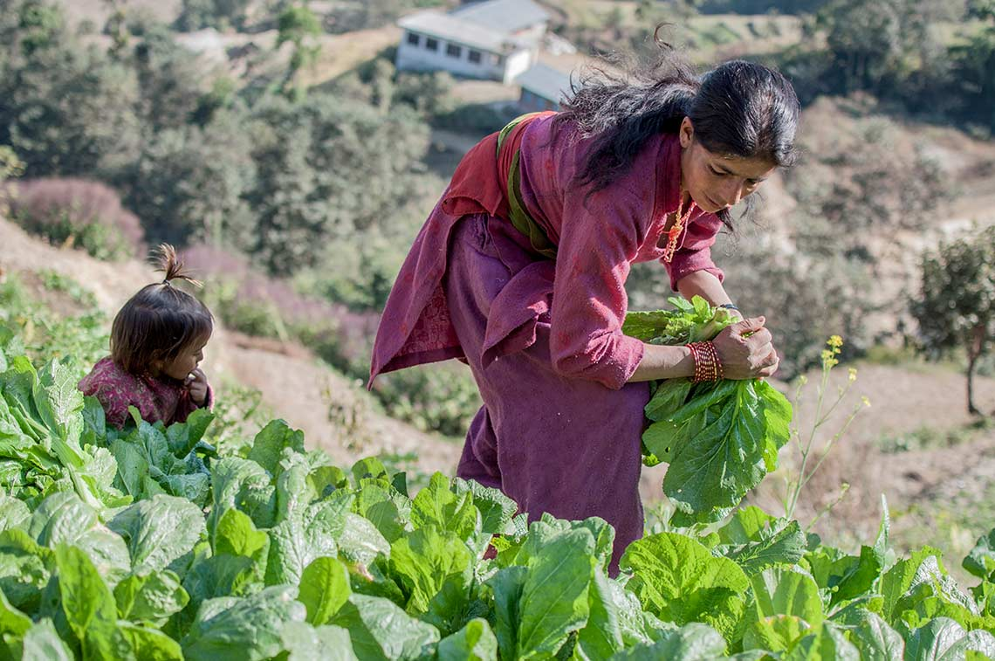
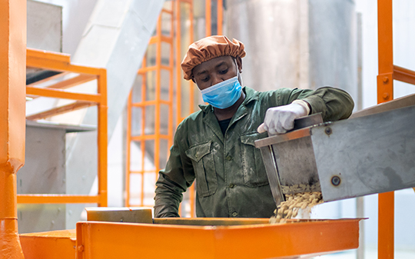
Climate nutrition adaptation actions
Protect children’s diets, nutrition services and nutrition practices from climate change
Adapting food systems to increase the availability of nutritious foods for children through climate-adaptive and resilient food supply chains.
e.g.
Using climate smart agriculture in the local production of nutritious, safe, affordable, sustainable foods for children.
Social marketing of these foods.
Large scale food fortification of staple foods using climate resilient food supply chains.

Slide 12
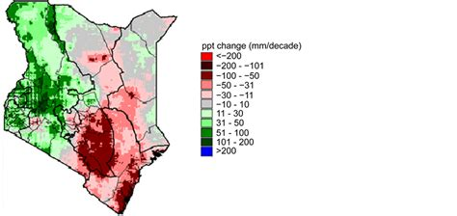
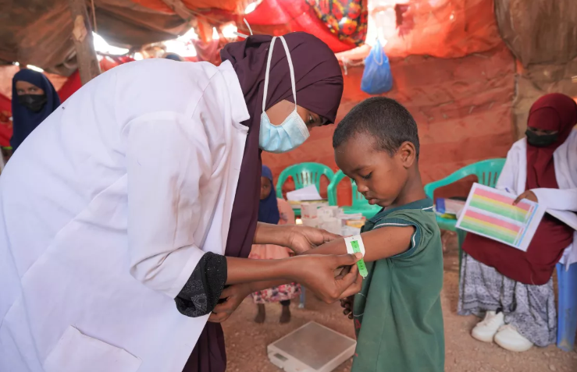
Climate nutrition adaptation actions
Strengthening the adaptability and resilience of health systems to deliver essential nutrition services in the face of climate change.
e.g.
Use climate data to adapt the design and delivery of nutrition services and trigger anticipatory responses.
Adapt nutrition service platforms to address changing needs (mobile health clinics, tele-nutrition, community-based services)

Slide 13
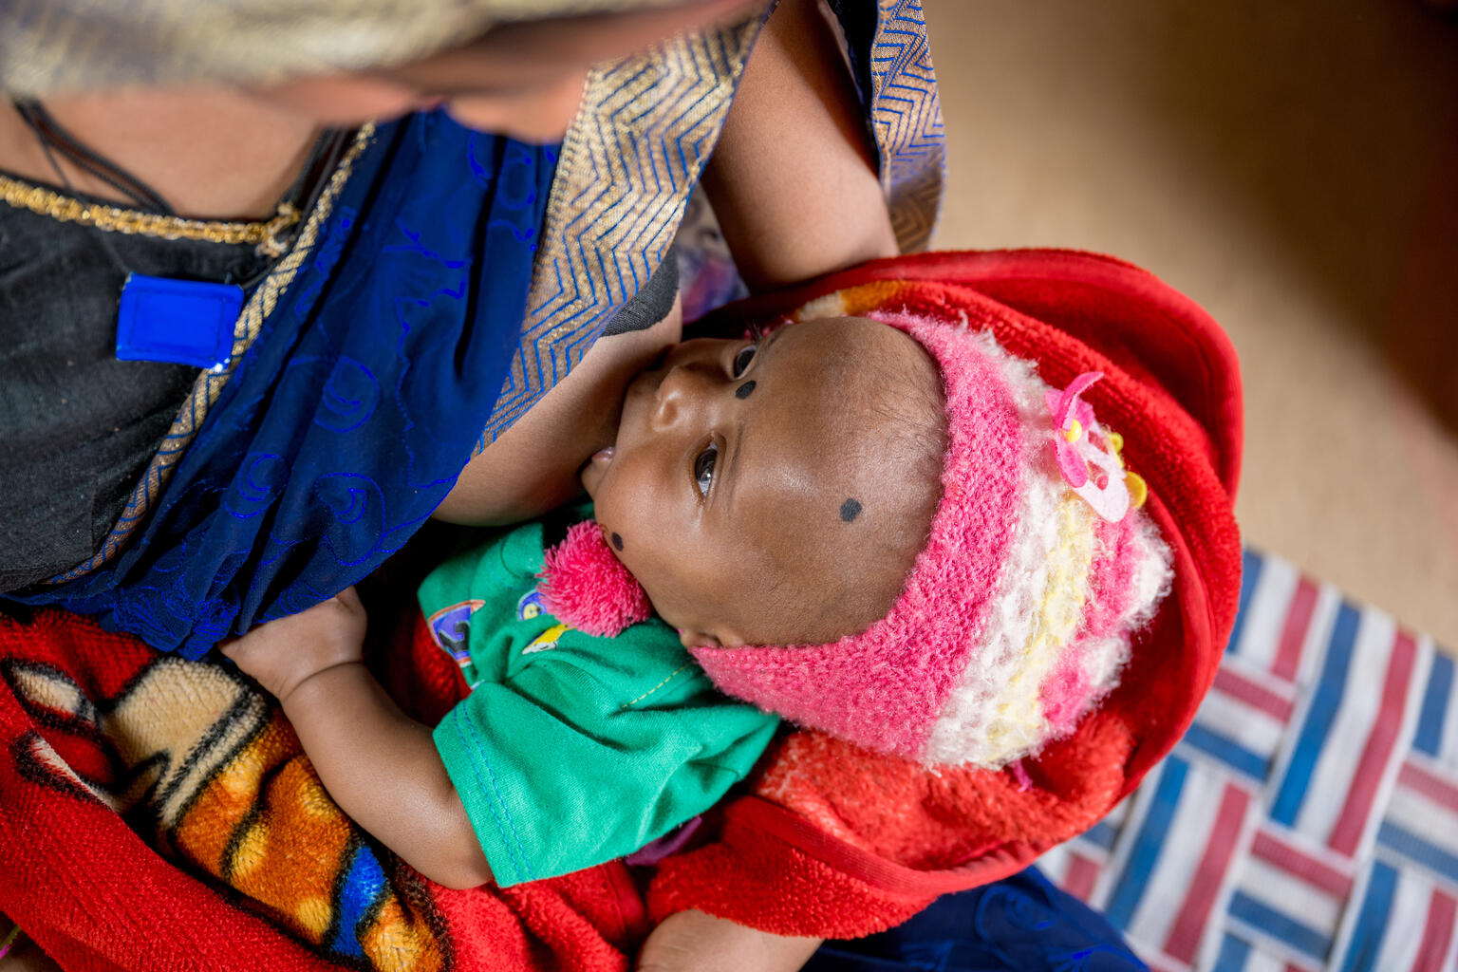
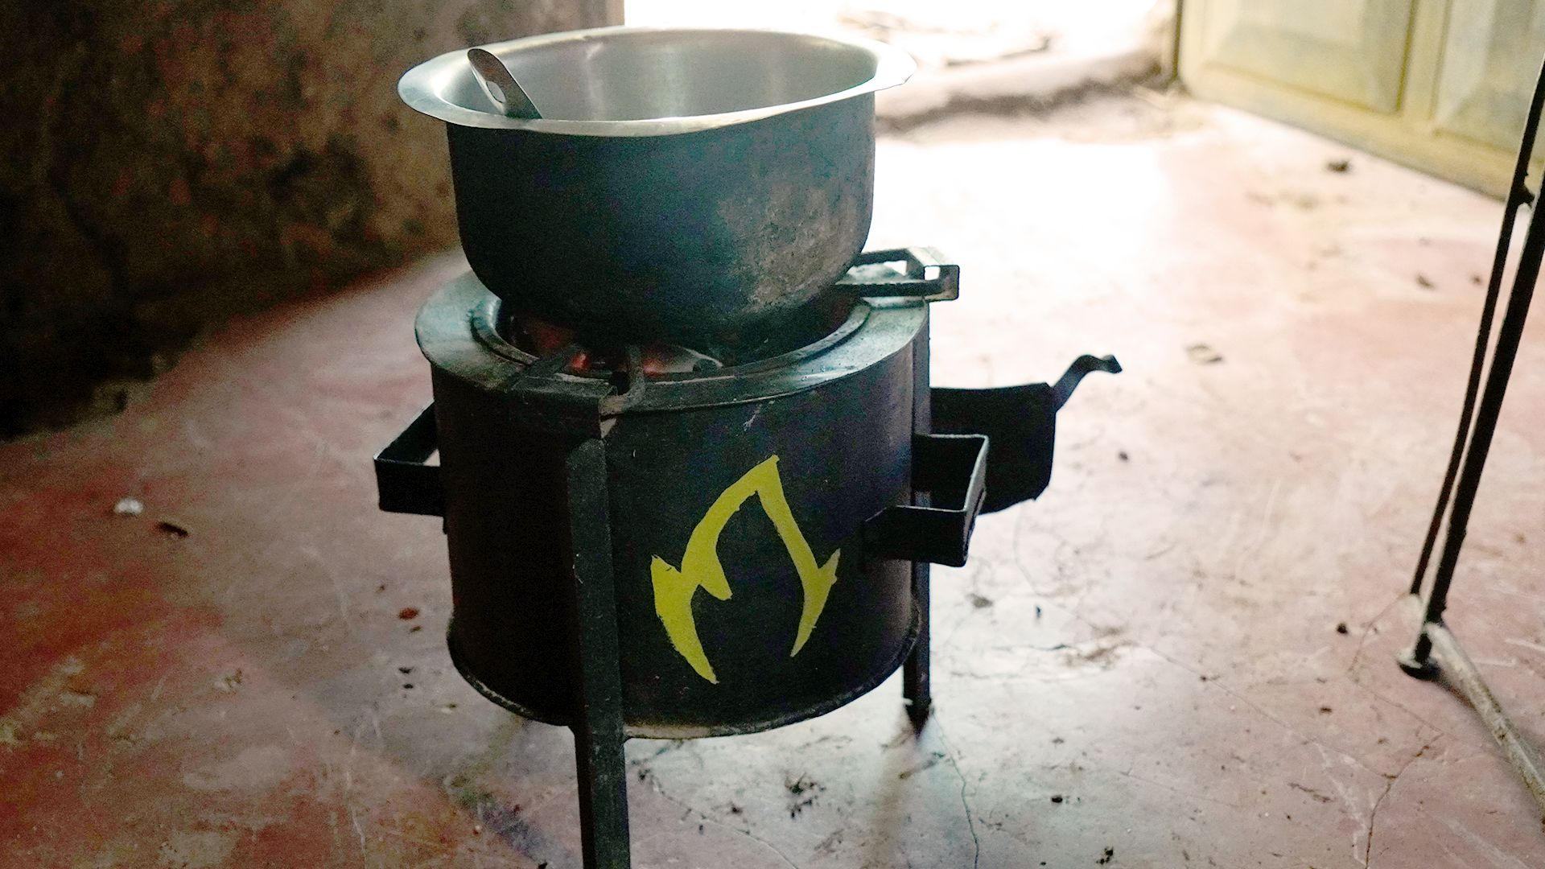
Climate nutrition mitigation actions
Promote nutritious diets, nutrition services and practices that are beneficial for the planet
Promoting low-carbon food supply chains that supply nutritious, safe, affordable and sustainable foods for children.
Building healthy food environments to reduce consumption of ultra-processed foods and beverages by children and young people.
Promote and support feeding and dietary practices beneficial for nutrition and the planet e.g. breastfeeding and clean cooking.

Slide 14
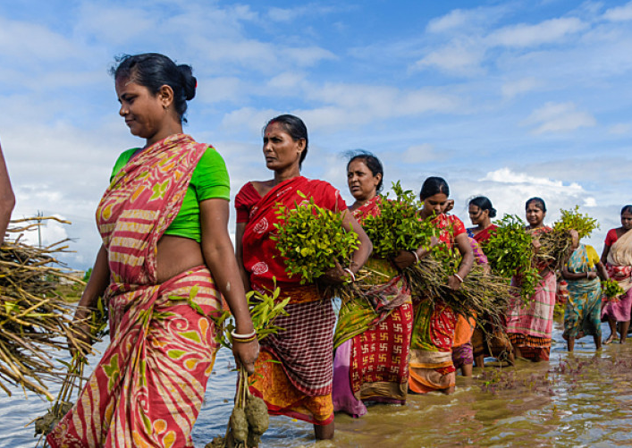
Positioning nutrition in climate agendas
Nationally Determined Contributions (NDCs)
National Adaptation Plans (NAPs)
Long term strategies
And in global and regional climate finance agendas

Slide 15
Aligning with country plans
NDC: The nationally determined contributions are commitments that countries make to reduce their greenhouse gas emissions as part of climate change mitigation.
LTS: a long-term strategy is a formal document a country uses to communicate its plans for long-term low-emissions development.
NAP: The National Adaptation Programme (NAP) Every 5 years, the government produces an assessment of the risks and opportunities from climate change and reports on how we will adapt in the NAP.
Thank you!
Likely under food, health and gender pillars
Notes:
Emilie
Galvanizing a global commitment to ensure a sustainable world and protect the most vulnerable children from the worst impacts of a changing climate and degrading environment.
Realizing the right of every child and adolescent to live in a clean, healthy and sustainable climate and environment

Slide 16
Sustainable Asset Valuation of the Nutrition Sensitive Agriculture Capacity Strengthening Project in Ethiopia

Slide 17
Our mission
The NBI Global Resource Centre aims to:
bring together key partners to establish an investment case for Nature-Based Infrastructure (NBI).
encourage and facilitate the widespread use of NBI to help address climate change, biodiversity loss and the global infrastructure gap.

Slide 18
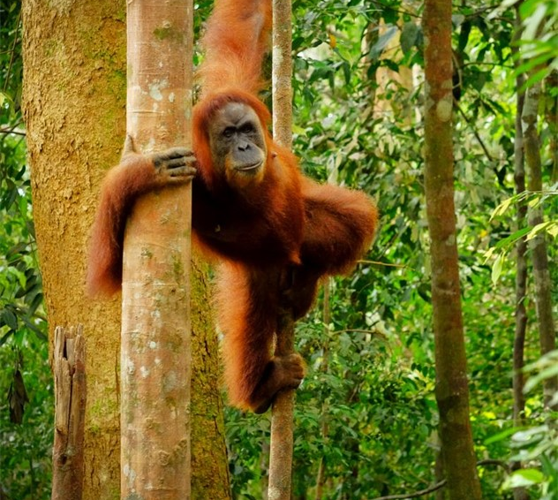
What is NBI?
Forest
Forests, street trees
Nature-Based Infrastructure (NBI) is a subset of Nature-Based Solutions (NbS) and is sometimes referred to as Natural Infrastructure or Green/Blue Infrastructure.
It describes landscapes or ecosystems that harness nature to provide infrastructure services for people, the economy, and the environment.
The combination of traditional “grey” infrastructure with NBI, such as rain gardens, green roofs, sustainable urban drainage systems and porous pavements, are referred to as hybrid solutions.
Coastal
Coral reefs, mangrove forests, sand dunes, salt marshes, sea grass
Urban
Rain gardens, green roofs, sustainable urban drainage systems
River
Rivers and floodplains
Wetland
Peatland, constructed or natural wetland, lakes

Slide 19
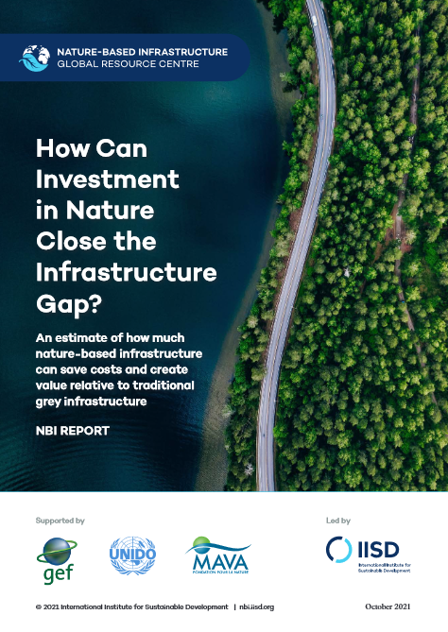
What if we invest in NBI where possible?
Insights from IISD‘s economic valuations
NBI is up to 50% cheaper than conventional built infrastructure that delivers the same infrastructure services
NBI provides about 28% more value through added benefits and avoided costs
Swapping 11% of investments from grey infrastructure to NBI could save USD 248 billion each year, and create additional benefits worth USD 489 billion every year

Slide 20
NUTRITION SENSITIVE AGRICULTURE CAPACITY STRENGTHENING IN ETHIOPIA (NSA CASE) Project
Results/Achievements to date
A heightened commitment to nutrition created both at the federal and regional level with agri-sector policies & strategies streamlining nutrition objectives
NSA indicators, standardizing reporting formats and AGMIS introduced
Strong NSA coordination platforms via established forums at federal & regional level
Strong organizational structure created:
Food and Nutrition office at federal MOA
Nutrition Directorates at project regions
958 nutrition positions created
Project area: Ethiopia MoA, Amhara, Oromia and Somali region BOAs
Project grant: 6,042,902 USD
Donor: Bill & Melinda Gates Foundation
Project Period: 2019-2024
Overview of the grant
- The NSA CASE project aimed to strengthen the agriculture sector capacity by addressing systemic bottlenecks: finance, human resource, M&E system and coordination capacity.
- The project operates through a grant under grant approach with close follow up and support to the subgrantee from SCI ET.
Key Issues
- Nutrition less financed and less prioritized by Ministry of Agriculture
- MOA M&E was weak with no uniform reporting formats, indicators, and digital system to manage nutrition and other Agri data
- The MOA did not have the technical capacity to coordinate nutrition both internally and across sectors
- There was weak organizational capacity in terms of human resource to operationalize NSA strategy of MOA
Outcomes of the project
- Increased financing for and prioritization of the implementation of the NSAS in three regions
- Increased capacity of MOA staff to regularly use NSA data for decision-making
- Improved capacity within the MOA and regional bureaus to coordinate NSA activities
- Sustained human resource capacity for nutrition-sensitive agriculture at regional, zonal and woreda levels
Key Lessons learned
Grant-Under-Grant mechanism helps creates capacity, ownership and accountability within MOA to lead implementation of a system-based NSA project
Strong NSA organizational structures positioned strategically at the MOA and regional BOAs ensure accountability and stronger alignment with lower administrative structures.
Digital data management guides agriculture sector nutrition initiatives by providing firsthand information in real-time.
Strong NSA governance and leadership of a sector can be achieved through targeted advocacy, strengthening sectoral coordination, and exposing sector high level officials to best practices.

Slide 21
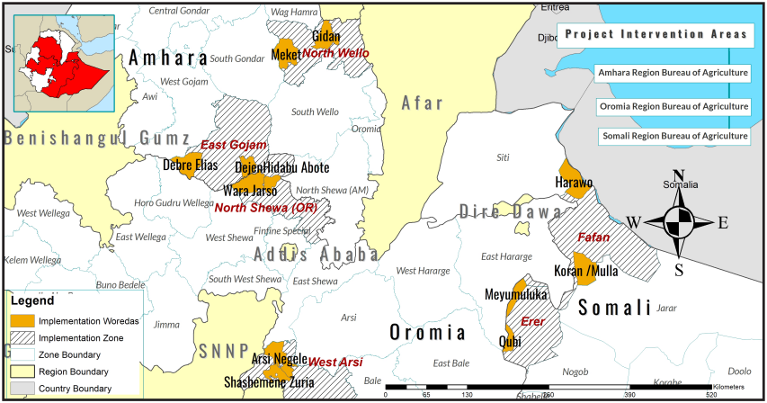
Map of the regions

Slide 22
Project context
Ethiopia, a landlocked nation in Northeast Africa, is marked by its diverse climates and landscapes. This diversity in geography makes Ethiopia highly vulnerable to the effects of climate change.
Since 1960, the country’s average temperature has risen by 1°C, with the most significant warming occurring from July to September. Alongside increasingly erratic precipitation patterns, this has led to severe droughts and floods that affect livelihoods and food security.
Rising temperatures and unpredictable rain patterns are causing soil erosion, reducing agricultural productivity, shortening growing seasons, and creating ideal conditions for crop diseases and pests.

Slide 23
The proposed solution
Agroforestry and sustainable agriculture
In response to these challenges, the Nutrition Sensitive Agriculture Capacity and System Strengthening Project (NSA CASE project) was designed to enhance food security and climate resilience in Ethiopia’s most vulnerable regions. This 5-year project (2019–2024) has been implemented in three regions of Ethiopia with the goal of enhancing
access,
availability, and
consumption of nutritious foods
What is the approach?
The project targets three key regions—Oromia, Amhara, and Somali—where interventions include:
planting drought-tolerant perennial fruit trees (nature-based infrastructure)
introducing improved seed varieties
utilizing moisture-harvesting technologies
The assessment used the outcomes of the NSA CASE project to estimate the full impacts of investments for food resilience under the National Nutrition Sensitive Agriculture Strategy.

Slide 24
Assessment objectives
Evaluate the social, environmental, and economic impacts of agroforestry and sustainable agriculture
Quantify the costs, benefits, and financial performance of the scenarios

Slide 25
Sustainable Asset Valuation methodology (SAVi)
Based on systems thinking, system dynamics simulation, spatial modeling, and project finance modeling.
Simulation
Developed by giving a financial value to economic, social and environmental externalities and risks.
Valuation
Customized to reflect local conditions and needs.
Customization
Co-created through a multi-stakeholder approach that allows for the identification of material risks and opportunities that are unique to the project.

Slide 26
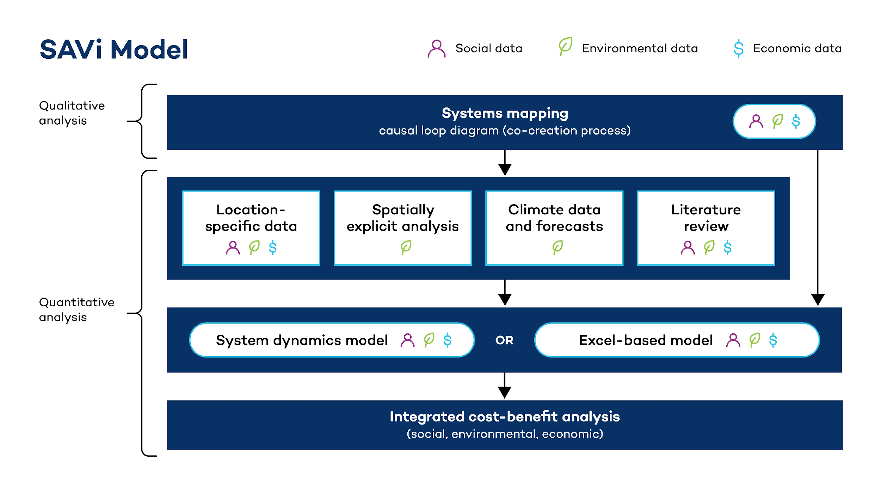

Slide 27
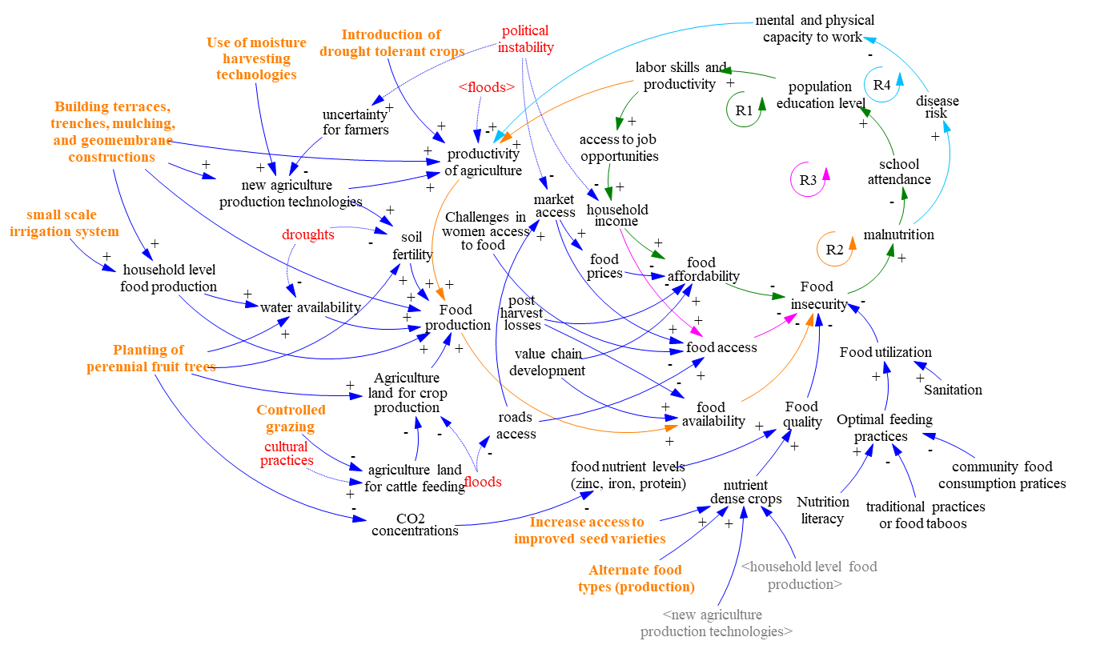
Causal Loop Diagram (CLD)
Visual tool used to represent the feedback loops and cause-and-effect relationships within a system
Tells the story of the problem
Generates a common understanding of the system
Created with a multidisciplinary team and different stakeholders
First step on the identification of indicators for cost-benefit analysis and basis for the quantitative model

Slide 28
Integrated CBA Indicators
Direct Costs
Capital Costs (CAPEX)
Operation and maintenance costs (OPEX)
Added Benefits
Income creation from implementation and O&M jobs
Revenues from additional agriculture production
Carbon storage
Avoided Costs
Flood damages to properties
Flood damages to agriculture
Drought damages to agriculture
Value of loss of life from flooding
Cost of malnutrition

Slide 29
Scenario Definitions
Overview of scenarios modelled
Business as Usual scenario
Nature-based infrastructure scenario 1
Nature-based infrastructure scenario 2
Nature-based infrastructure scenario 3
No-action scenario where no interventions are implemented to
either improve the food security situation or increase climate resilience in Oromia, Amhara,
and Somali regions.
The NBI scenario includes all the CBA indicators for the following interventions:
- planting of perennial fruit trees (agroforestry)
- increasing access to improved seed varieties
introduction of drought-tolerant crops, and
use of moisture-harvesting technologies
Includes the same interventions of the NBI scenario 1 but takes into account only the externalities directly related to the agriculture sector:
(i) job creation in implementation and O&M, (ii) revenues
from additional agriculture, (iii) flood damages to agriculture, and
(iv) drought damages to agriculture.
Includes the same interventions of the NBI scenario 1 but narrows down the analysis only to:
(i) revenues generated by the agriculture sector due to the
interventions and the (ii) job creation in construction and O&M from the interventions.

Slide 30
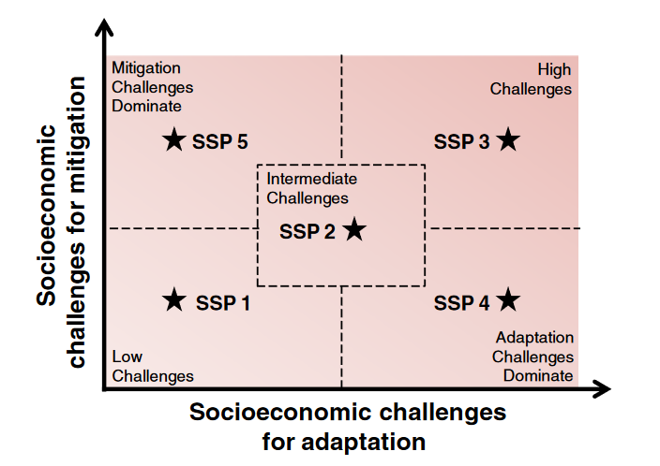
Scenario Definitions
Climate scenarios
The Shared Socioeconomic Pathways (SSPs) describe five possible future scenarios :
SSP1: Sustainable development; low inequality; rapid technological change leads to low carbon energy sources and high land productivity
SSP2: Intermediate between SSP1 and SSP3
SSP3: Unmitigated emissions from moderate economic growth; high population growth; slow technological change; large inequality; reduced trade flows due to a regionalized world
SSP4: Rapid technological change in key emitting regions; slow development in other areas with large inequality and isolated economies
SSP5: High energy demand is met with fossil fuels; rapid economic development with investments in human capital leads to equitable resource distribution and slower population growth

Slide 31
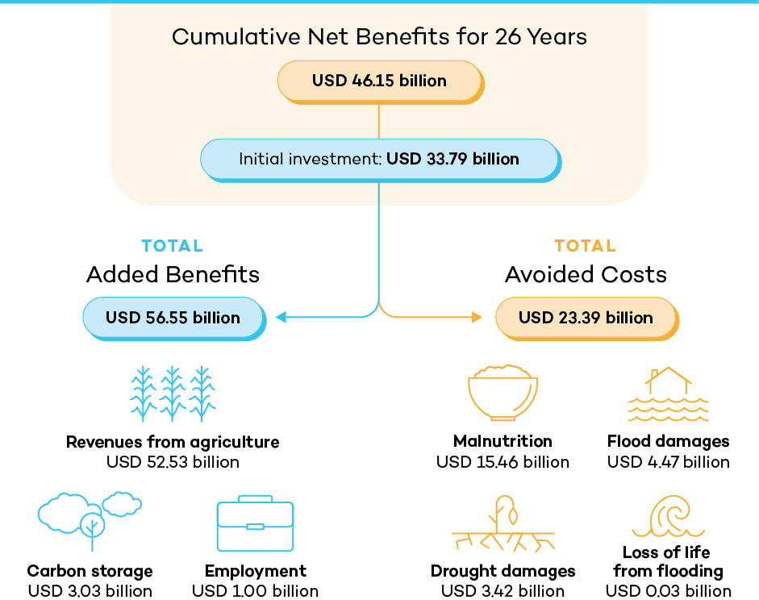
Results Nbi scenario 1

Slide 32
Integrated Cost-Benefit Analysis (CBA)
Cost-Benefit Analysis, cumulative discounted values from 2024 to 2050 | NBI scenario 1 | NBI scenario 2 | NBI scenario 3
Total costs | 33.79 | 33.79 | 33.79
Capital cost | 3.57 | 3.57 | 3.57
Operations & Maintenance costs | 30.21 | 30.21 | 30.21
Total added benefits | 56.55 | 53.53 | 53.53
Job creation from implementation | 0.70 | 0.70 | 0.70
Job creation from O&M | 0.30 | 0.30 | 0.30
Revenues from additional agriculture production | 52.53 | 52.53 | 52.53
Carbon storage | 3.03 | - | -
Total avoided costs | 23.39 | 7.77 | -
Flood damages to properties | 0.12 | - | -
Flood damages to agriculture production | 4.35 | 4.35 | -
Drought damages to agriculture production | 3.42 | 3.42 | -
Value of loss of life from flooding | 0.03 | - | -
Cost of malnutrition | 15.46 | - | -
Net profit | 46.15 | 27.51 | 19.74
Benefit-to-cost ratio | 2.37 | 1.81 | 1.58
Internal rate of return | 153.89 % | 93.97 % | 85.77 %
Values in USD billion cumulative over 26 years, discounted at a 10% rate.

Slide 33
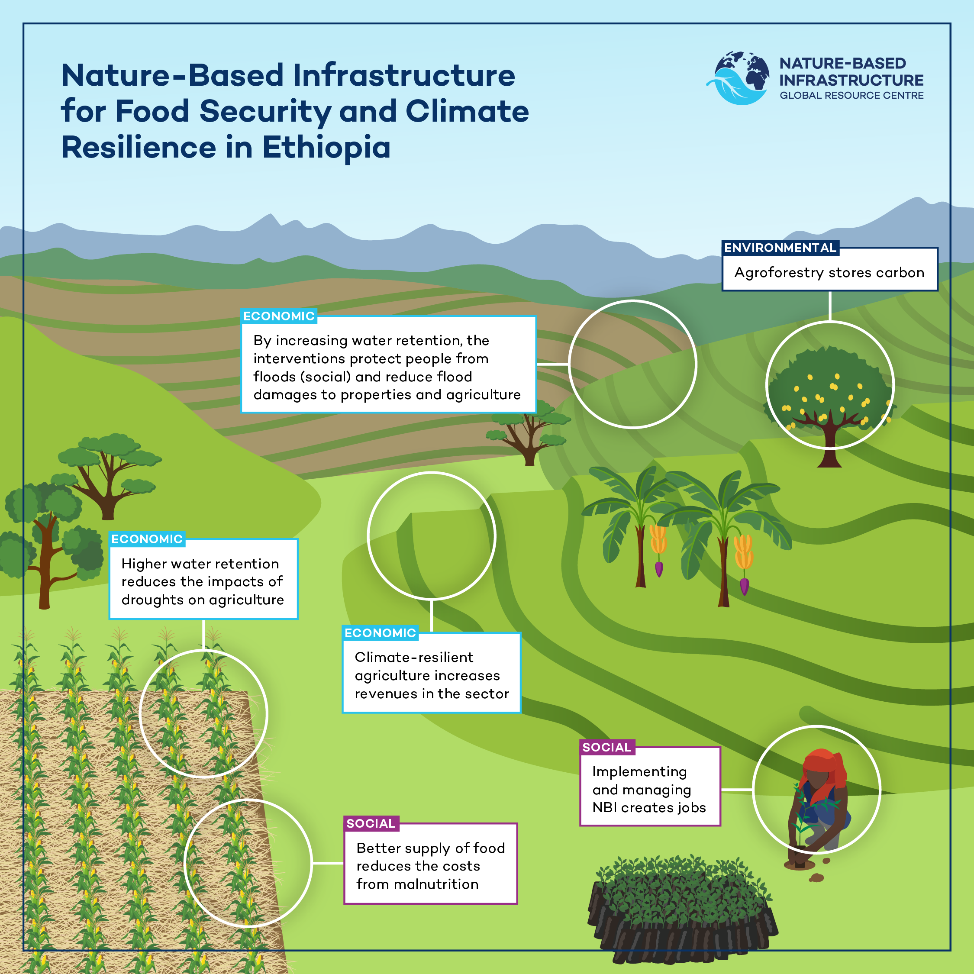
Benefits of NBI
Social:
Reduction of malnutrition
Job creation
Reduction of loss of life from flooding
Environmental:
Carbon storage
Economic:
Increased agriculture revenues
Reduced flood damages
Reduced drought damages

Slide 34
Conclusions
Economic Viability: All modeled scenarios show positive returns on investment, with Scenario 1 yielding the highest Benefit-Cost Ratio (2.37) and Internal Rate of Return (153.89%).
Health and Nutrition Co-Benefits: Significant reduction in malnutrition costs (USD 15.46 billion avoided under Scenario 1) underscores NBI’s impact on improving public health and reducing stunting in children.
Environmental Sustainability: Carbon sequestration (USD 3.03 billion under Scenario 1) and reduced flood and drought damages highlight long-term environmental resilience.
Nature-Based Infrastructure (NBI) as a Game Changer:
NBI integrates ecological restoration and sustainable agricultural practices, offering a viable path to address climate change while enhancing food security and public health.
Comprehensive Accountability for Externalities: Scenarios that include a full spectrum of social and environmental impacts yield the highest economic and societal benefits, emphasizing the necessity of addressing both direct (e.g. food production) and indirect (e.g. malnutrition) externalities.
Multi-faceted Benefits:
NBI scenarios demonstrate the ability to mitigate climate-induced challenges such as droughts, floods, and soil degradation, directly impacting agricultural resilience and food systems.

Slide 35
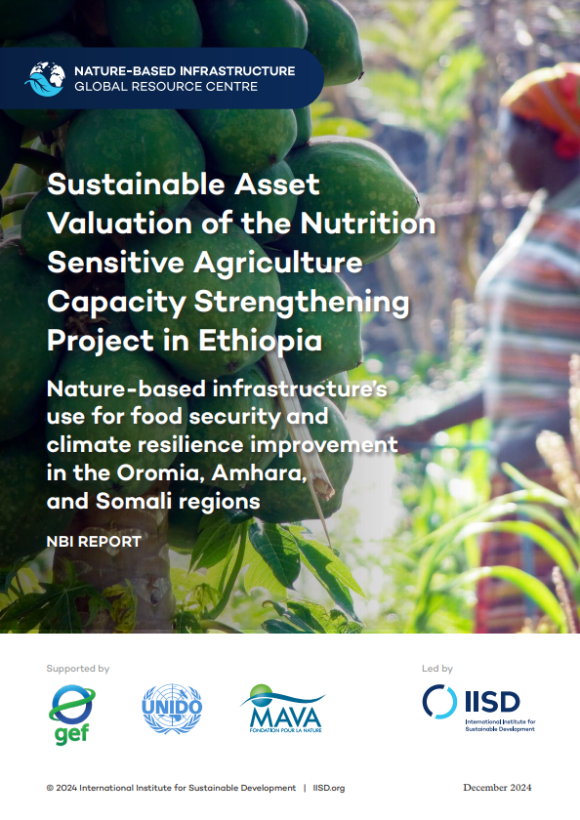
Sustainable Asset Valuation of Climate-Smart Agriculture in Ethiopia
Technical report:
https://nbi.iisd.org/report/climate-smart-agriculture-ethiopia/

Slide 36
How the assessment findings will be used by the project/ MOA
Informing Policy and Planning
Prioritize NBI investments
Integrate NBIs into sectoral policies
Develop NBI guidelines and standards
Securing Funding and Investment
Attract public and private investment for NBI
Advocate policy makers/government for funding NBI
Implementing and Scaling Up NBIs
Scale up successful NBIs

Slide 37
Thank you!
For more information, please contact:
Liesbeth Casier – lcasier@iisd.org
Tamene Taye – tamene.taye@savethechildren.org
Nathalia Niño Giraldo – nathalia.nino@ke-srl.com
https://nbi.iisd.org

Slide 38
Questions and Answer Discussion Please put any questions in the chat for our moderators. S’il vous plaît, poser vos questions dans le chat.

