Slide 1
CHILD SURVIVAL ACTION
A Results Framework for Accountability, Advocacy and Action
January 22, 2025
Acknowledgements to: Countdown to 2030, Global Financing Facility, JSI, London School of Hygiene & Tropical Medicine, MOMENTUM, PRB, Save the Children, UNICEF, USAID, and WHO

Slide 2
Outline
4
1
Section 4
Section 1
Use of existing data in Sierra Leone:
Situational Analysis
Introduction to CSA
2
5
Section 2
Section 5
Q&A and Closing Remarks
Development of the CSA Results Framework
3
Section 3
CSA Results Framework
Core Set of Indicators
Equity and Quality, Learning agenda
Implementation milestones
Way Forward

Slide 3
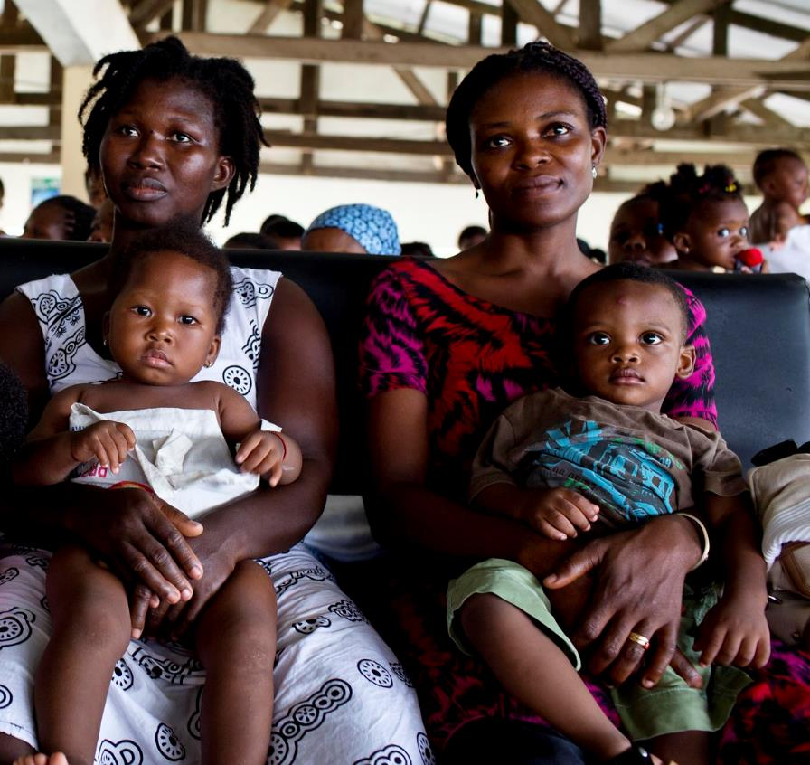
Section 1 Introduction to CSA
Photo: Kate Holt/MCSP Ghana

Slide 4
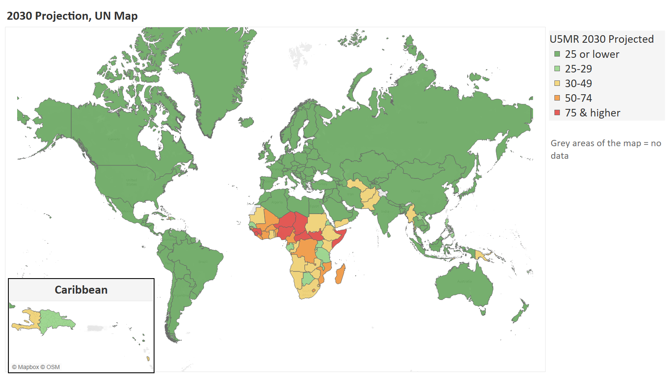
Child Survival Action: What Brings us Together?
59 countries need accelerated action to meet the SDG target for children under 5 of 25 deaths per 1000 live births.
In 38 off track countries, over 50% of the deaths occur in the 1-59 month period. These are generally also the countries with highest overall under-five mortality rates.
CSA focuses on supporting countries to reduce mortality for children ages 1-59 months in alignment with the continuum of care (EWENE; formerly ENAP/EPMM)
Notes:
Option 3 for What Brings Us Together Slide

Slide 5
CSA’s Goal: End preventable child deaths, with focus on children 1–59 months of age
The CSA initiative is a call to partners to address the challenges that have hampered progress in ending preventable child mortality with a focus on high burden countries
Focuses on the countries, over 75% in Africa, that urgently need accelerated efforts to achieve the SDG3 2030 target on child mortality of 25 deaths or fewer per 1000 live births (as of April 2024).
Reaches the children being left behind and at risk from leading killers - pneumonia, diarrhea, and malaria - due to malnutrition, lack of access to quality health services including immunization, unsafe water and sanitation, air pollution, conflict and humanitarian disasters, and other key risks to children’s health and survival.
Strengthens primary health care in facilities and communities to more effectively prevent, diagnose, and treat these causes of child death, and to promote good health and nutrition for all children.
Builds effective partnerships between governments, local partners, civil society, private sector, regional and global organizations, as part of renewed commitment to child survival.
Mobilizes required resources from domestic and international sources and sectors to deliver on this renewed vision for children’s health, nutrition, and survival.

Slide 6
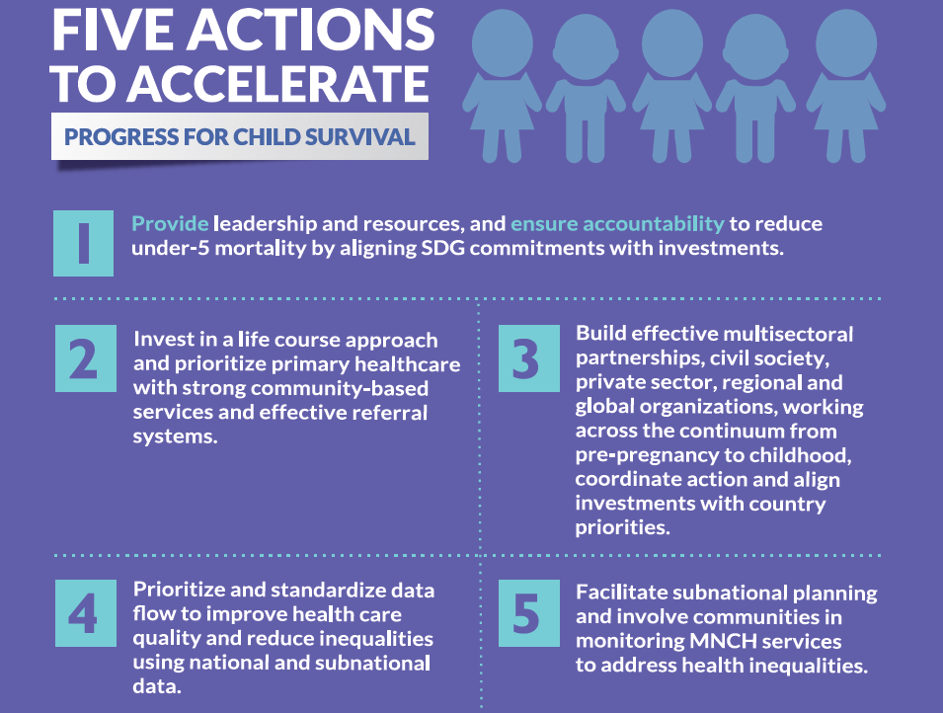
In response to these mortality, intervention, and systems challenges, Child Survival Action (CSA) was launched in 2023

Slide 7
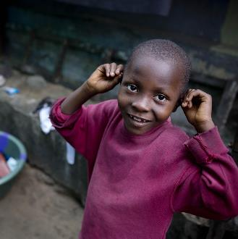
Child Survival Action
Our Goal: End preventable child deaths, with focus on children 1–59 months of age
Accelerate action to reduce mortality throughout the life course continuum
Ending preventable maternal mortality (EPMM)
Every newborn action plan (ENAP)
Child Survival Action (CSA)
Align with efforts by other sectors and programmes
Air pollution

Slide 8
Section 2 Development of the CSA Results Framework
Photo: MOMENTUM; IMA World Health

Slide 9
Why a CSA Results Framework?
Advocacy & Accountability
Action
Use impact and coverage indicators to raise awareness and financing at global and country levels
Engage and coordinate with partners in countries to work toward common goals
Use evidence to plan, program, inform resource allocation, and monitor and track implementation

Slide 10
Principles in results framework development
Overarching principles of CSA
Child’s rights to survive and thrive ● Leave no child behind ● Family- and child- centered care ● Whole-of-government action ● Accountability
Build on other global tracking initiatives (e.g., SDGs, Countdown to 2030) to highlight and advocate rather than recreate and duplicate
Leverage existing country data in to reduce data collection and reporting burden
Focus on main causes of mortality in children 1-59 months of age in countries off-track to reach SDG 3.2.1
Select validated and recommended indicators (e.g., Child Health Accountability and Tracking technical advisory group)

Slide 11
CSA follows EWENE approach to a global results framework and has two main components
Implementation milestones and country-specific implementation indicators
Structures/Inputs
Processes
Outputs
Limited number of validated indicators
Outcomes
Promote, Prevent & Treat
Impact
Coverage ● Quality ● Equity

Slide 12
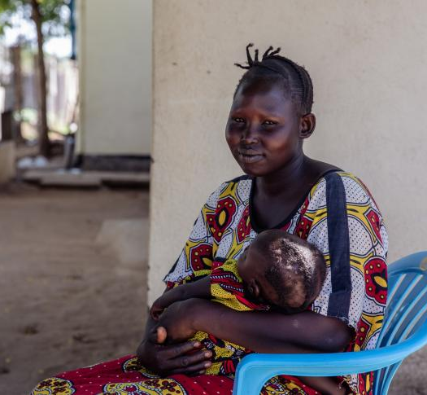
Section 3.1 CSA Results Framework: Core Set of Indicators for Global Advocacy
Photo: MOMENTUM; Hadjara Laouali Balla

Slide 13
Process for selecting the core set of indicators for global advocacy
1
2
Mapping of indicators on child survival from all major global and regional initiatives
Develop Criteria for selecting core indicators
CHAT, Countdown to 2030, WHO 100 indicators, Nurturing Care Framework, CAP 2030 Child Health and Well-being Dashboards, JMP indicators, Monitoring guide for HMIS/Pink Book, QED catalogue, WHO Pediatric quality of care metrics, PHC measurement framework, TEAM for nutrition, IA2030 for immunization, Global Action Plan for the Prevention and Control of Pneumonia and Diarrhea
Reference to ENAP-EPMM to ensure continuity
3
4
Iterative process for consensus on core indicators
Presentation to Child Health community at the CHTF event in June 2023
Regular convenings of the Results and Accountability WG
Consultations with other groups in the CSA governance structure (face to face meeting in the spring 2023, discussions with the CSA partner group and with the Steering Committee)
Consultations with expert groups
Nutrition (WHO, UNICEF, TEAM, Data Dent)
Immunization (WHO, UNICEF, GAVI, IA2030)
Malaria (WHO, UNICEF)
WASH (WHO, UNICEF, JMP)
GFF Results team
Countdown to 2030
2 consultations with CHAT to finalize list
5
Finalization of list

Slide 14
Four types of Core Indicators
Indicator Type
Impact (Mortality and Nutrition)
Outcome: Nutrition (Promote)
Outcome: Illness Prevention (Prevent)
Outcome: Illness Management (Treat)
Contextual Factors

Slide 15
Impact and outcome indicators
Indicator Type | Indicator
Impact | Under-five Mortality Mortality 1 month-59 months Wasting prevalence (moderate/severe) Stunting prevalence (moderate/severe)
Outcome/ Coverage | Nutrition Exclusive breastfeeding Minimum Dietary Diversity (component that drives MAD) Vitamin A supplementation (2 dose) Illness prevention ITN use in children under the age of 5 Diphtheria, tetanus and pertussis (DTP3) immunization coverage Measles immunization coverage (second dose) Zero dose (absolute number) Illness management Diarrhea treatment with oral rehydration salt solution (ORS) and zinc Malaria diagnostics usage Care Seeking for symptoms of ARI Care-seeking for fever Children diagnosed with malaria treated with ACT (or first line antimalarial based on national policy)
Contextual | Population using basic drinking water services* (SDG 6.1.1) Population using basic sanitation services* (SDG 6.2.1) Population with basic handwashing facilities at home* Food Insecurity Experience Scale (SDG 2.1.2) Gender/Women’s empowerment (SDG 5.1.1.)

Slide 16
Example of aligned targets for CSA core indicators: Mortality
Indicator | Associated Global Target | Global target and initiatives alignment
Under-five Mortality | Reduce child under-5 mortality rate to at least as low as 25 deaths per 1 000 live births by 2030 | Global target is SDG target 3.2. and SGD Indicator 3.2.1. Indicator is aligned with all major child health global initiatives.
Mortality 1 month-59 months | Child 1 to 59 months mortality rate at least as low as 13 deaths per 1,000 children aged 28 days by 2030 | Proposed global target. Indicator aligned with UNIGME reporting 2024 and mortality estimates dashboard.
*CSA advocacy products will also include analyses of the leading causes of deaths in children 1-59 months in the off-track countries

Slide 17
Example of aligned targets for CSA core outcome/coverage indicators: Nutrition (protect)
Indicator | Associated Global Target | Global target and initiatives alignment
1. Exclusive breastfeeding | By 2025, at least 50% of infants are exclusively breastfeeding in the first 6 months By 2030, at least 70% of infants are exclusively breastfeeding in the first 6 months | Global target is stated in the Global Nutrition Monitoring Framework, endorsed as target number 5. Target also included in the Global Action Plan on Child Wasting and Global Action Plan for Prevention and Control of Pneumonia and Diarrhea. Target for 2030 proposed by nutrition community. Indicator consistent with these and other initiatives.
2. Minimum dietary diversity | N/A | Indicator aligned with indicators in the Global Nutrition Monitoring Framework and recommended by the TEAM advisory group.
3. Vitamin A supplementation (second dose) | N/A | Indicator aligned with indicators in the Global Nutrition Monitoring Framework and recommended by the TEAM advisory group.

Slide 18
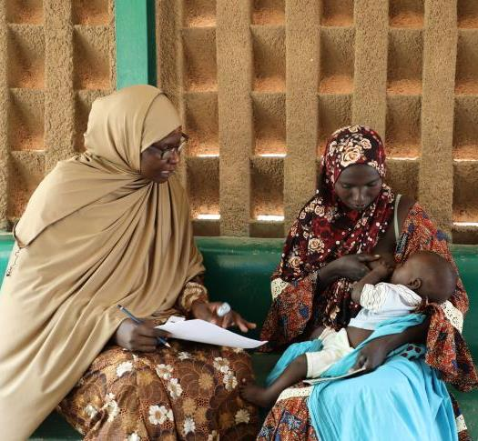
Section 3.2 CSA Results Framework: Equity, quality, and learning agenda
Photo: MOMENTUM; Hadjara Laouali Balla

Slide 19
Equity in the CSA Results Framework
Impact and outcome indicators should be disaggregated by key equity factors such as rich-poor, urban-rural, geography, and mother’s education
Recommended equity analyses
Compare equity patterns across countries using national estimates and equity patterns within countries using subnational estimates
Examine progress towards mortality targets at the national level and amongst the poorest quintile
Calculate coverage gap between wealthiest and poorest quintile
Compare coverage level in the poorest quintile to the national average
Examine progress towards coverage targets between poorest, wealthiest, and national average
Use maps and equiplots to visualize the data
Consider other equity indicators for specific analyses, such as child food poverty measures
Note: Gender equity captured through relevant disaggregation (e.g., women’s education) and context indicator for Gender/Women's empowerment SDG 5.1.1

Slide 20
Incorporating Quality of Care indicators into the CSA Results Framework
Rationale:
Processes:
Key Global Resources:
Quality of Care (QoC) is an essential driver of child survival
QoC metrics include system readiness measures, process measures including provision and experience of care, and outcome measures
Limited standard child health QoC measures collected and available across countries
CSA mapped globally recommended pediatric QoC indicators to each of the core CSA indicators
CSA developing a “living indicator menu” for countries to consider tracking at national and sub-national levels, based on their specific child health programs
CSA is advocating for more measurement work and learning on pediatric quality of care indicators and promotion of their uptake
WHO QoC Standards and Core and menu of pediatric QoC indicators
WHO Analysis and use of facility data –2023 recommendations for MNCAH programme managers
Indicator and monitoring framework for the Global Strategy for Women’s, Children’s and Adolescents Health
Network for Improving quality of care for maternal, newborn and child health –core indicators in monitoring framework

Slide 21
CSA Results Framework learning agenda
Protect Measures:
Improve measurement of nutrition counseling interventions and other interventions delivered through the health system, such as management of acute malnutrition
Examine and improve indicators related to air quality and links with childhood asthma and respiratory disease
Prevent Measures:
Consider measures for the malaria vaccine roll-out
Improve measurement around DTP3 drop-out rates
Examine whether identification and measurement of zero-dose children can identify children missing out on other services
Illness Management Measures:
Examine ways to improve indicators of pneumonia and malaria treatment, especially within the context of antibiotic and antimicrobial resistance
Improve the measurement of disease severity for fever, diarrhea, etc. related to careseeking and treatment indicators
Equity Measures:
Improve measurement equity categories such as disability status, ethnicity/race, more granularity by age, etc.

Slide 22
Section 3.3 CSA Results Framework: Implementation Milestones
Photo: MOMENTUM; Hadjara Laouali Balla

Slide 23
Development of Implementation Milestones: Mapping of domains across similar initiatives
1
CSA Theory of Change
2
ENAP-EPMM milestones and results framework (previous and 2023)
3
WHO Primary Health Care Levers, Monitoring framework & indicators
4
WHO Quality of Care Network Leadership, Action, Learning and Accountability
5
CSA country engagement learnings. For example, Sierra Leone identified a set of country-specific bottlenecks potentially relevant to all countries in implementation

Slide 24
Development of Implementation Milestones: Criteria to identify suitable milestones
Indicates the quality of program implementation
Signals importance to countries for accountability, tracking, advocacy and dialogue
A menu of milestones and further resources that countries can use and adapt
Some milestone areas may require data that are not routinely collected and reported
Previous ENAP Milestones seen as “best fit” for CSA to use as its model

Slide 25
CSA Implementation Milestones (under revision)*
Governance & accountability, national plans, & financing Milestone 1: Countries have implemented coordination structures, plans, and specific policies for improving the health of children | ● Governance and coordination structures ● National vision, strategy & operation plan(s) ● Standards & policies for QoC ● Financing & allocation of resources ● Civil society engagement & social accountability mechanisms
Service delivery systems Milestone 2: Countries have service delivery systems that provide integrated, high-quality child health services | ● Integrated care protocols, referral systems & care pathways ● Health Workforce ● Medicines, Diagnostics, commodities and equipment ● Systems to improve quality and experience of care ● Payment systems and fee exemptions
Community & Family engagement Milestone: Countries foster community and family engagement in child health and wellbeing | ● Community, civil society and other stakeholder involvement ● Parents’ voices and champions
Data & Evidence Milestone: Countries are routinely tracking, collecting and using to data to track progress toward reaching targets for child Mortality 1 month-59 months mortality | ● Minimum child health data set and program review ● Disaggregated child health data ● Data to improve quality ● Monitoring mortality and cause of death ● Learning for innovation, implementation & adaptation
Partnerships Milestone: Partnerships leveraged to improve child health | ● Public-private partnerships leveraged & aligned ● Multi-sectorial partnerships & partnership platforms ● Partnership and coordination with private sector services
Coverage ● Quality ● Equity
*Milestones and domains may change slightly pending further work

Slide 26
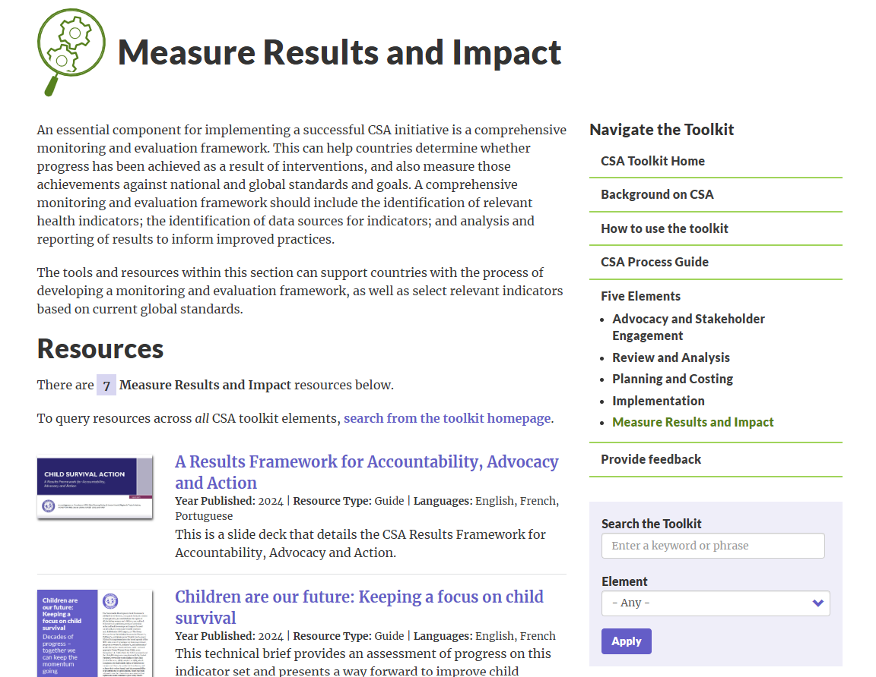
Implementation measurement guidance that includes child health and survival indicators at implementation level
Child Health Accountability and Tracking – online indicator toolkit WHO-CHAT (srhr.org)
WHO SRMNCAH Policy Survey 2023 Report and Dashboard
WHO RMNCAH program review
WHO Primary Health Care Monitoring Framework and Indicators
WHO Analysis and use of health facility data: guidance for maternal, newborn, child and adolescent health programme managers
Indicator and monitoring framework for the global strategy for women’s, children’s and adolescents’ health (2016-2030)
Global core indicators for measuring WHO’s paediatric quality-of-care standards in health facilities
CSA Toolkit

Slide 27
Section 3.4 The Way Forward
Photo: MOMENTUM; Hadjara Laouali Balla

Slide 28
CSA Results Framework: Way forward
CSA R&A Framework is a “Living document”
Incorporate additional targets, especially for diarrhea and pneumonia
Improve implementation milestones with country engagement
Ensure CSA results and metrics are aligned with and included in related initiatives, such as:
Every Woman, Every Newborn, Everywhere; Lusaka Agenda; IMNCI indicator work; sub-national targets and target setting; others
CSA R&A Framework used at the Global Level for Accountability and Advocacy
Support reporting related to the World Health Assembly Resolution 77.5, including impact and outcome indicators, and implementation milestone measures incorporated into EWENE tracker
Complete and disseminate detailed report on the development of the CSA Results Framework
Develop evidence briefs for advocacy using existing data
Promote the CSA Learning Agenda to improve measurement, especially for QoC
CSA R&A Framework used and measurement supported at the regional, country and sub-National Levels
Support knowledge management and translation for M&E guidance and results and accountability frameworks
Support countries to use available and new data and information in planning, monitoring and evaluating child health
Support countries to document their experiences developing and implementing child health strategies and associated M&E frameworks
Modified and more nimble governance structures and expanded group membership

Slide 29
Section 4 Use of existing data in Sierra Leone:
Situational Analysis
Photo: MOMENTUM; Allison Shelley

Slide 30
Sierra Leone Outline
1
Section 1
Introduction
2
Section 2
Types of Data used
3
Section 3
Child Survival Action Plan of Sierra Leone
4
Section 4
Challenges
5
Section 5
Next Steps

Slide 31
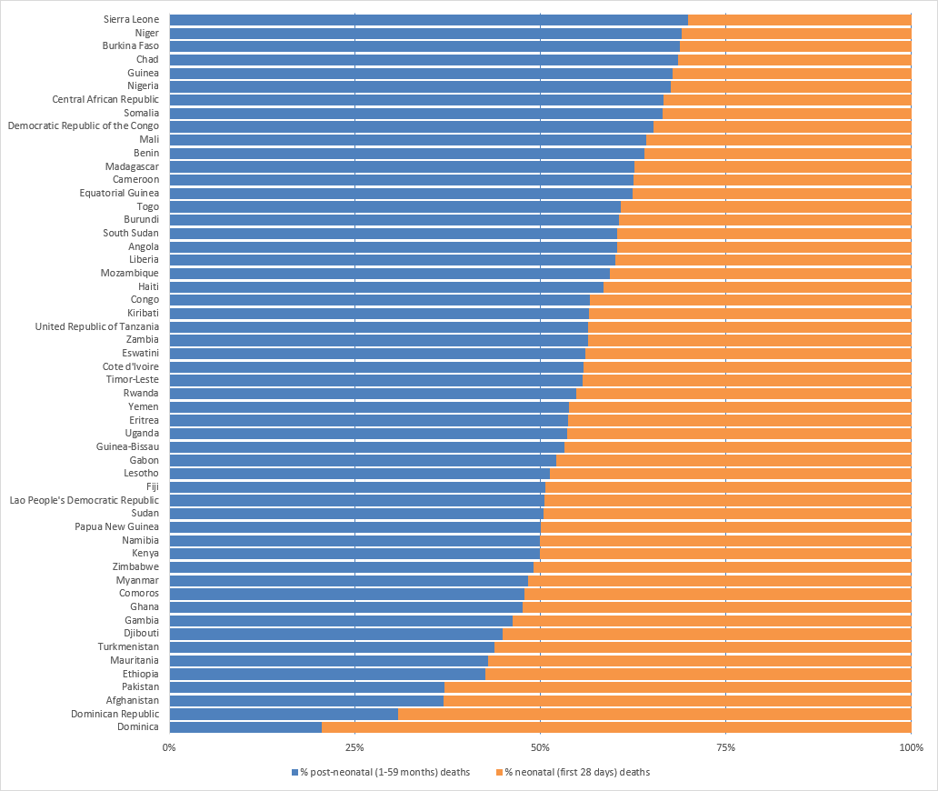
Percent of Under-Five Deaths by Age Group
1 to 59 months
Sierra Leone is the country with the highest proportion of under-five deaths in the 1–59-month period
A substantial proportion of under-five deaths are in the 1- 59-month period
A significant proportion of deaths in the 1–59-month age group are from conditions that can be prevented and most often treated at primary health care level
Gaps in coverage and quality of essential health services
First 28 days
Source: UN IGME Report 2022

Slide 32
Sierra Leone is off-track to reach SDG 3.2
Among deaths in children under-five:
33% caused by malaria
20% caused by pneumonia
14% caused by diarrhoea
4% HIV/AIDS
Malnutrition - important underlying cause
These are diseases that are preventable and commonly treatable at the primary healthcare level
Sierra Leone - estimated deaths in U5
70% under-five deaths occur in the post-neonatal (1-59 month) period

Slide 33
Background to CSAP and the National Child Health Programme…..A Call to Action
Leadership & commitment of H.E Dr. Austin Demby (Min of Health) at the World Health Assembly in May 2022.
Calling on global Leaders to help Sierra Leone reduce its child mortality.
Minister declared to treat child survival as a national emergency
Designated a lead in the MoHS (RCH directorate) to coordinate the effort.
Joint stakeholder mission in Nov 2022 from global and national partners agreed to develop CSA Plan as part of RMNCAH strategy, and the need to establish a national child health programme to coordinate child health activities and elevate child health issues.
Strategic discussions with relevant directorates/programmes and partners

Slide 34
Purpose of the CSAP
Renewed call to action to end preventable child deaths
Life-stages vision / Approach
Part of Ministry-wide plan
Strengthening primary health care (PHUs, CHWs) with strong referral, and referral level care at hospitals
Complements joint ENAP/ EPMM action plan for maternal and newborn survival
Not bringing something new, rather highlights priorities of the RMNCAHN strategy and elevate child health issues to the highest level.

Slide 35
Bottlenecks identified from the Stakeholder Meeting held in Nov 2022
Ineffective or Lack of Leadership and governance in Child Health at national and subnational levels, especially engagement and alignment of multiple stakeholders in child health inside and outside the government
Lack of quality data for child health, including accountability and oversight for reporting and use across all levels
Poor adherence to norms, standards, and guidelines for care, due to weaknesses in health worker competencies at community, PHU and referral levels
Stockouts or unavailability of essential child health commodities at community, PHU, and referral levels
​Inadequate community outreach and services to promote care-seeking, prevent childhood illnesses, and treat children in hard-to-reach areas
​Actual and potential role of private sector providers is not fully exploited

Slide 36
Sierra Leone Child Survival Action (CSA) Plan – 2023 – 2025
Goal: Refocusing efforts with a holistic approach to end preventable child deaths in Sierra Leone
Target: By 2025, reduce the under-five mortality rate to less than 71 per 1000 live births
Strategic approaches | Tackle issues to improve Child Health & increase Child Survival in Sierra Leone by bringing together stakeholders from across the directorates & programmes of the MoHS to collaborate for action |  |  | Joint action of government & partners to end preventable child deaths through addressing programmatic & health system challenges that hamper progress in Child Survival |  | Leadership, accountability, & action at national, district, health facility & community level for Child Survival |  | Expanded strategic investments in PHC, with IMCI as a key priority strategy | Expanded strategic investments in PHC, with IMCI as a key priority strategy
Objectives
Elevate Child Survival Action at the highest level for visibility & accountability |  | Improve the collection, management & use of Child Health data at all levels | Improve the quality-of-service delivery, especially healthcare worker skills/ competencies & quality improvement |  | Improve visibility & ownership of quantification & stock monitoring of Child Health commodities, advocate with partners to support, & engage in distribution & monitoring of consumption |  | Ensure all children in hard-to-reach areas can access iCCM, & preventive/promotive health & nutrition interventions implemented by CHWs |  | Understand the role of & ways to better engage private sector for delivery of essential Child Health services

Slide 37
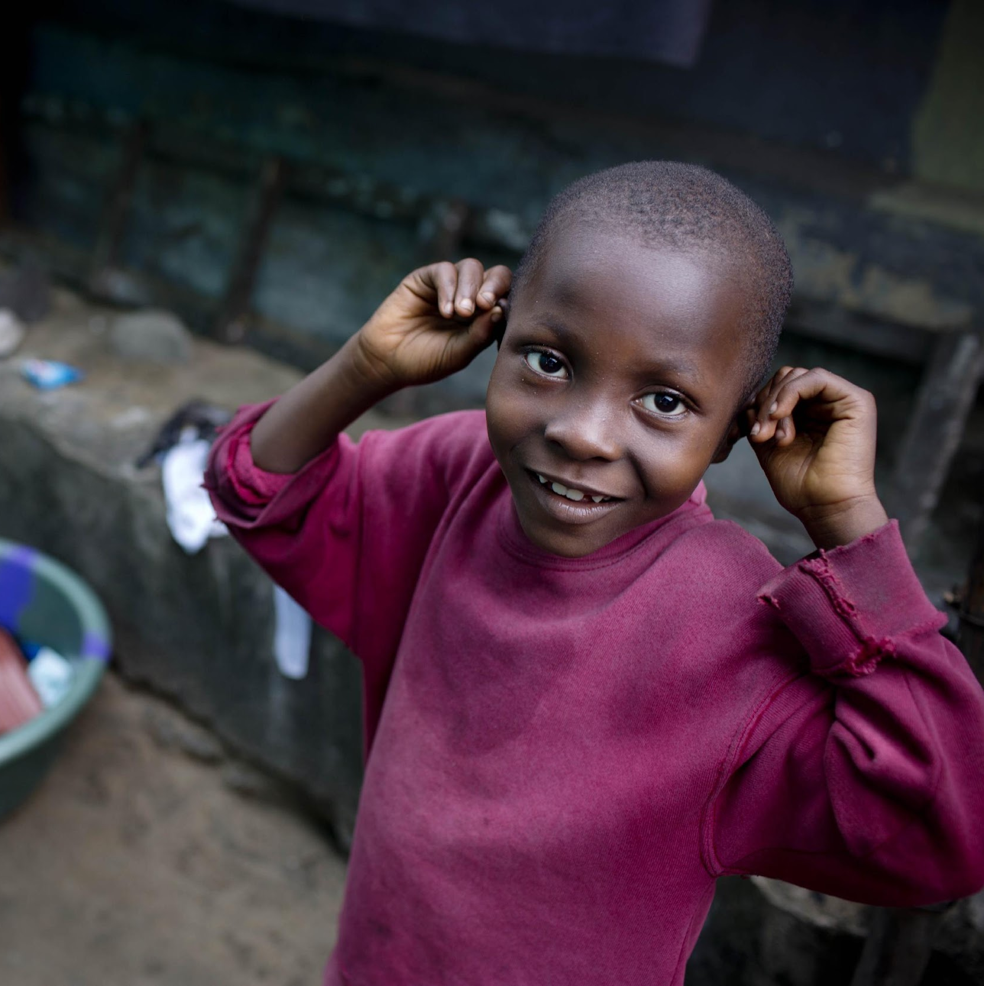
Child Centered Holistic Integration
Minister of Health & Sanitation
Chief Medical Officer
Reproductive & Child Health Directorate
Child Health Programme
DPPI
Health Education Department
NMCP
HIV, TB Programs
QoC
Health workforce
DHMT
CHWs
NMSA
Partners/MDAs
Food & Nutrition Directorate
EPI Programme
HRH Directorate
Directorate of Training
PHC Directorate

Slide 38
Highlights – Activities & Milestones – Joint Action for directorates and programmes
Review Child Health governance & accountabilities within RCH directorate & across directorates/programmes
Accountabilities for Child Health clearly defined among all directorates and programmes
Develop costed annual workplan for Child Health across the departments
Monthly progress update on Child Survival to Senior Management
Nominate Child Health Focal Points in key directorates/programmes with refined working relationships/areas of collaboration & joint workplan

Slide 39
Highlights – Activities & Milestones – Joint Action for directorates and programmes
Increase efficiencies through joint planning and implementation e.g HIV, TB programme, etc.
Monthly Child Survival TWG meeting
Advocacy for the inclusion of Child Survival actors in complete proposal development process for major funding opportunities
Develop and implement a national CSA advocacy plan/actions
Identify and empower high level/prominent champions for Child Survival

Slide 40
Highlights – Activities & Milestones – Joint Action for directorates and programmes
Data for Child Health
Integrating indicators related to Child Health into HMIS (Hospitals & districts)
Digitalization
Review, analyse, and feedback mechanism for data
Quality of Service Delivery
Child Death audit dashboard
Mentorship of HCWs
Quarterly supportive supervision for Child Health interventions
Community Outreach
Improve PHU support for CHWs, strengthen home visits

Slide 41
Highlights – Activities & Milestones – Joint Action for directorates and programmes
District Level and Hospitals
Capacitate Child Health Focal Point at district level
Strengthen Child Survival governance and coordination at district level (e.g., Child Health TWG where specific diseases discussions and other issues affecting children can be discussed)
DMOs to report progress for CSA at national level
Costed annual workplan for Child Survival implementation activities at district level

Slide 42
Key Achievements so far as per the CSA
Milestone/Activity | Measurement | Target | Achieved
Develop costed annual workplan for Child Health | Annually | Every year | Yes
Monthly progress update on Child Survival to Senior Management through the Child Health TWG | Monthly through the Technical working group meetings | 12 | Yes
Child Health Focal appointed in all hospitals and at Districts | Once-off | All hospitals and districts | Yes
Integrating indicators related to Child Health into HMIS (DHIS2, Hospitals & districts) Child Death audit dashboard | Indicators in the DHIS2 Child death weekly reviews done at hospitals | Update the DHIS2 Child health dashboard developing | On-going On-going
Collaboration opportunities | Trying to collaborate with programmes and Directorates | All programmes dealing with children

Slide 43
Challenges and Opportunities
Challenges
Opportunities
Operationalisation of the newly established National Child Health Programme
Partner Mapping and Partner Support to the programme
Implementation of Child Survival Action Plan nationwide
Identify champions for CSA at national and district level
Ongoing efforts for alignment & systems support across programmes and directorates
Resource mobilization, allocation and utilization
HIV, TB, Malaria: Support and use IMNCI/ ETAT as entry point to assessment of the holistic sick child for specific disease and help with quantification of HIV / TB paediatric commodities
Integrate outreach services with EPI vaccination outreaches
Joint budgeting and key activity implementation
Joint operational Research

Slide 44
Final tips & Takeaways
CSA needs both political and technical commitment at the highest level
Partner should align and support country CSAP
Continuous advocacy within the MOH and other ministries, departments, and agencies
Continuous engagement and collaboration with Global and regional partners and donors
Person centeredness life stage model should be embraced as we implement CSAP

Slide 45
Thank you! Questions?
Lynda M.L Farma-grant
Programme Manager and Child Survival Lead
National Child Health Programme, MOH, Sierra Leone
+232-99000008
lyndafarmagrant@gmail.com

Slide 46
Section 5 Questions and Closing Remarks
Photo: Kate Holt/MCSP Ghana

